Slide 1
This activity has been supported by a grant from Roche Products Ltd
Neuronal
communication
'Presenter 1'
'Presenter 2'

Slide 2
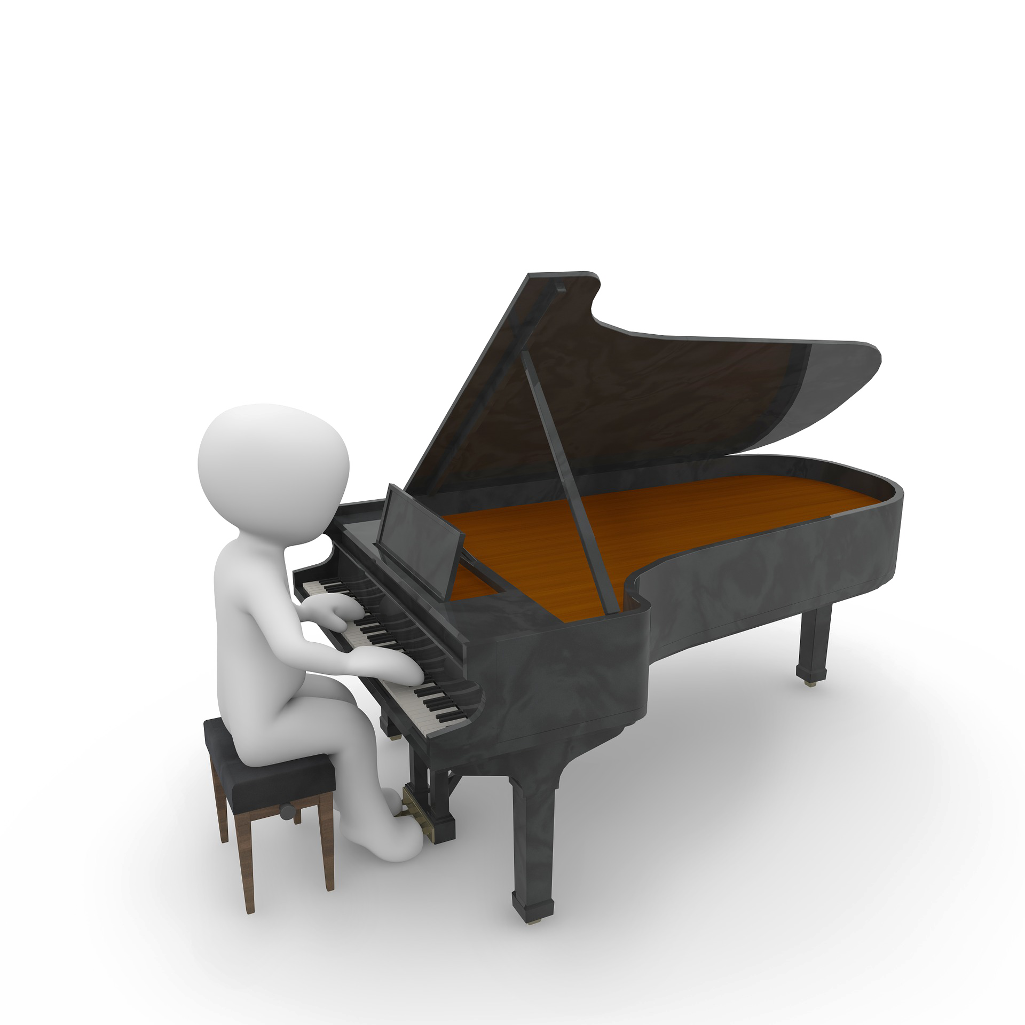

Slide 3
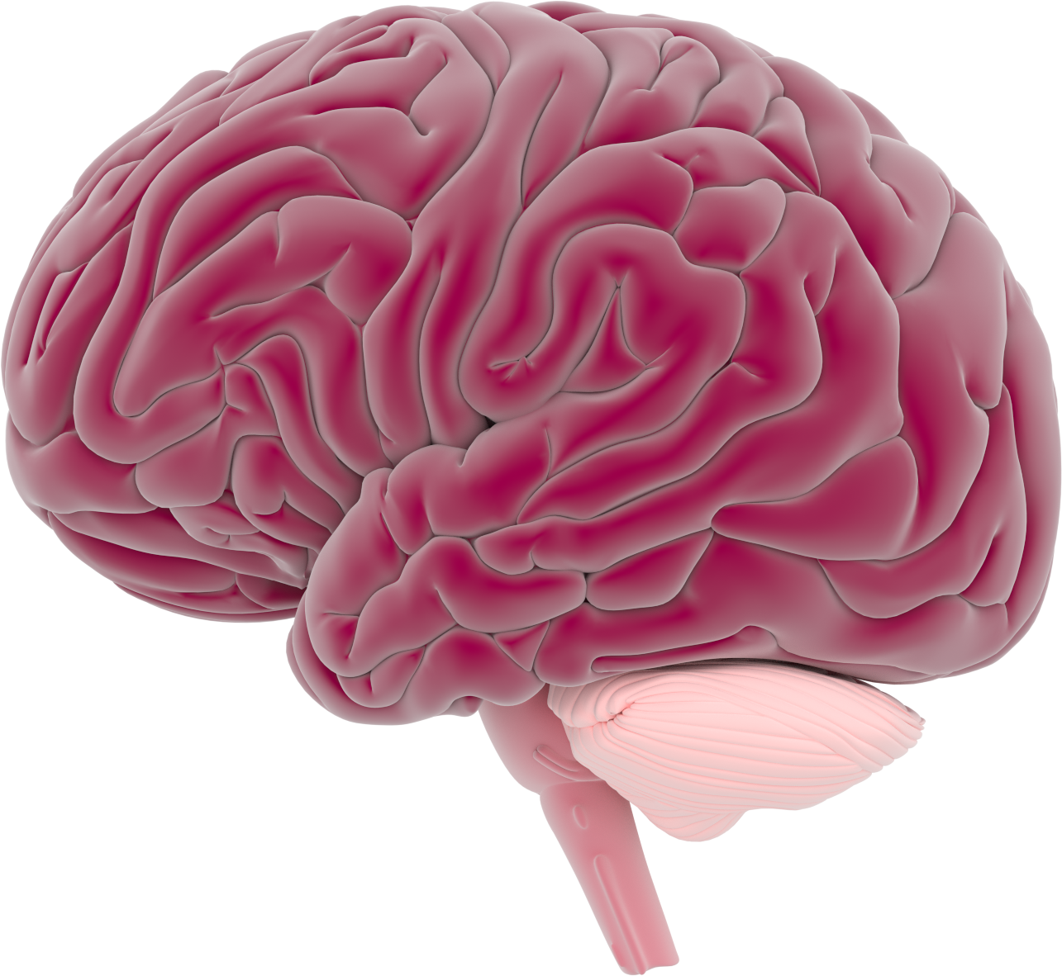
What do you know about the brain?

Slide 4
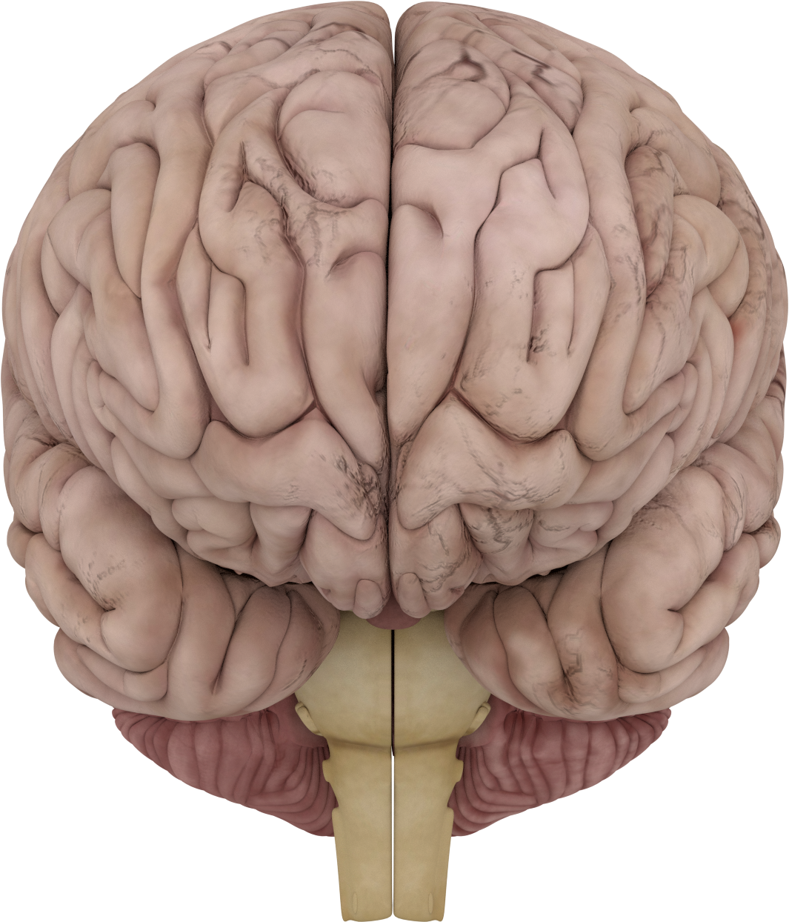
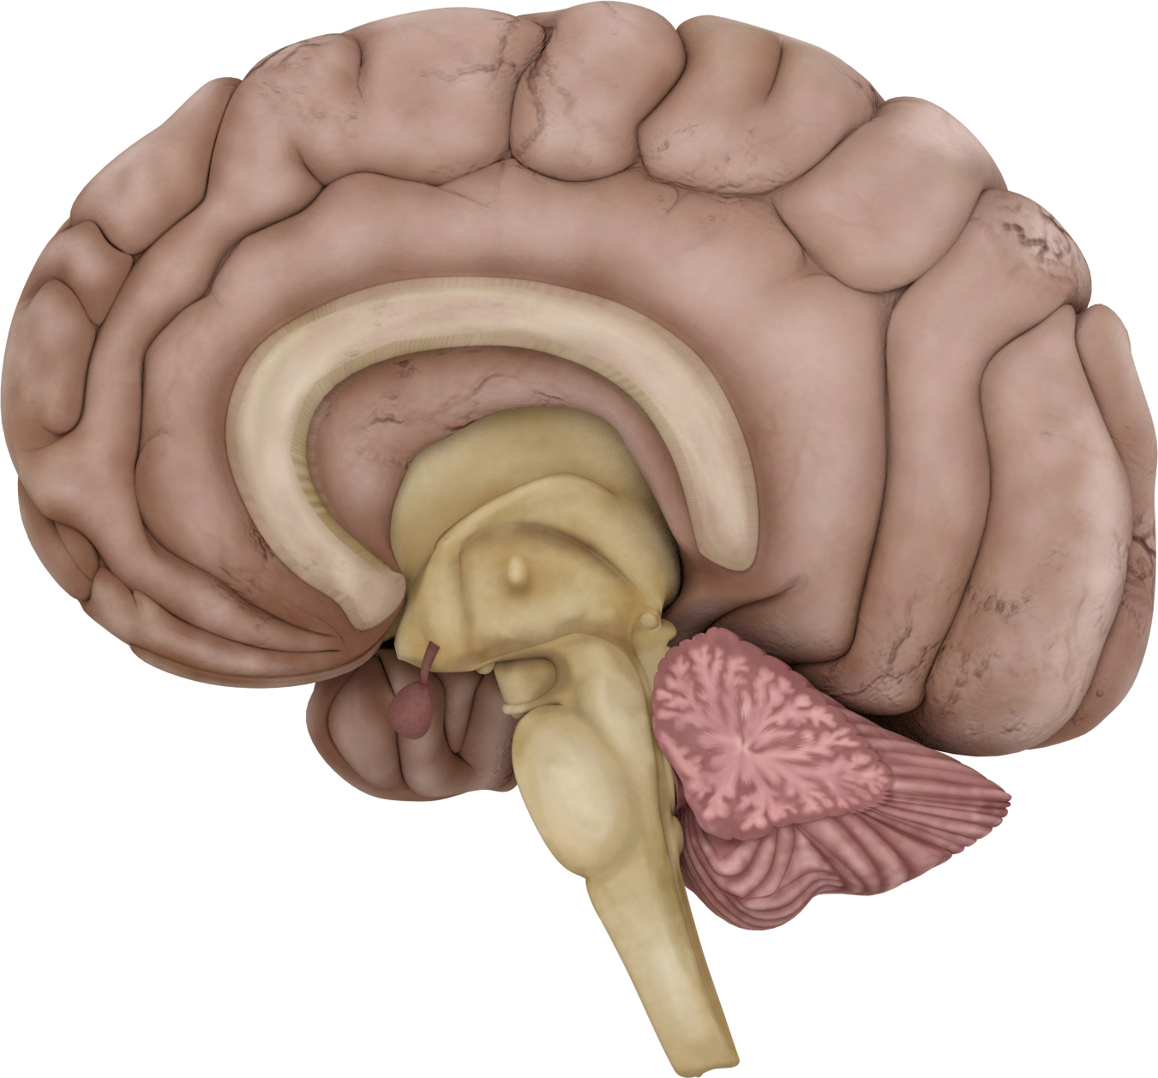
The brain has 2 sides: hemispheres

Slide 5
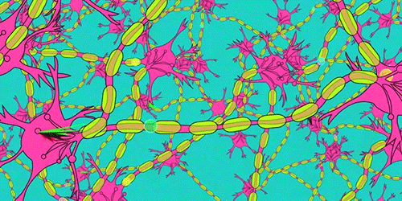
The brain is made up of different areas
Cortex
There are billions of neurons in the brain!!!
Corpus callosum
Cerebellum
Neurons make networks

Slide 6
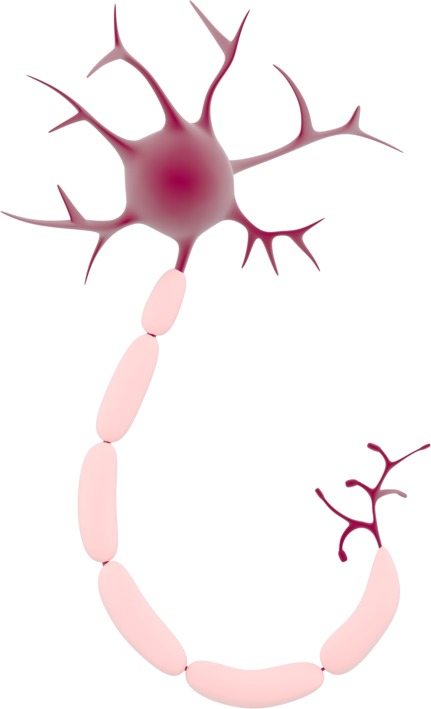
Neuron
Axon terminal
Soma
Dendrites
Axon
Myelin
'Neurons in the brain' by Dr Jonathan Clarke

Slide 7
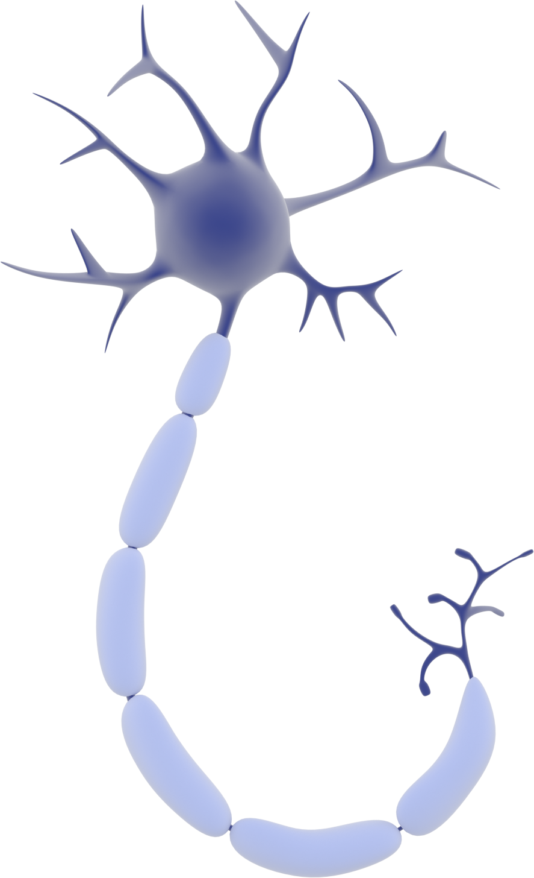
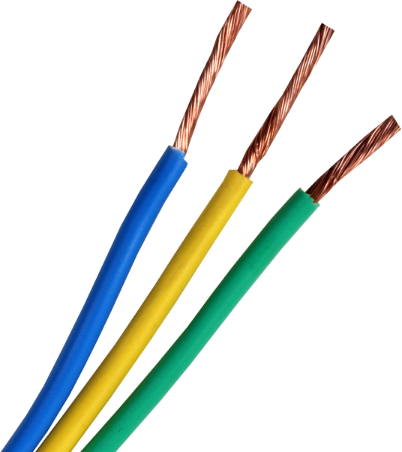
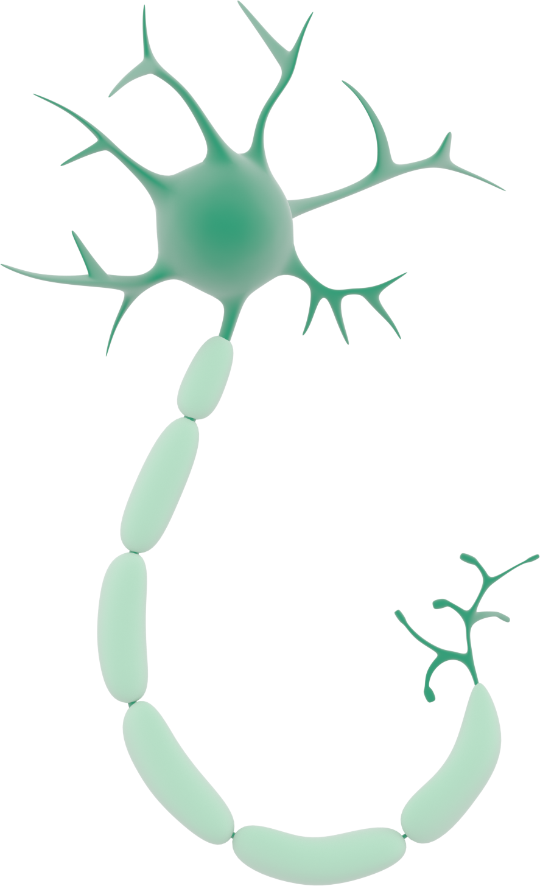
Axons work as electric cables connecting different neurons
Myelin =
Makes transmission messages faster

Slide 8
Action Potential
-
Ion negative charged
+
Ion positive charged
-
-
+
-
+
+
+
-
-
+
-
-
+
+
-
-
+
+
+
+
+
+
+
+
+
+
-
-
+
-
-
-
-
+
-
+
-
+
+
-
+
-
-
+
-
+
-
-
+
-
+
-
-
-
+
+
+
+
-
+
-
-
+
Movements of ions in and out of the neuron

Slide 9
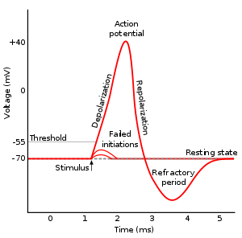
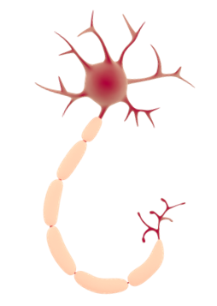
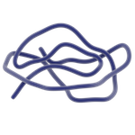
Action potential due to movements of ions in and out of the neuron
Ions
Na⁺
K⁺
Na+/K+
pump
Na+ Voltage-gated channel
K+ Voltage-gated channel
Outside cell
Inside cell

Slide 10
1. Resting state
Ions
Na⁺
K⁺
Outside cell (+)
Membrane potential
-70mV
Inside cell (-)

Slide 11
1. Resting state
Ions
Na⁺
K⁺
Outside cell (+)
Membrane potential
-70mV
Inside cell (-)

Slide 12
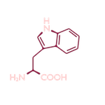
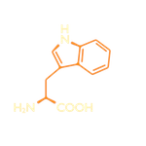
2. Initial depolarization
Ions
Na⁺
K⁺
Na+ Voltage-gated channel opens
Outside cell (+)
Membrane potential
-55mV
Stimulus
Inside cell (-)

Slide 13
2. Depolarization
Ions
Na⁺
Na+ ions rush into the cell
K⁺
Outside cell (-)
Membrane ptential
-40mV
Stimulus
Inside cell (+)

Slide 14
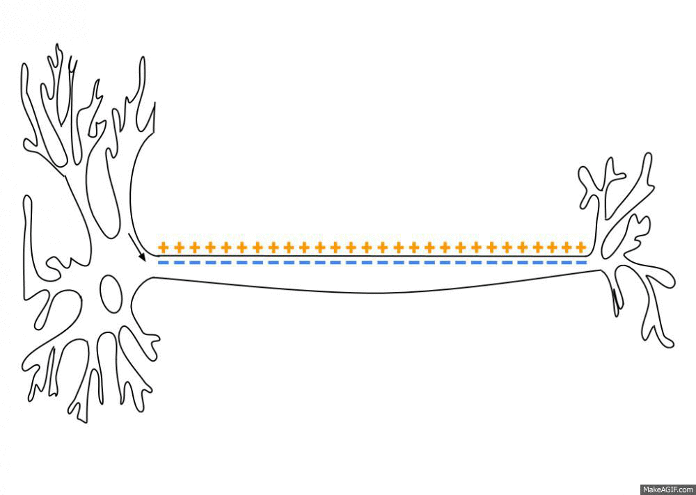
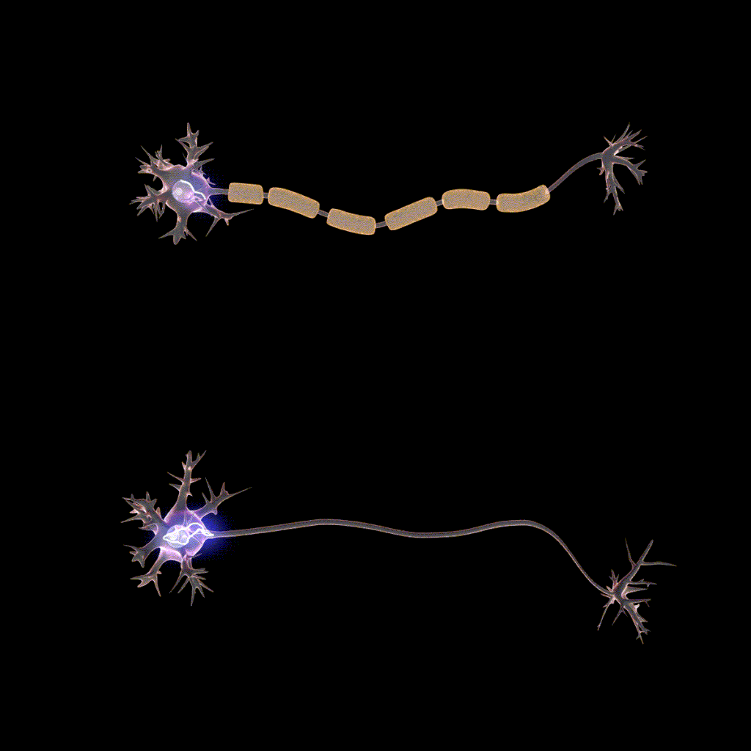
3. Depolarization ‘sea wave’
Myelinated axon
Non-myelinated axon

Slide 15
3. Repolarization
Ions
Na⁺
K⁺
K+ Voltage-gated channel opens
Membrane potential
+40 to -70 mV

Slide 16
3. Repolarization
Ions
Na⁺
K⁺
K+ leaves the cell
Outside cell (+)
Membrane potential
<-70mV
Inside cell (-)

Slide 17
4. Refractory period
Ions
Na⁺
K⁺
K+ leaves the cell
Outside cell (+)
Membrane potential
<-70mV
Inside cell (-)

Slide 18
5. Resting state
Ions
Na⁺
K⁺
Outside cell (+)
Membrane potential
-70mV
Inside cell (-)

Slide 19
A gap called synapse
Synaptic vesicle
Neurotransmitters
Receptor for neurotransmitter
Ion channels

Slide 20
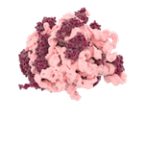
Termination of the neurotransmission
Neurotransmitters
Enzymes
Glial cell

Slide 22
Activity - Neuron Race

