Slide 1



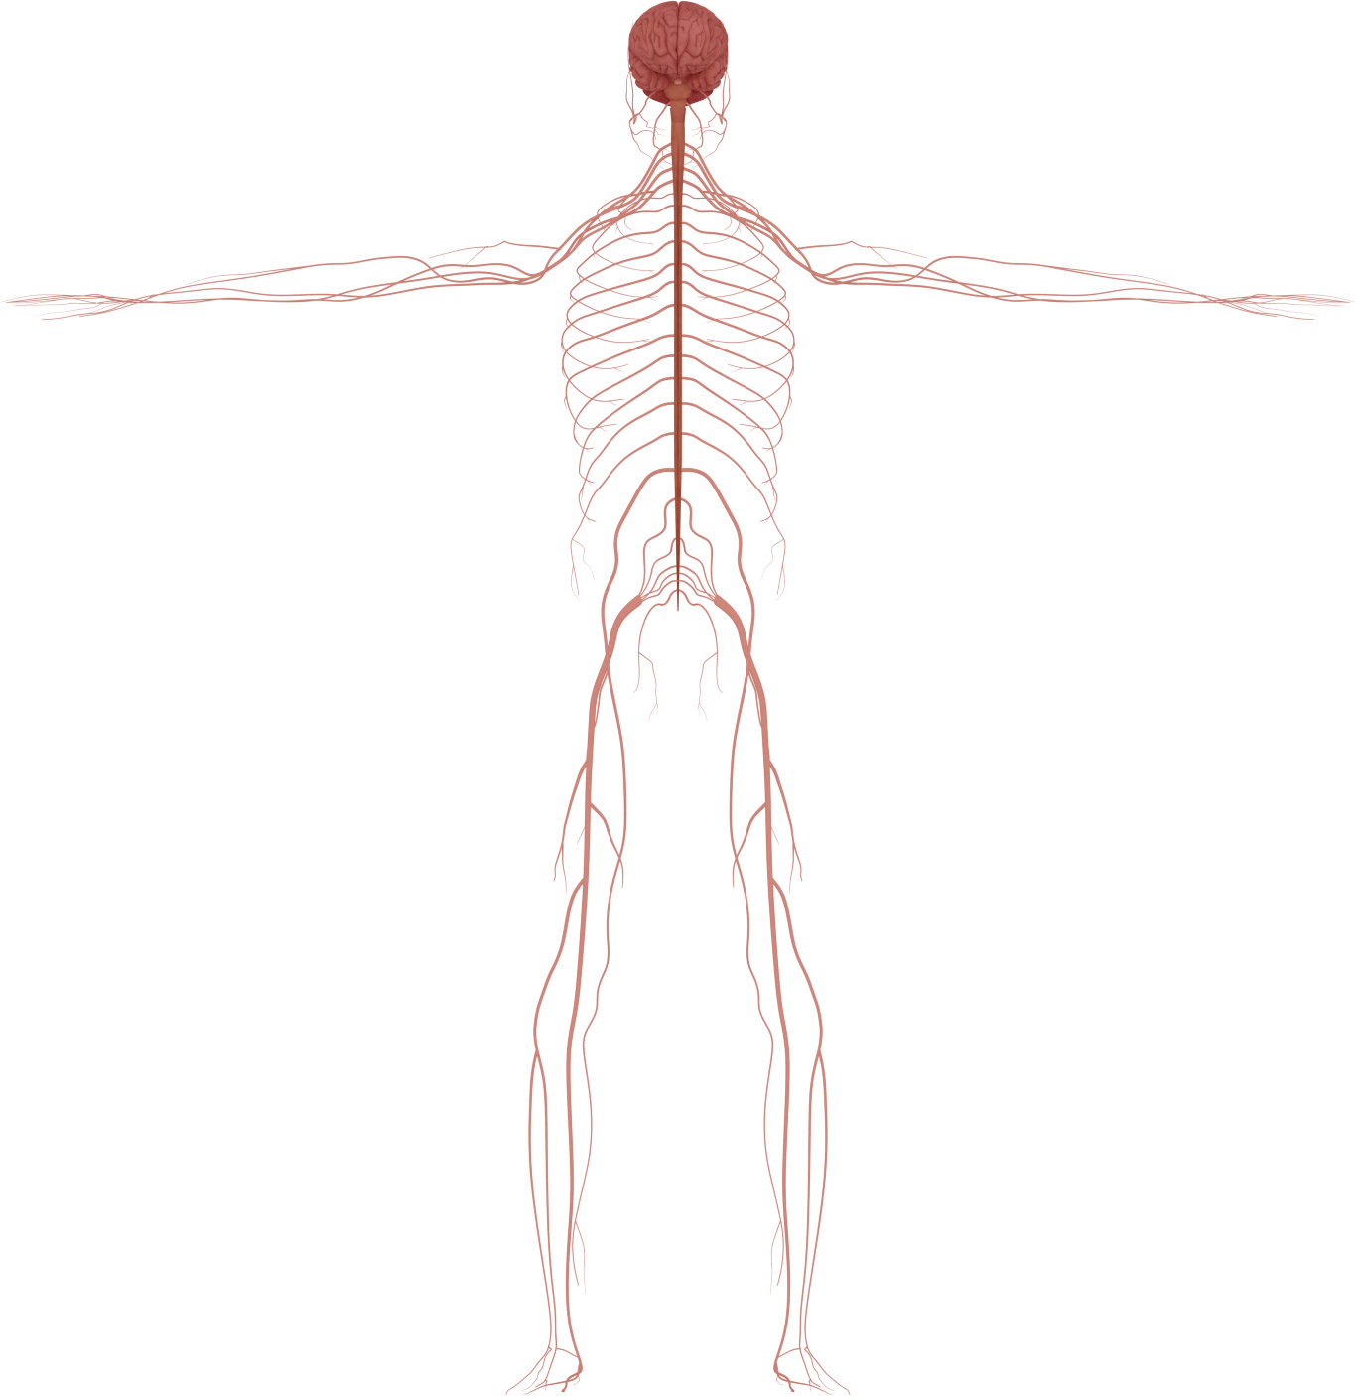
This activity has been supported
by a grant from Roche Products Ltd
Nervous
System
'Presenter 1'
'Presenter 2'
Notes:
Briefly Introduce myself

Slide 2

What do you know about the brain?
Notes:
Briefly Introduce myself

Slide 3
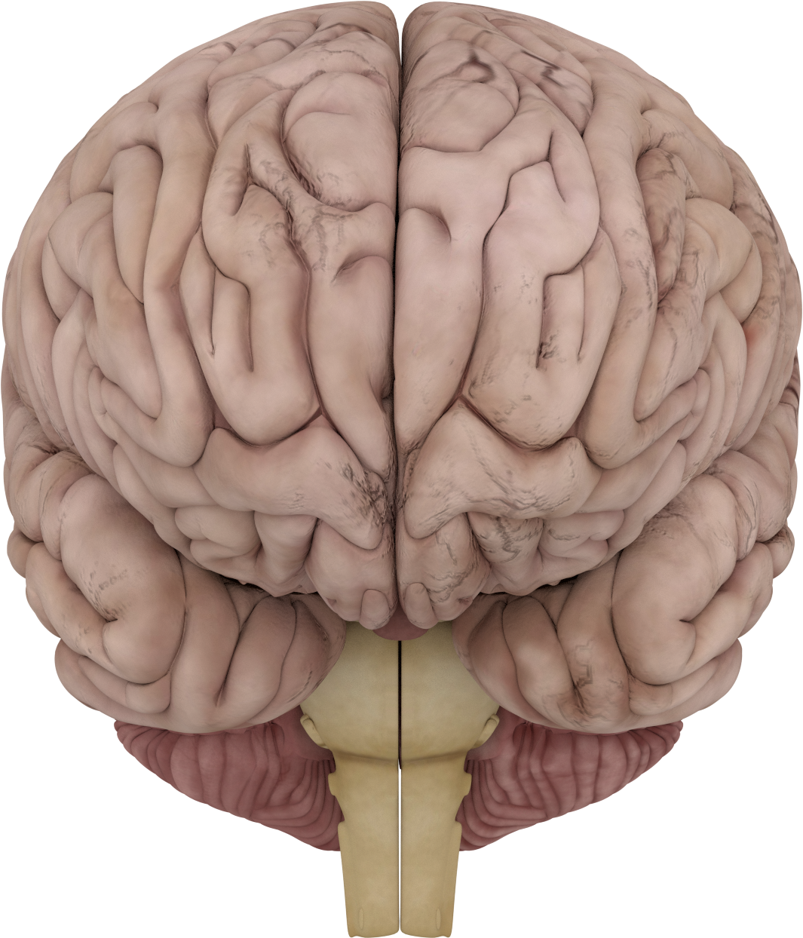
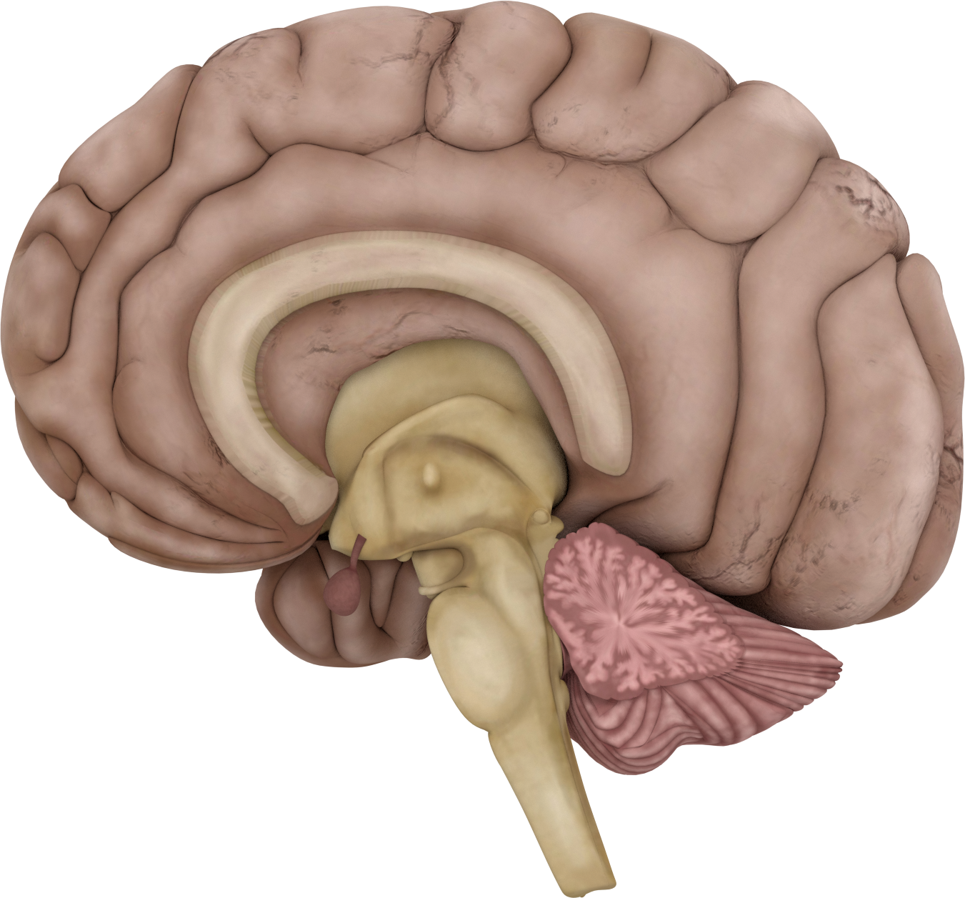
The brain has 2 sides: hemispheres
Notes:
Briefly Introduce myself

Slide 4
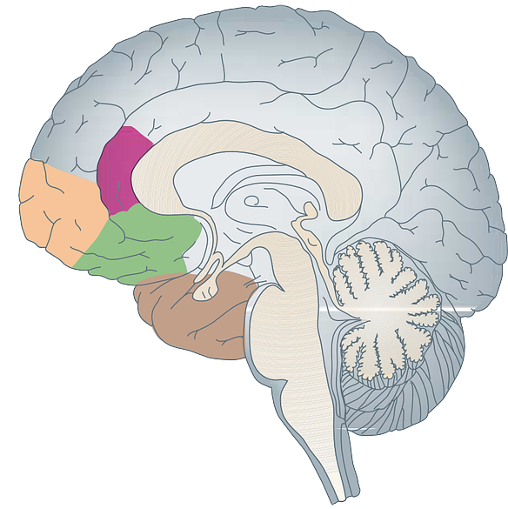
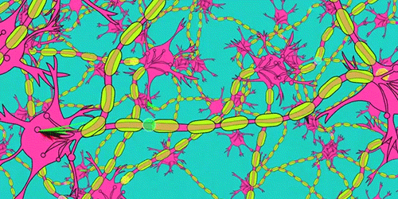
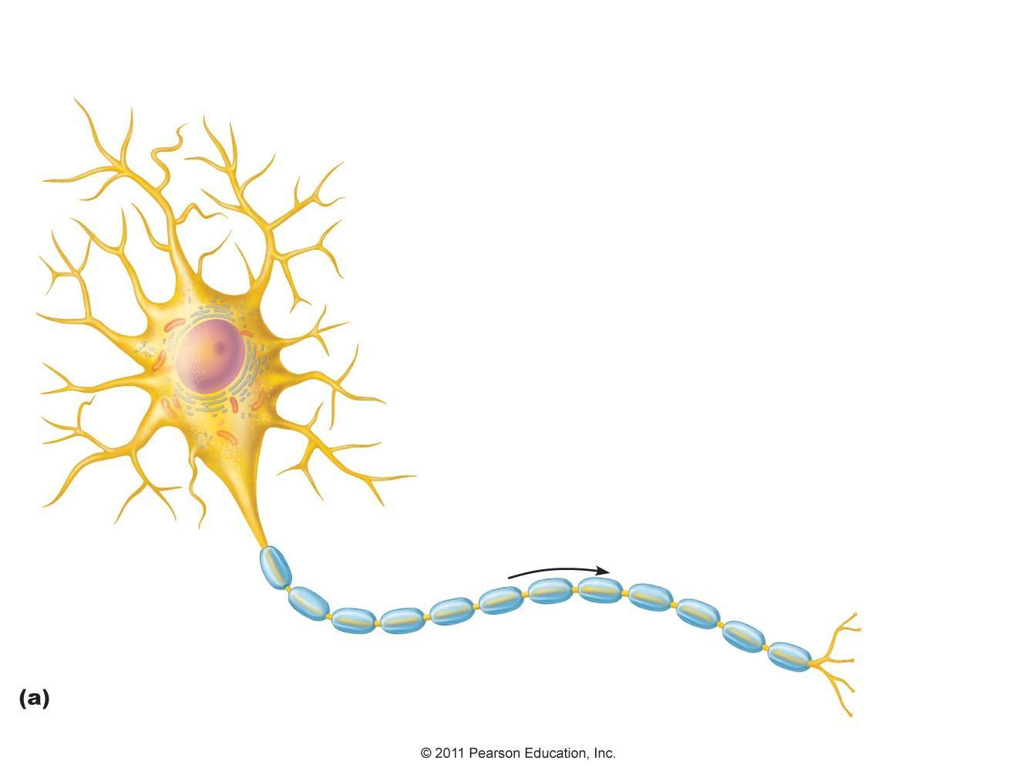
The brain is made up of different areas
Cortex
There are billions of neurons in the brain!!!
Corpus callosum
Cerebellum
Neuron
Neurons make networks

Slide 5
The nervous system allows the brain to send messages quickly to the rest of the body
Notes:
Briefly Introduce myself

Slide 6
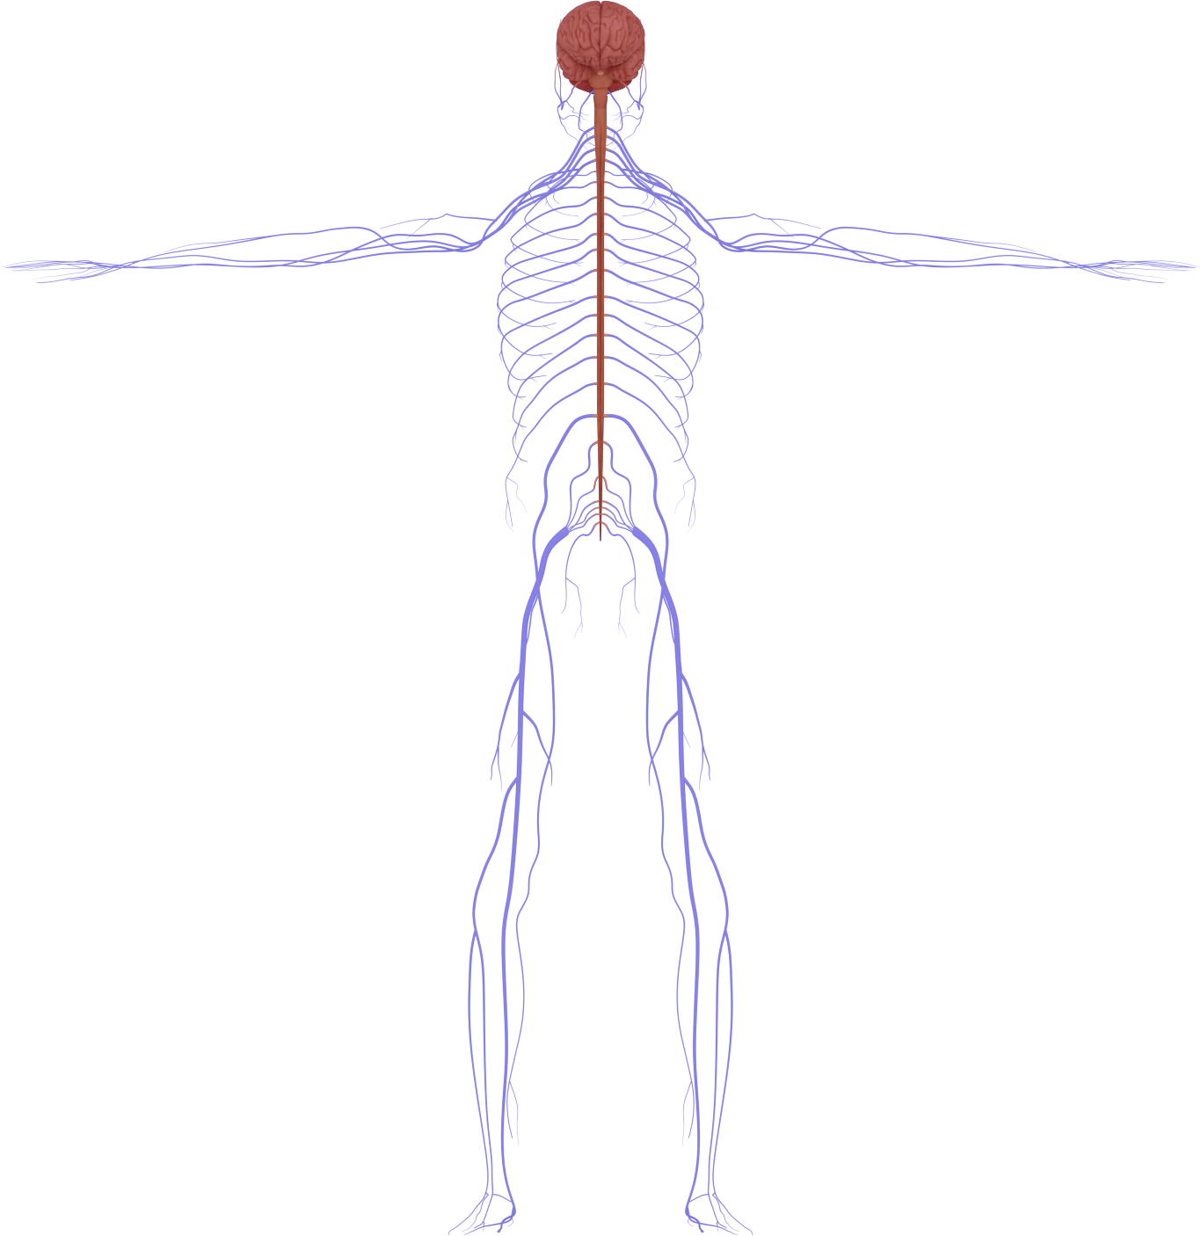
Central Nervous System
(CNS): Brain + spinal cord
Peripheral Nervous System (PNS)
Notes:
Briefly Introduce myself

Slide 7
The CNS and PNS have a bidirectional communication
Notes:
Briefly Introduce myself

Slide 8
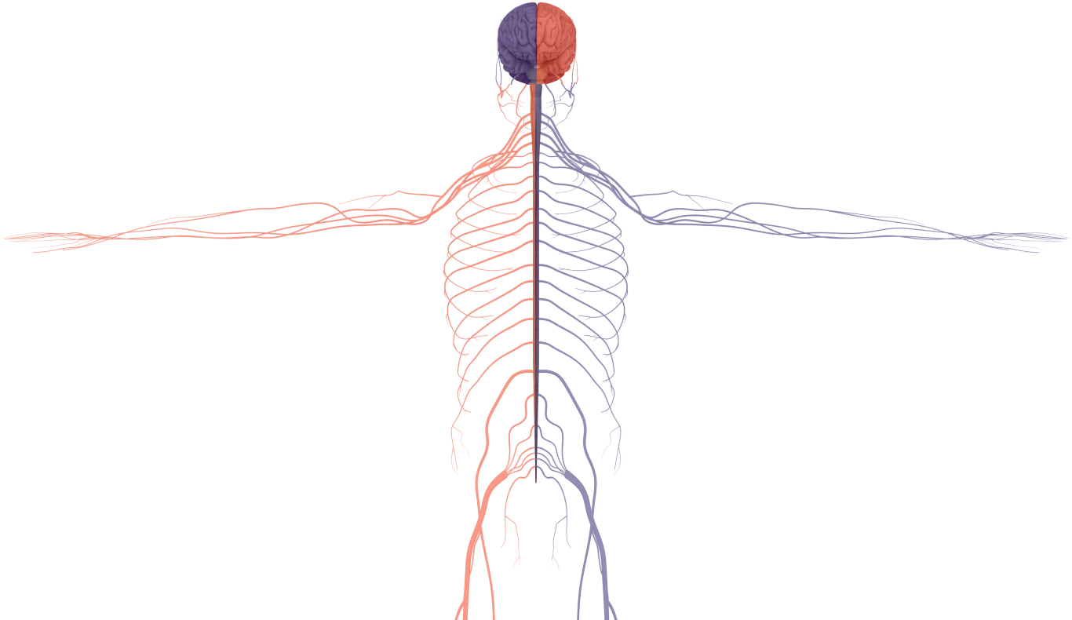
The brain receives messages from the opposite side of the body
The brain sends messages to the opposite side of the body
Notes:
Briefly Introduce myself

Slide 9
The PNS has two main divisions: Sensory and Motor
Notes:
Briefly Introduce myself

Slide 10

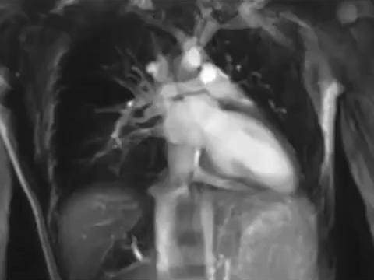

The motor division of the PNS is subdivided in:
Voluntary actions
Involuntary actions
Notes:
Briefly Introduce myself

Slide 11

The involuntary system is divided into:
Sympathetic ‘fight or flight’
Parasympathetic ‘rest and digest’
Notes:
Briefly Introduce myself

Slide 12
Messages travel form the PNS to the brain and back
These electrical messages are sent very quickly - up to 150 metres/second
What would happen if we needed a quicker response?

Slide 13
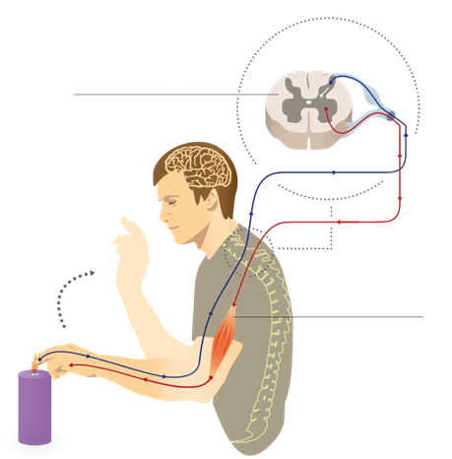
Faster messages: Reflexes
Spinal cord
Sensory nerve
Motor nerve
Muscle

Slide 14
The knee reflex experiment
Notes:
MartaAguayo

Slide 15
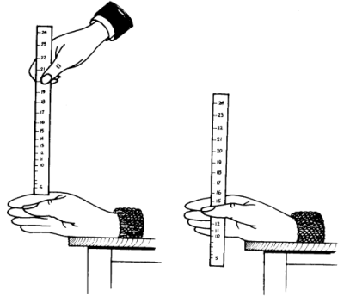
How fast are you?
Distance | Time
2 in (~5 cm) | 0.10 sec (100 ms)
4 in (~10 cm) | 0.14 sec (140 ms)
6 in (~15 cm) | 0.17 sec (170 ms)
8 in (~20 cm) | 0.20 sec (200 ms)
10 in (~25.5 cm) | 0.23 sec (230 ms)
12 in (~30.5 cm) | 0.25 sec (250 ms)
17 in (~43 cm) | 0.30 sec (300 ms)
24 in (~61 cm) | 0.35 sec (350 ms)
31 in (~79 cm) | 0.40 sec (400 ms)
39 in (~99 cm) | 0.45 sec (450 ms)
5 seconds window

