Slide 1



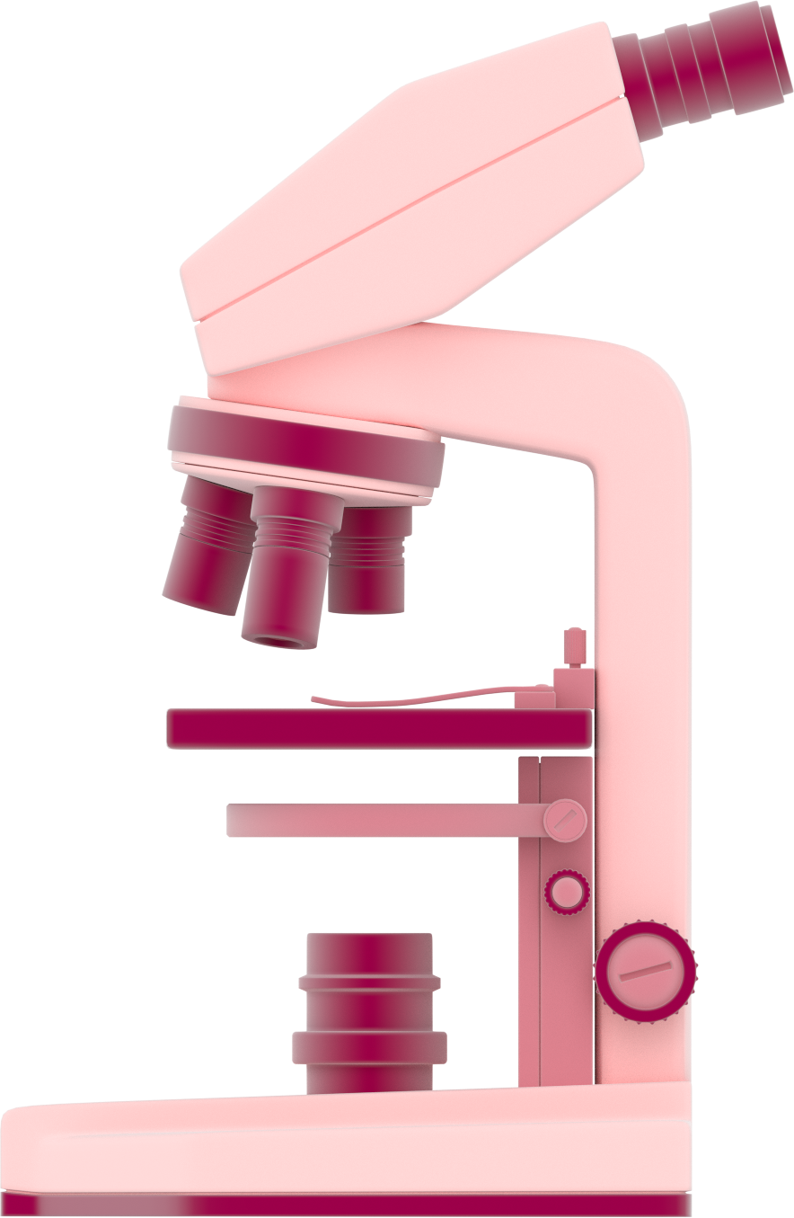
This activity has been supported
by a grant from Roche Products Ltd
What is a
Scientist?
'Presenter 1'
'Presenter 2'
Notes:
Briefly Introduce myself

Slide 2
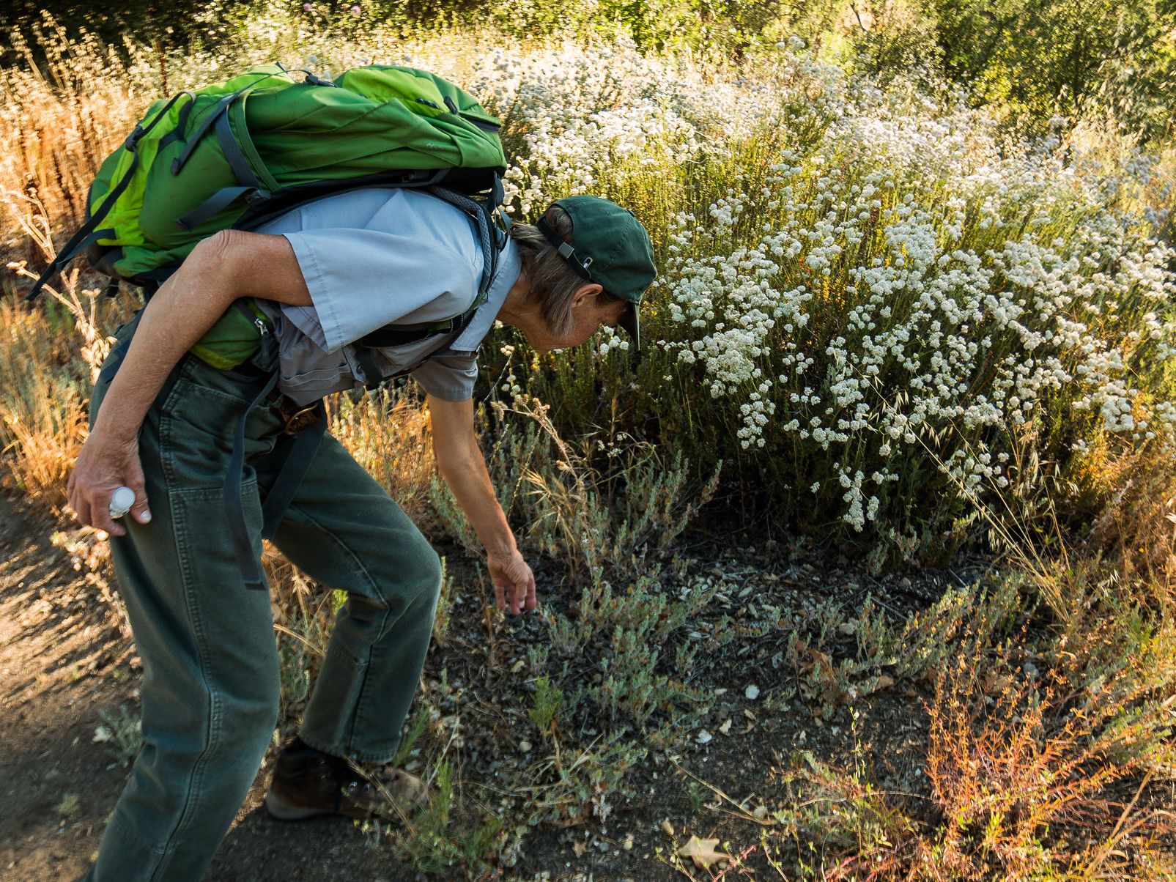
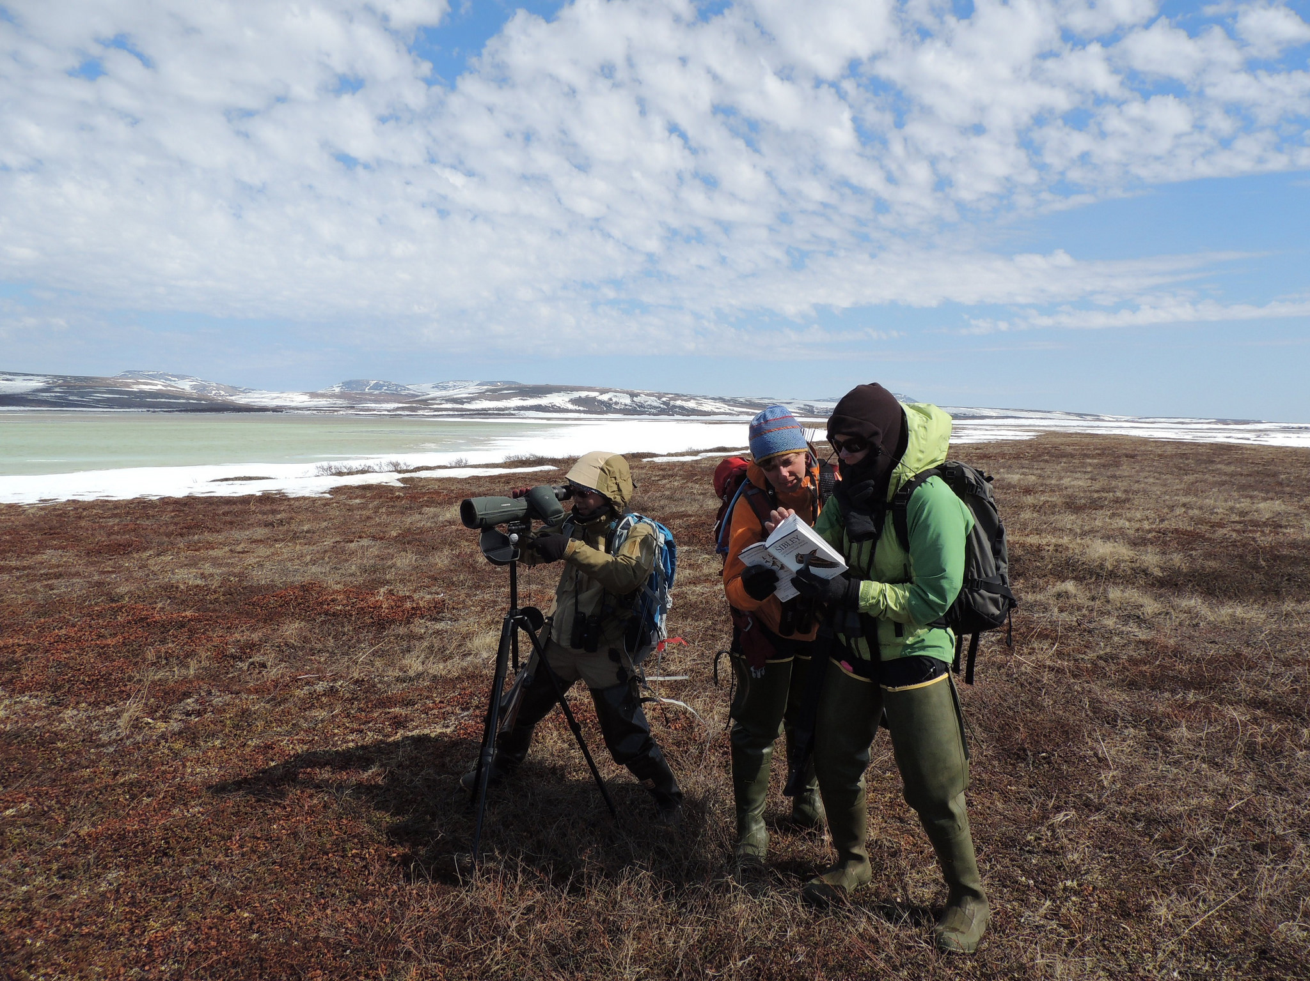
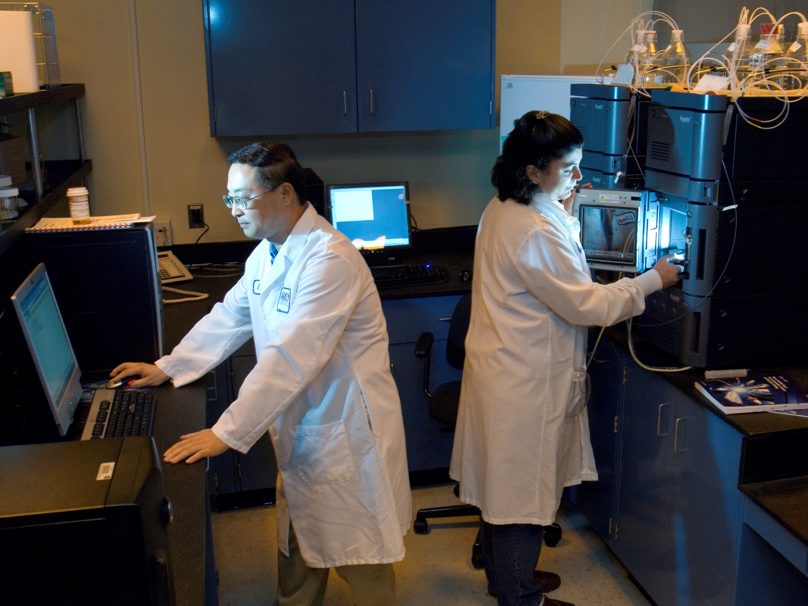
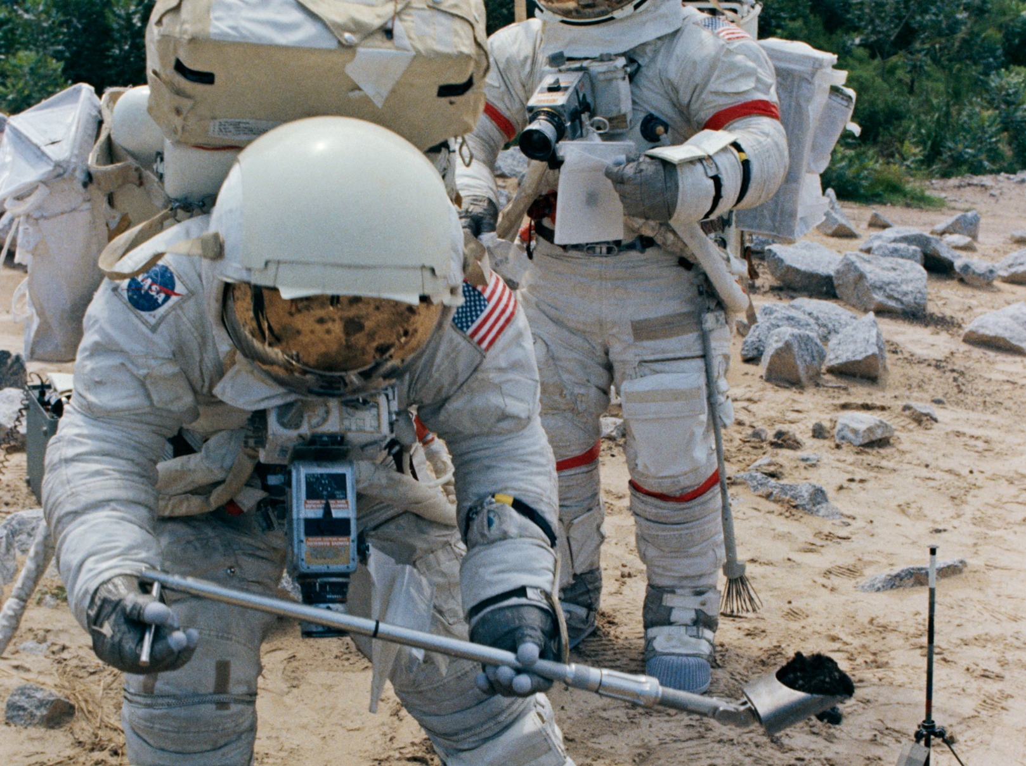
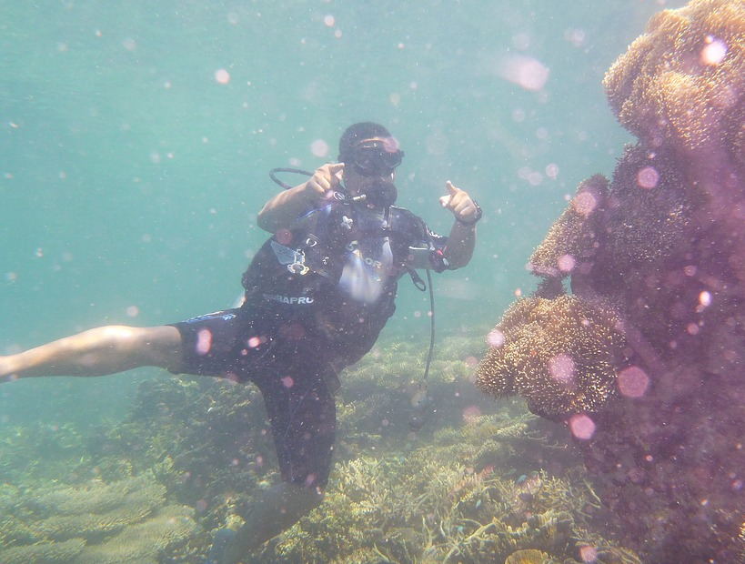
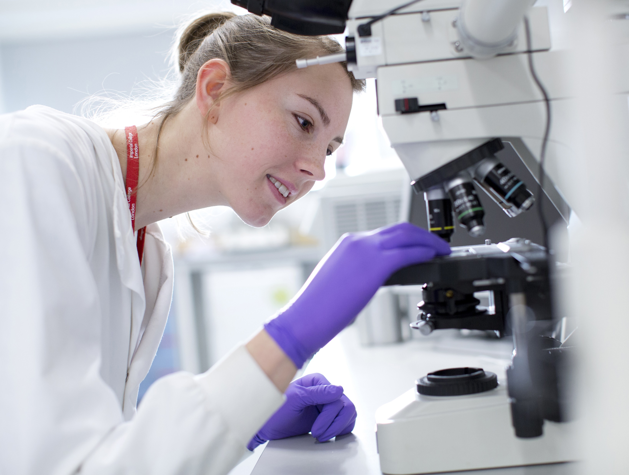
What does a scientist look like?
Notes:
Briefly Introduce myself

Slide 3
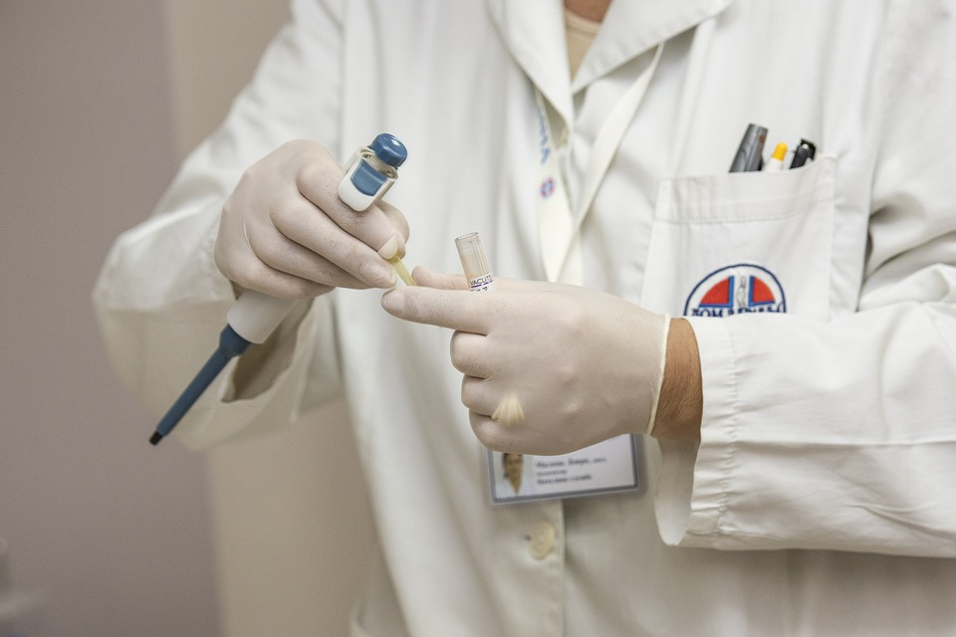
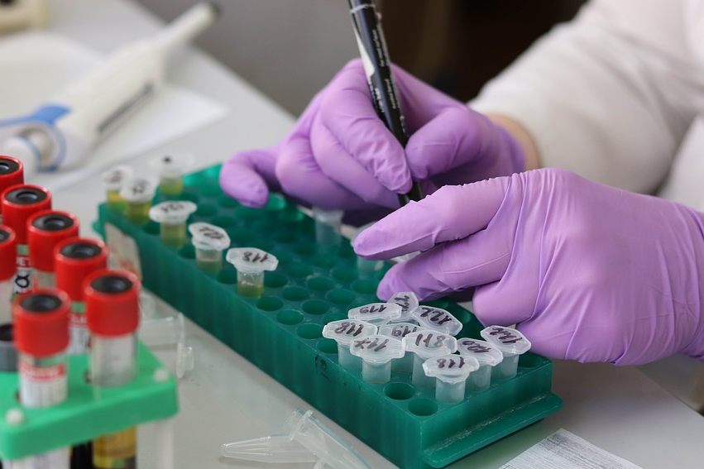
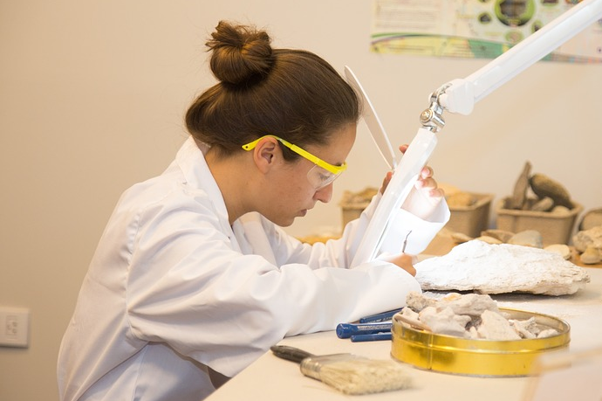
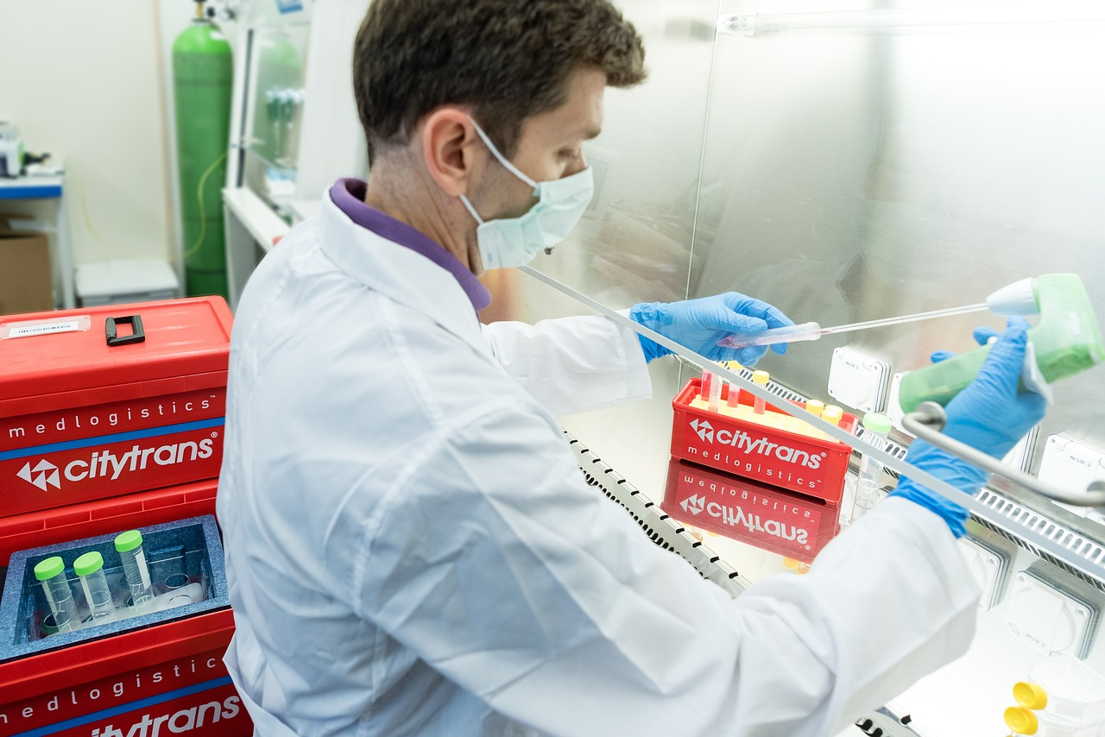
What does a lab scientist wear?
Lab coat
Gloves
Goggles
Face mask
Notes:
Briefly Introduce myself

Slide 4
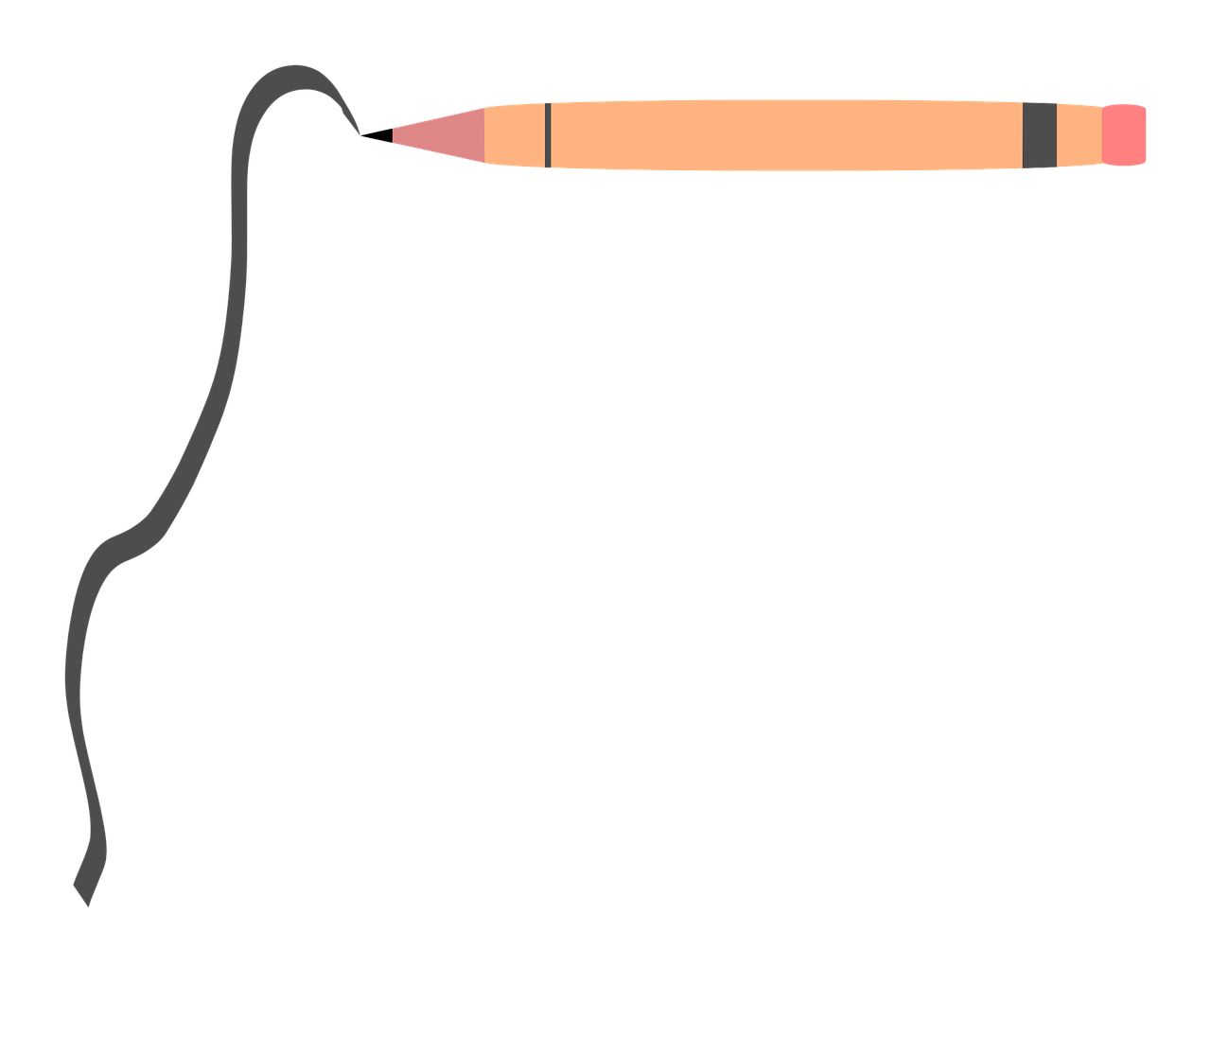
Draw yourself as a scientist
Notes:
Briefly Introduce myself

Slide 5

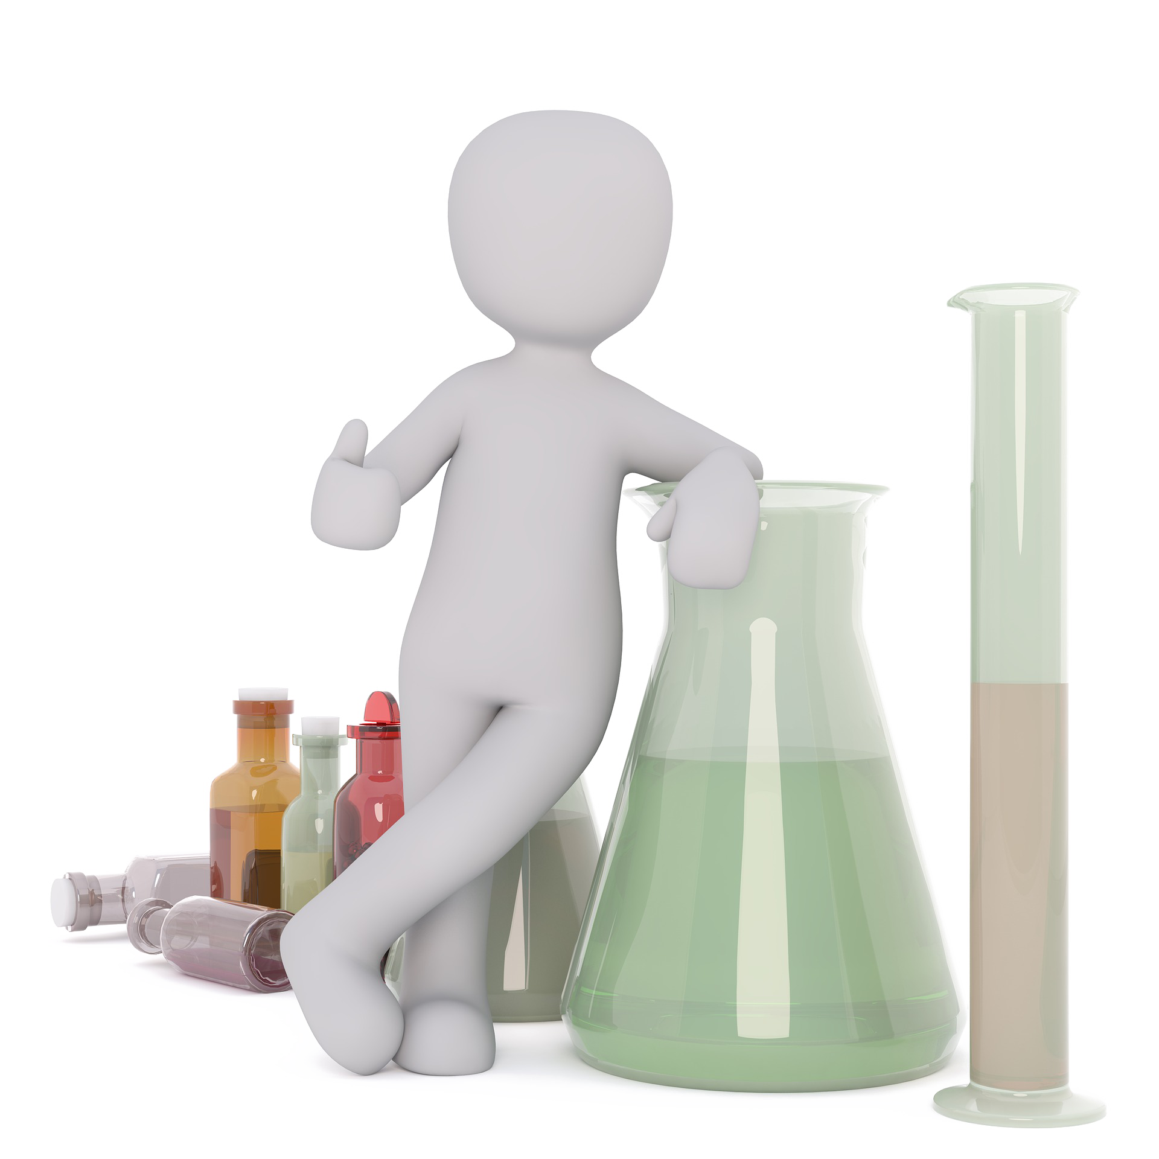
What makes a good scientist?
Problem-solving
Notes:
Briefly Introduce myself

Slide 6


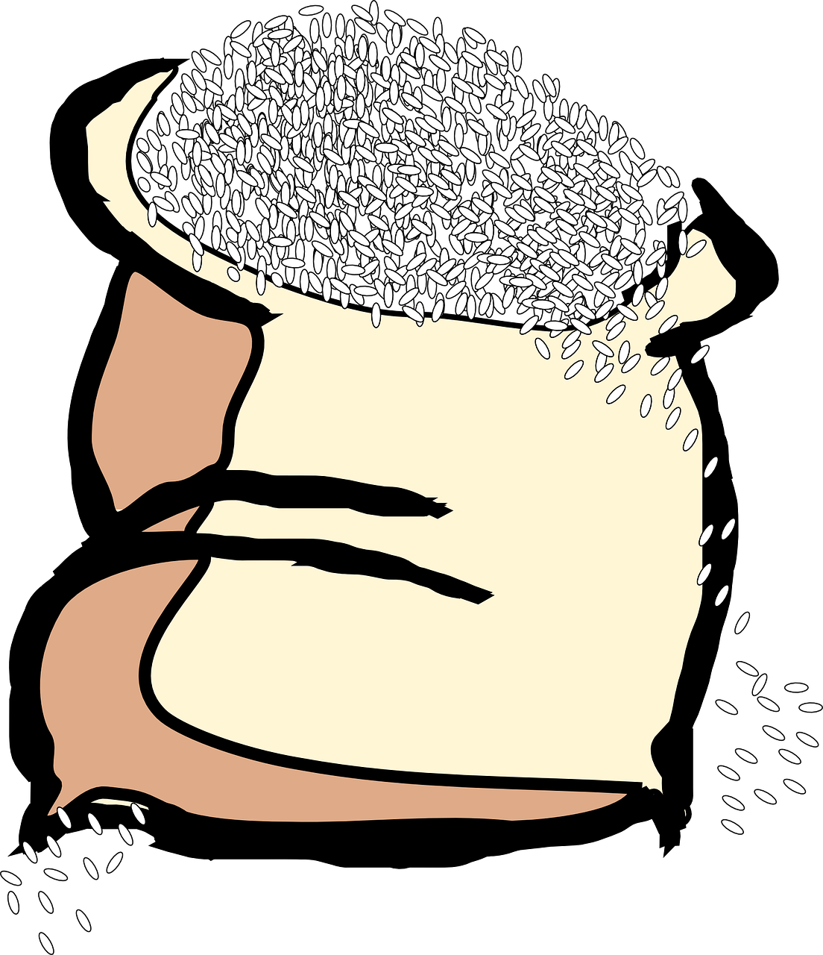
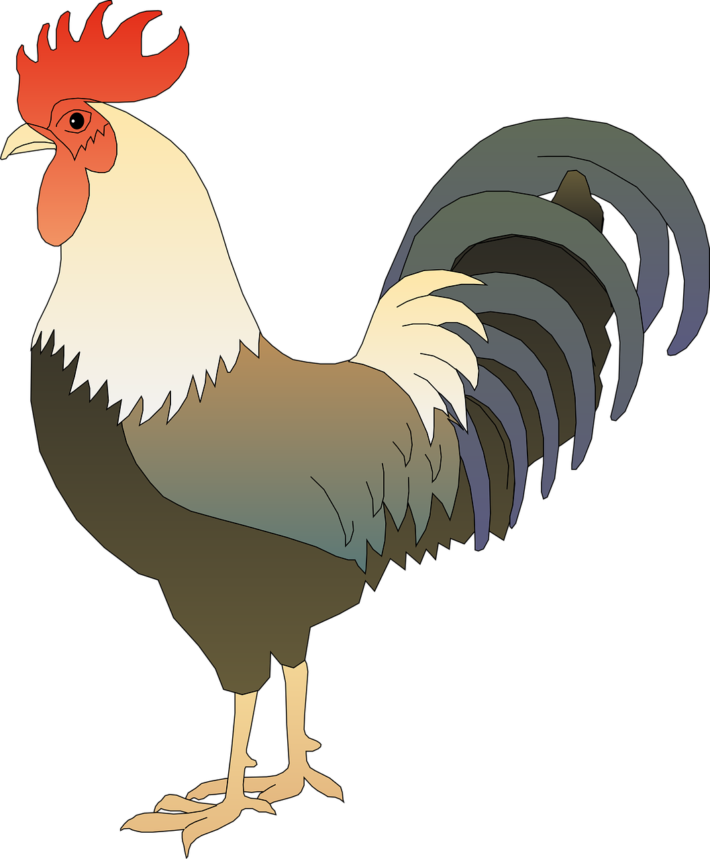

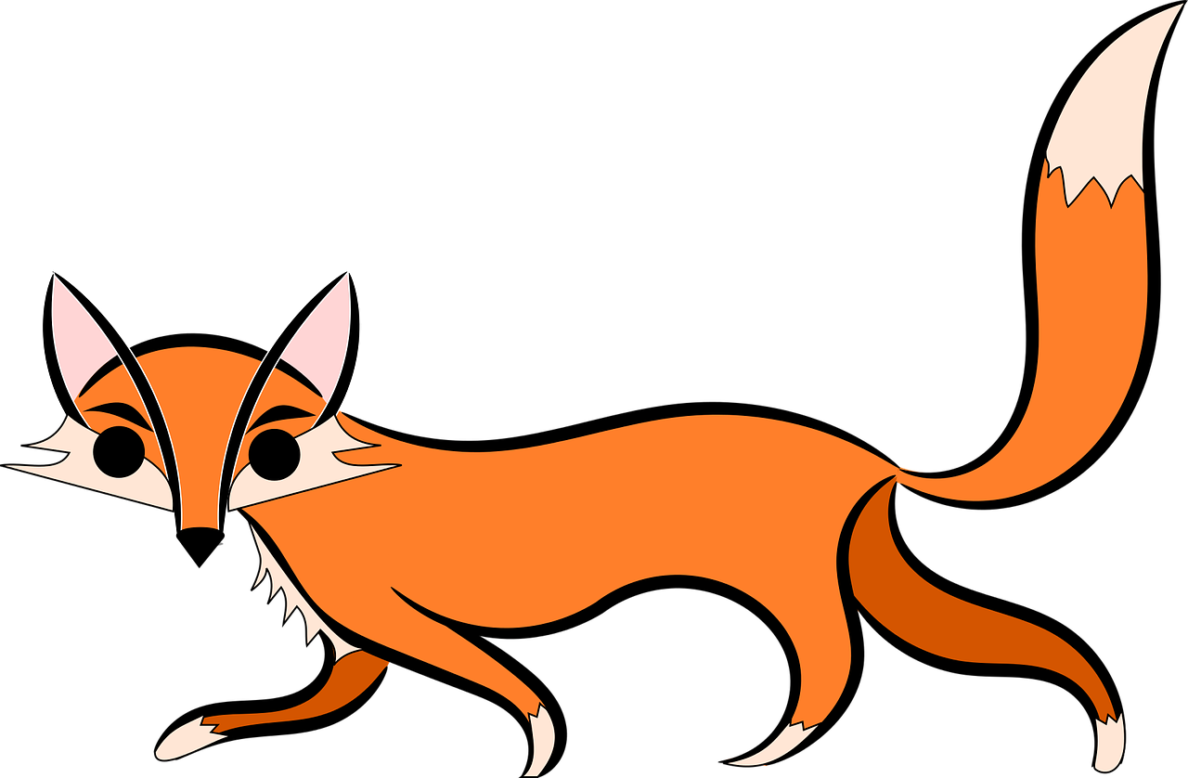
Chicken, fox & a bag of grain
Notes:
Briefly Introduce myself

Slide 7

What makes a good scientist?
Problem-solving
Observation
Notes:
Briefly Introduce myself

Slide 8



What makes a good scientist?
Problem-solving
Observation
Creativity
Speaking & Listening
Strong
Notes:
Briefly Introduce myself

Slide 9

Scientist Race
Notes:
Briefly Introduce myself

