Slide 1


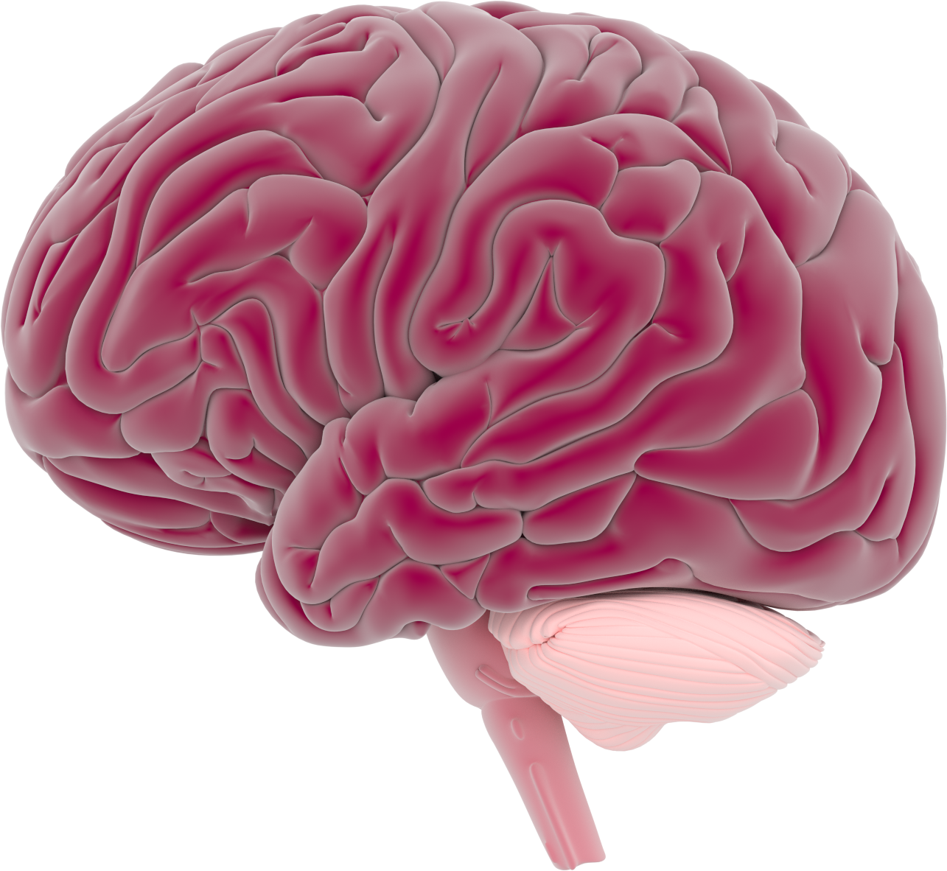
This activity has been supported
by a grant from Roche Products Ltd
Learning &
Memory
'Presenter 1'
'Presenter 2'
Notes:
Briefly Introduce myself

Slide 2
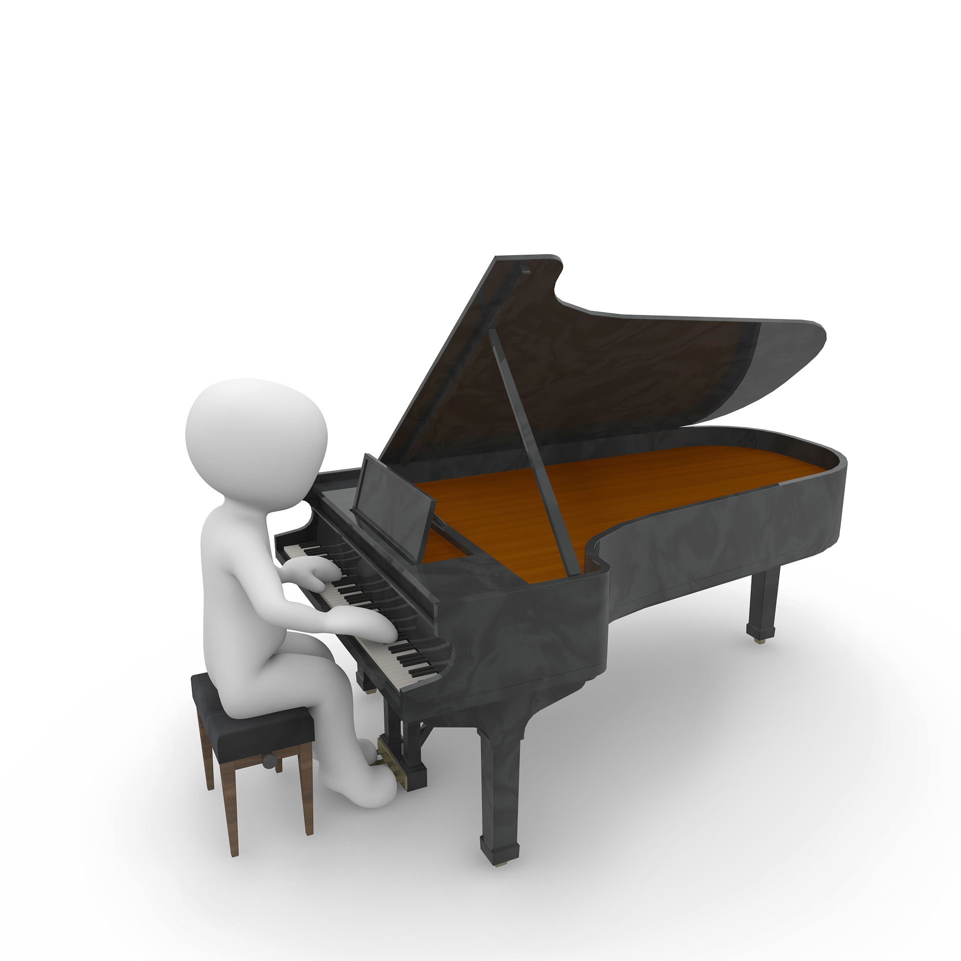


Notes:
Briefly Introduce myself

Slide 3
What do you know about the brain?
Notes:
Briefly Introduce myself

Slide 4
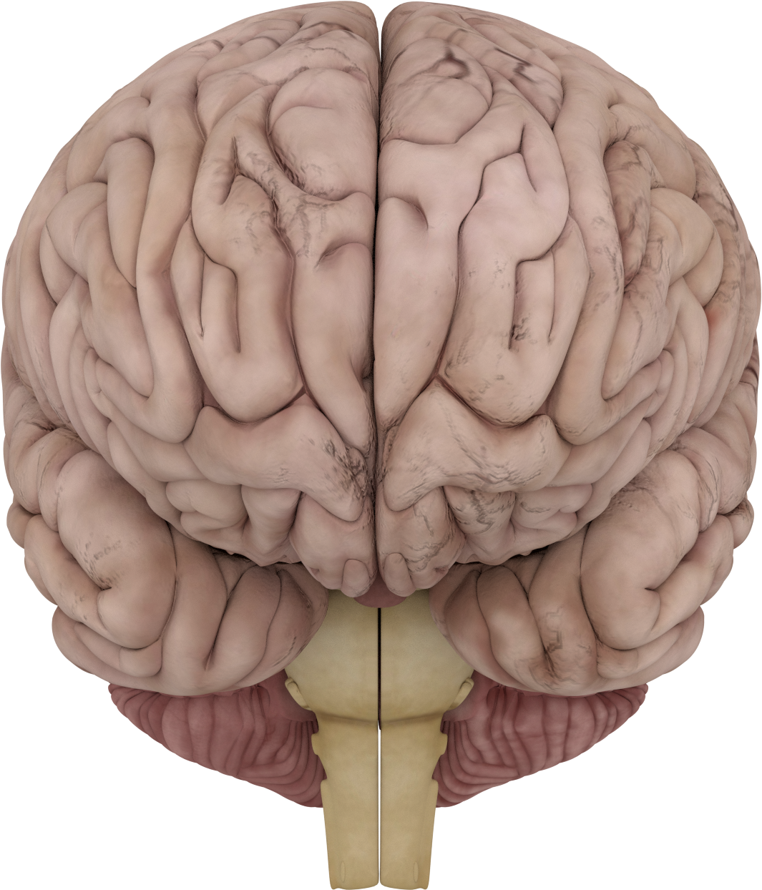
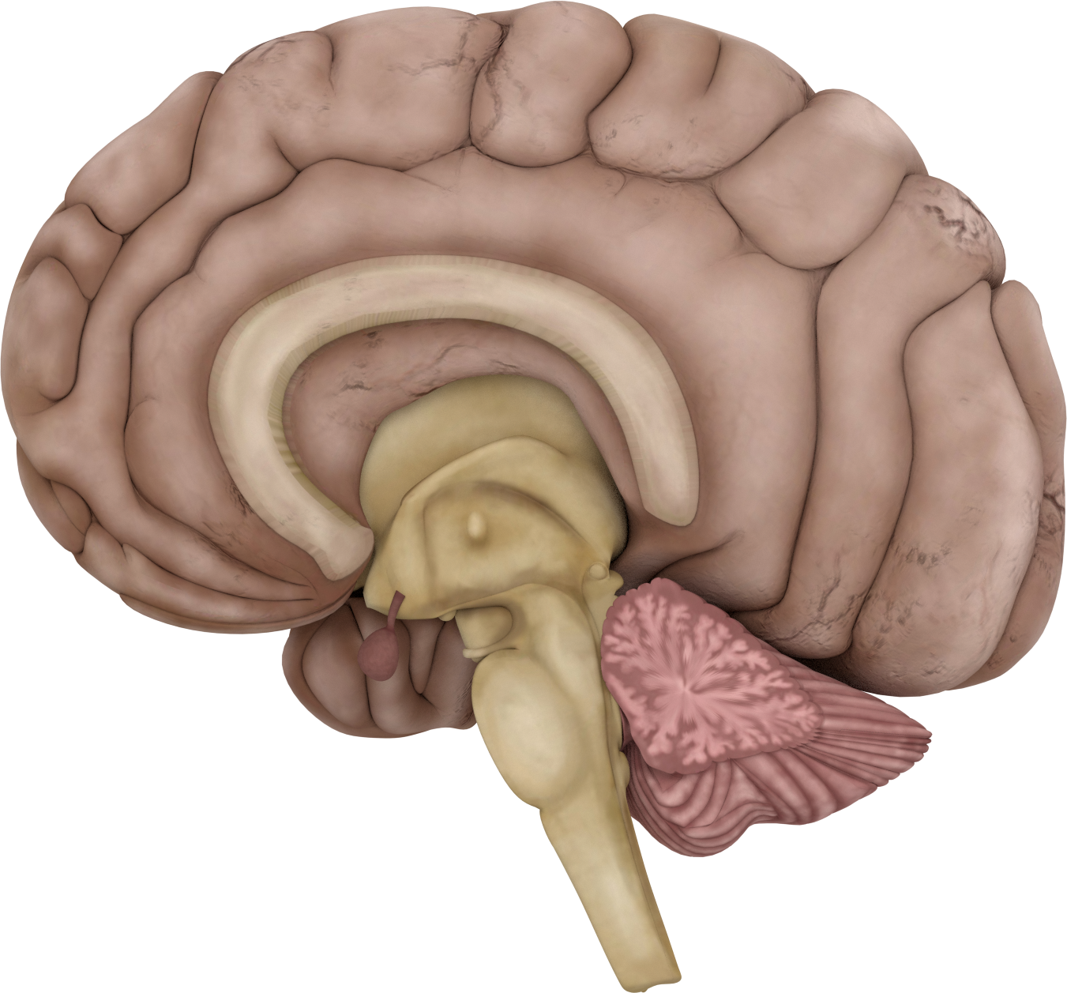
The brain has 2 sides: 2 hemispheres
Notes:
Briefly Introduce myself

Slide 5
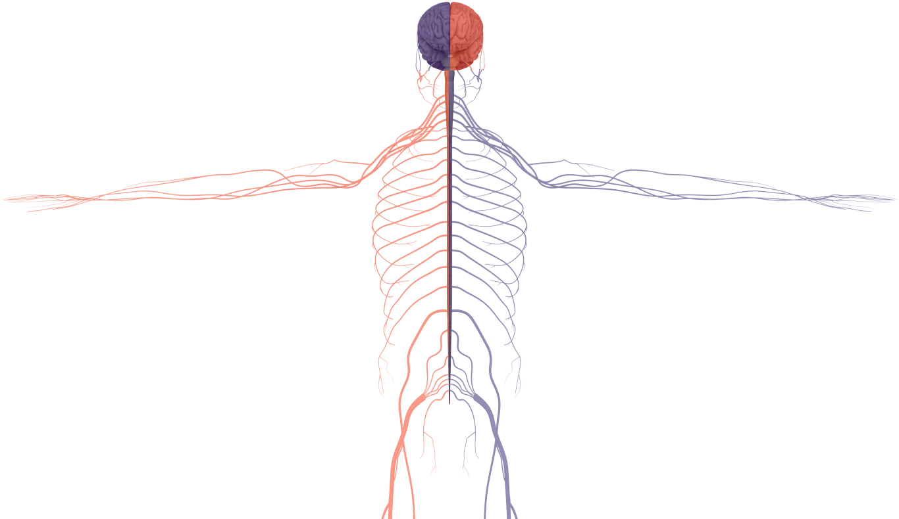
The brain sends messages to the opposite side of the body
Notes:
Briefly Introduce myself

Slide 6
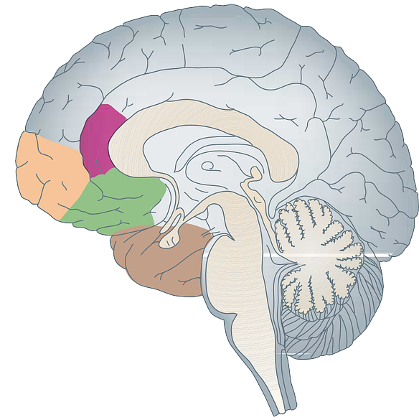
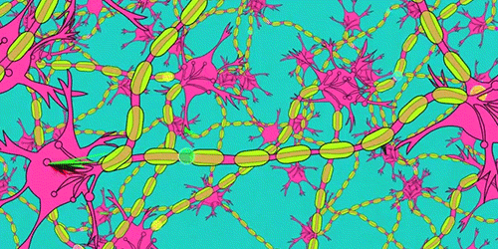
The brain is made up of different areas
Cortex
There are billions of neurons in the brain!!!
Corpus callosum
Cerebellum
Neurons make networks

Slide 7

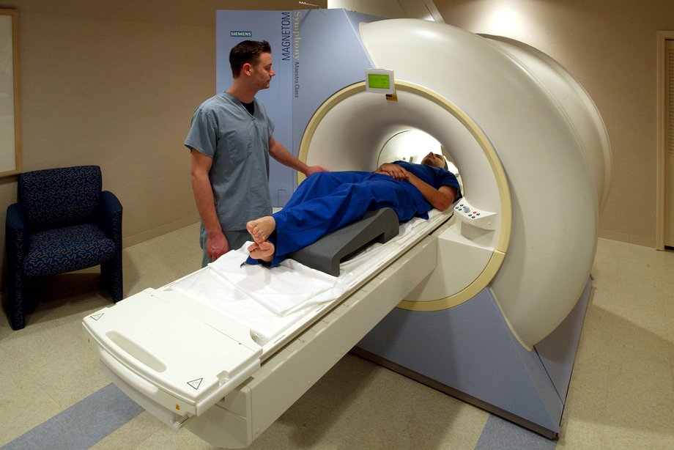
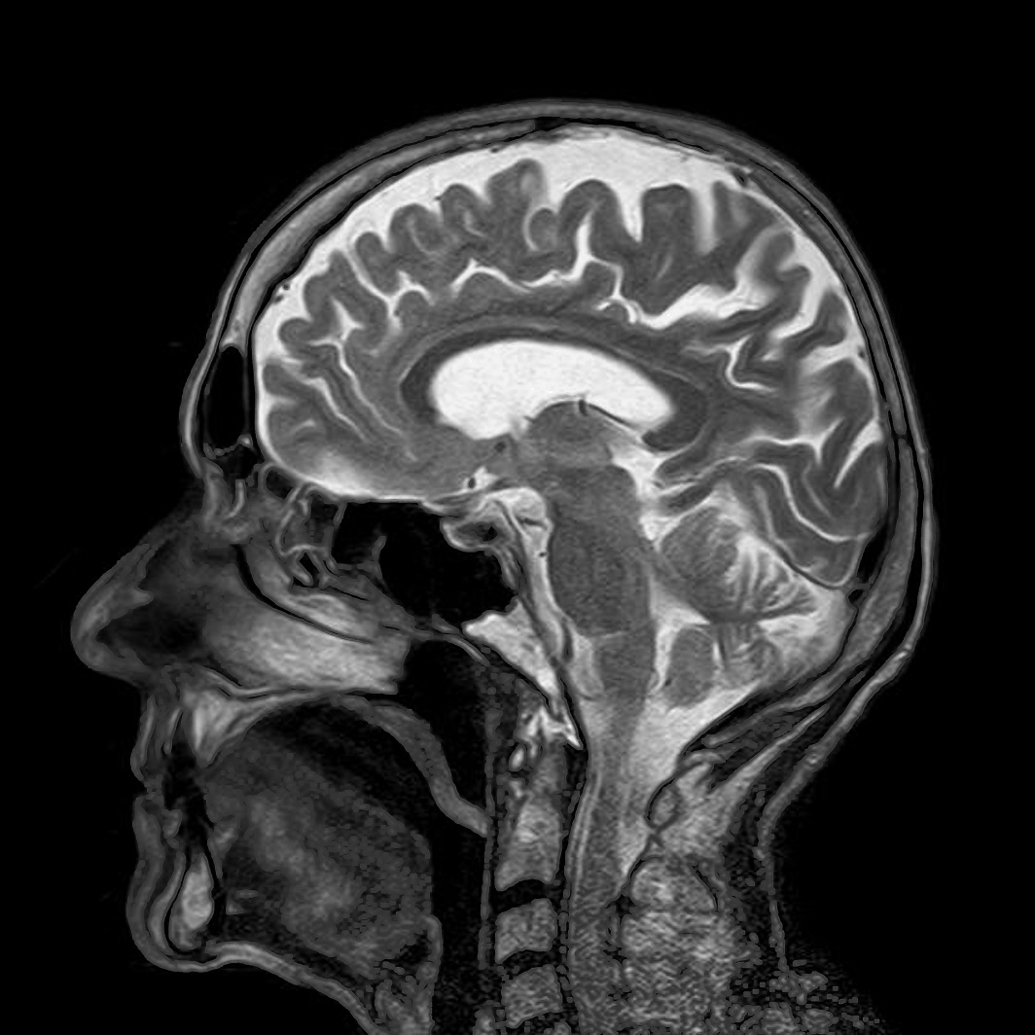
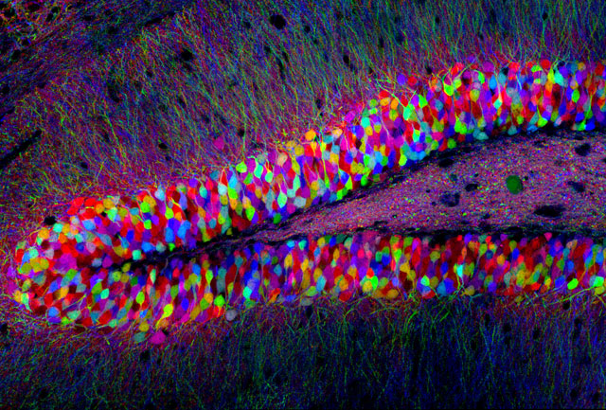
Microscopy
Brain Scanner
Notes:
Briefly Introduce myself

Slide 8
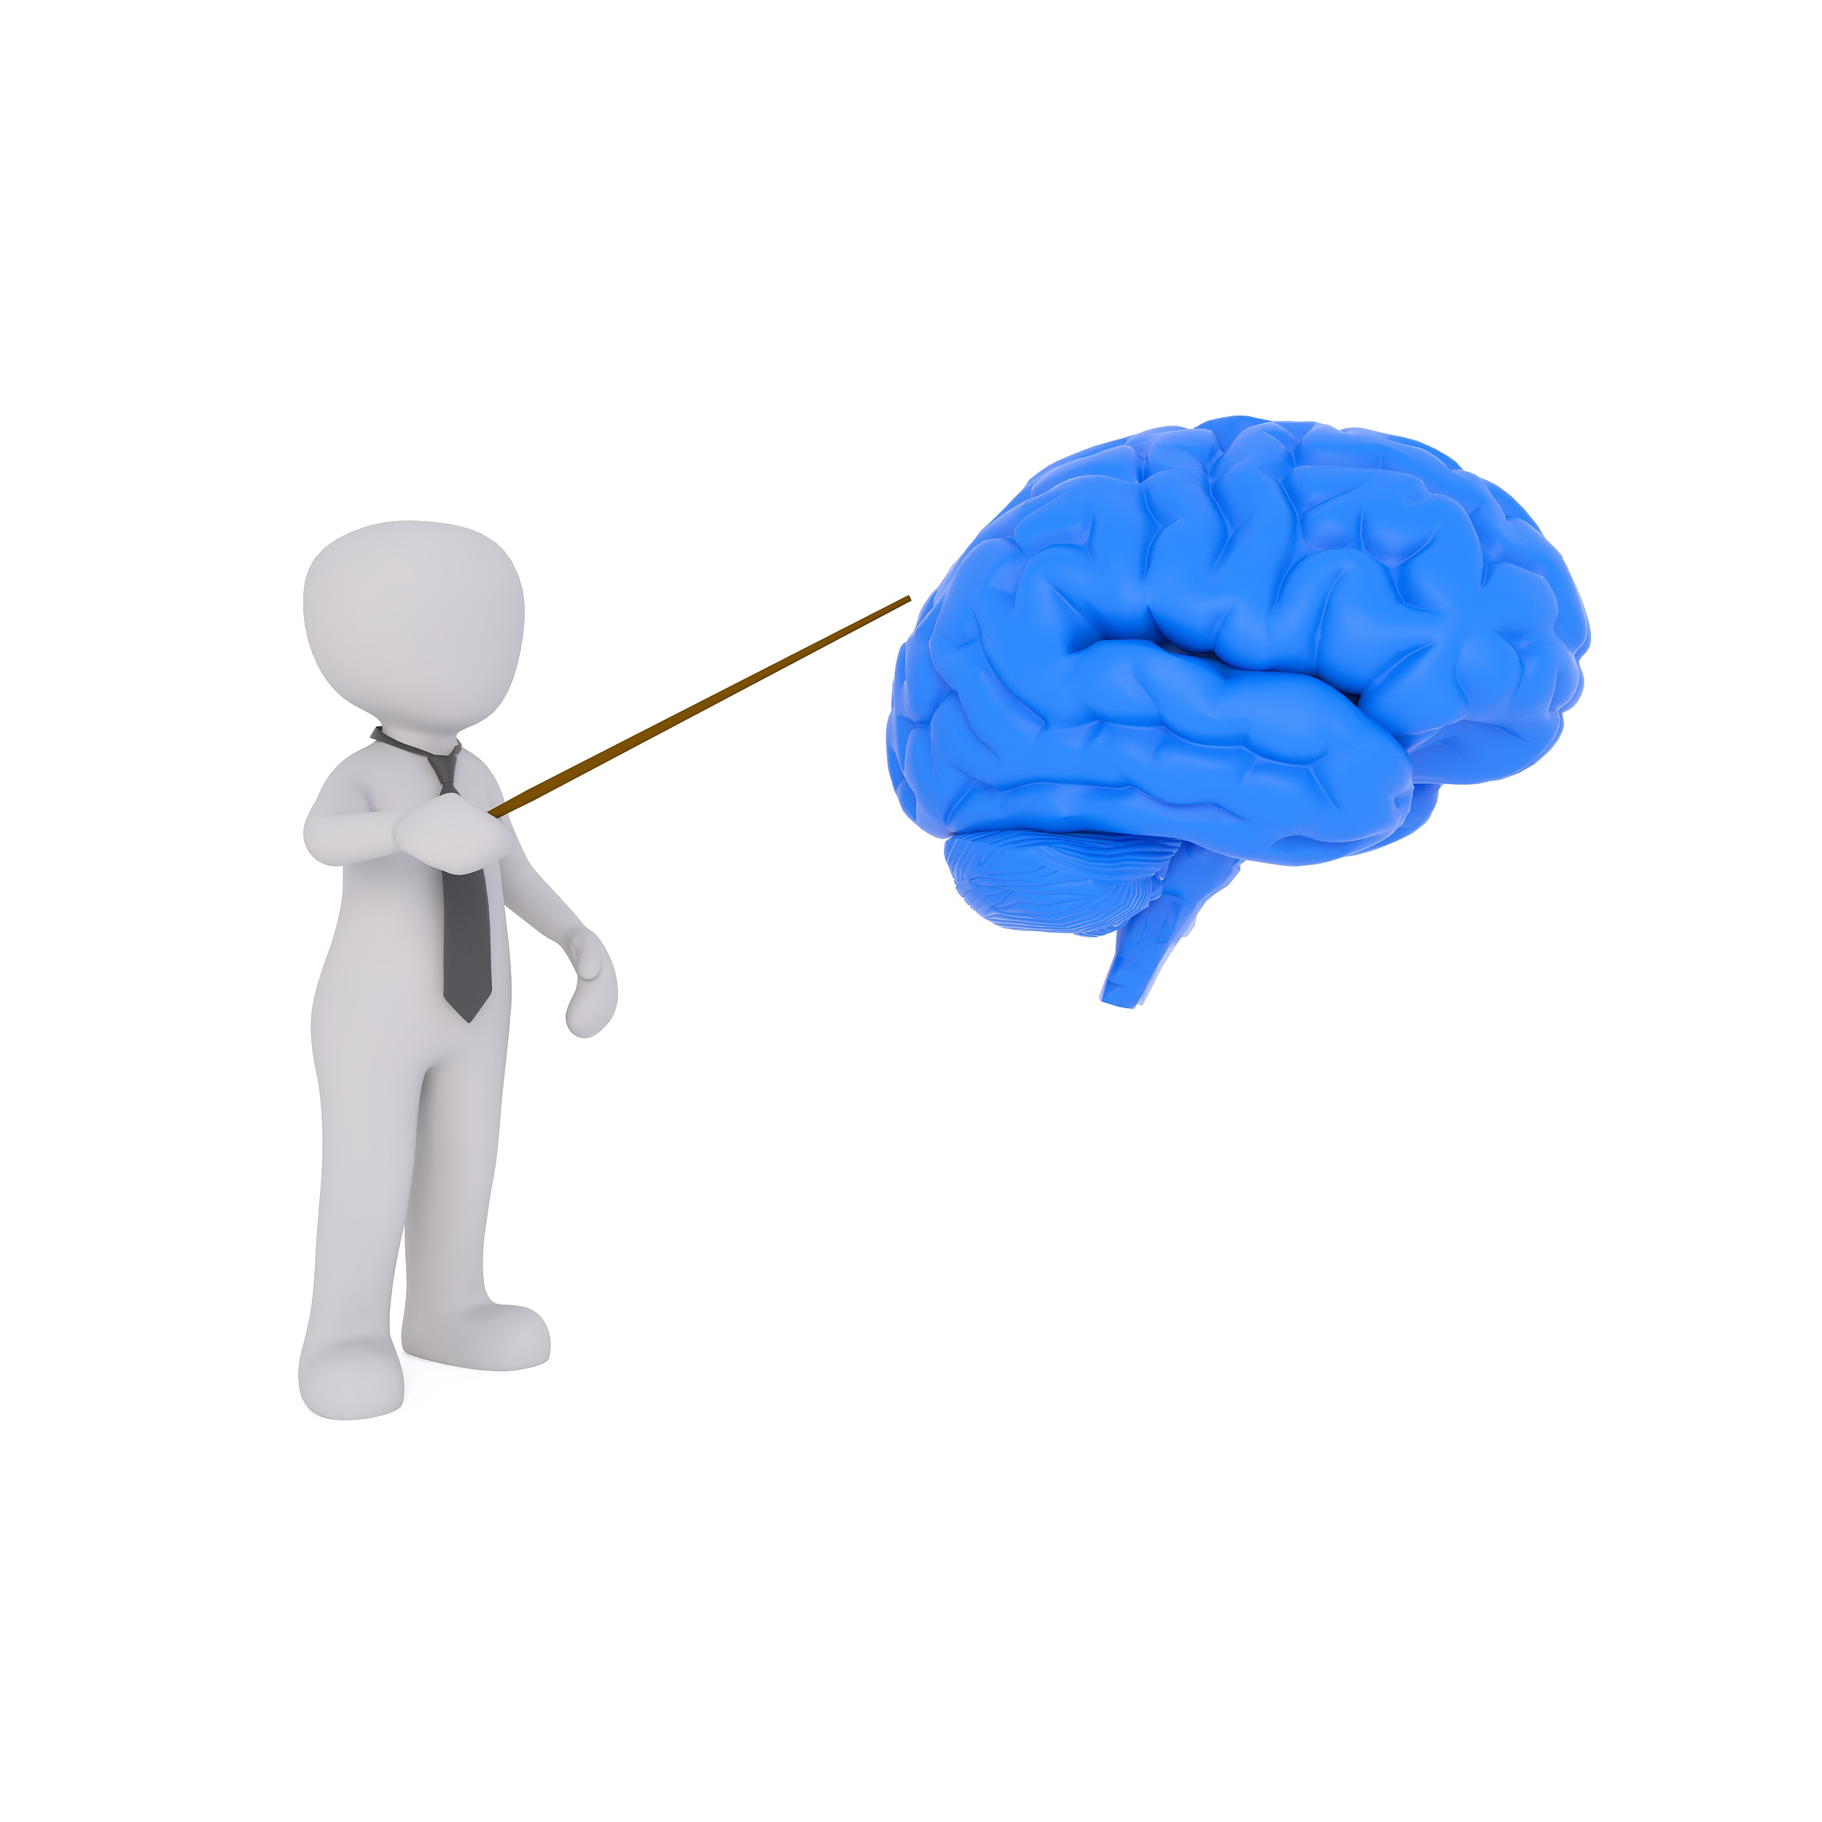

What is learning & memory?
Memory is…
the way in which the brain stores information
Learning is…
the process of gaining new information and skills
Notes:
Briefly Introduce myself

Slide 9

What is learning & memory?
Memory
Learning
Notes:
Briefly Introduce myself

Slide 10
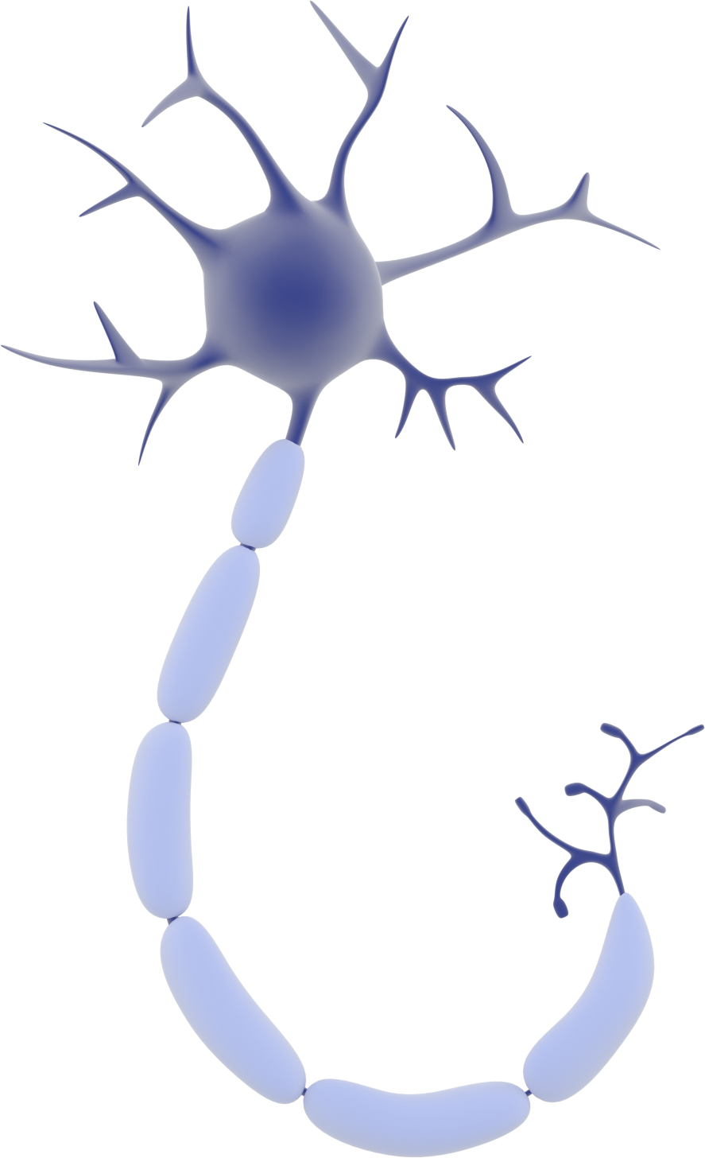
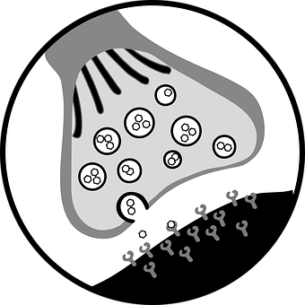
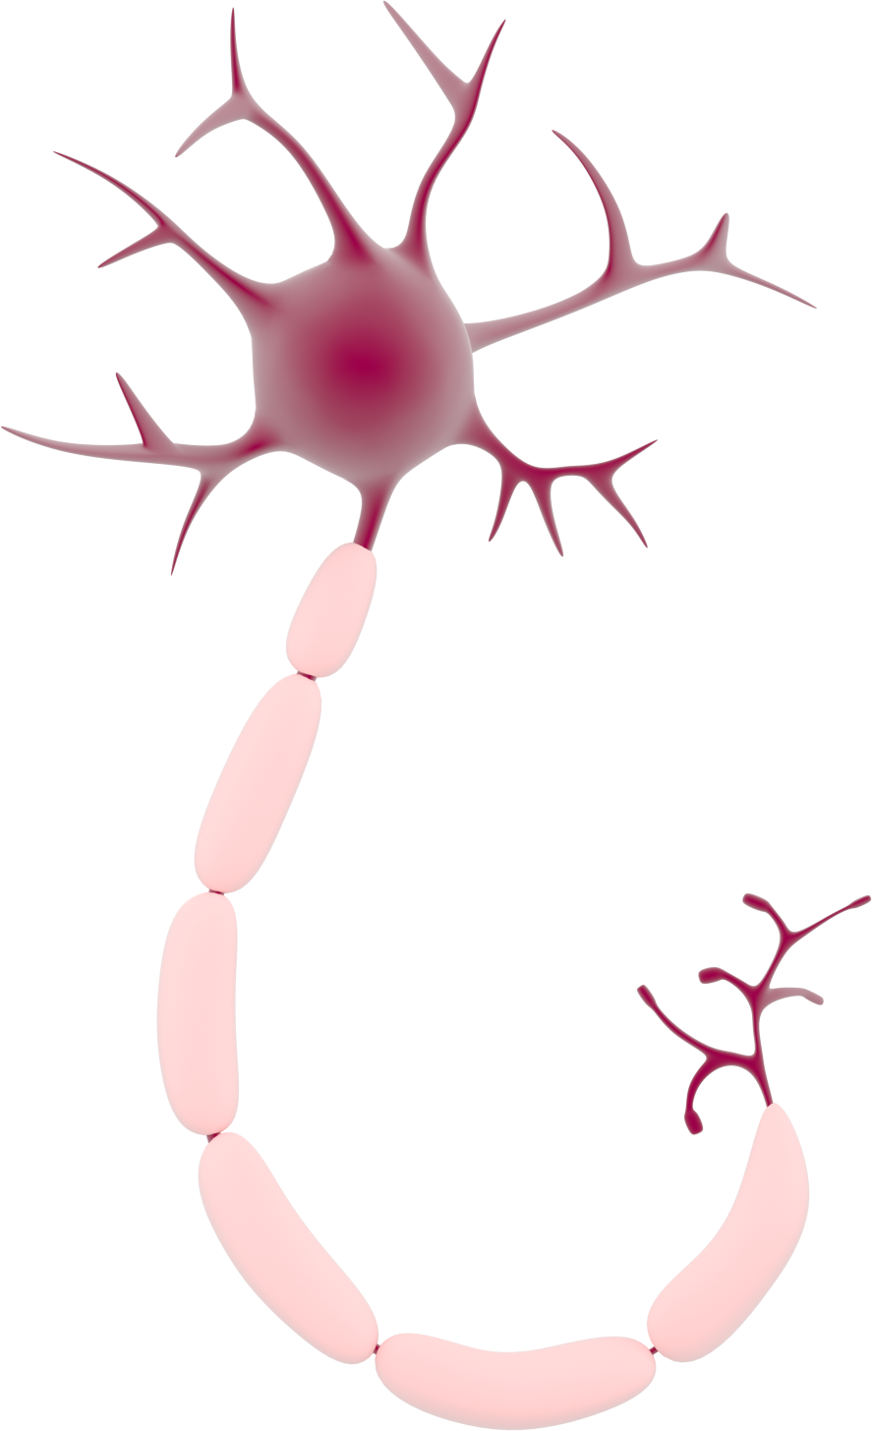
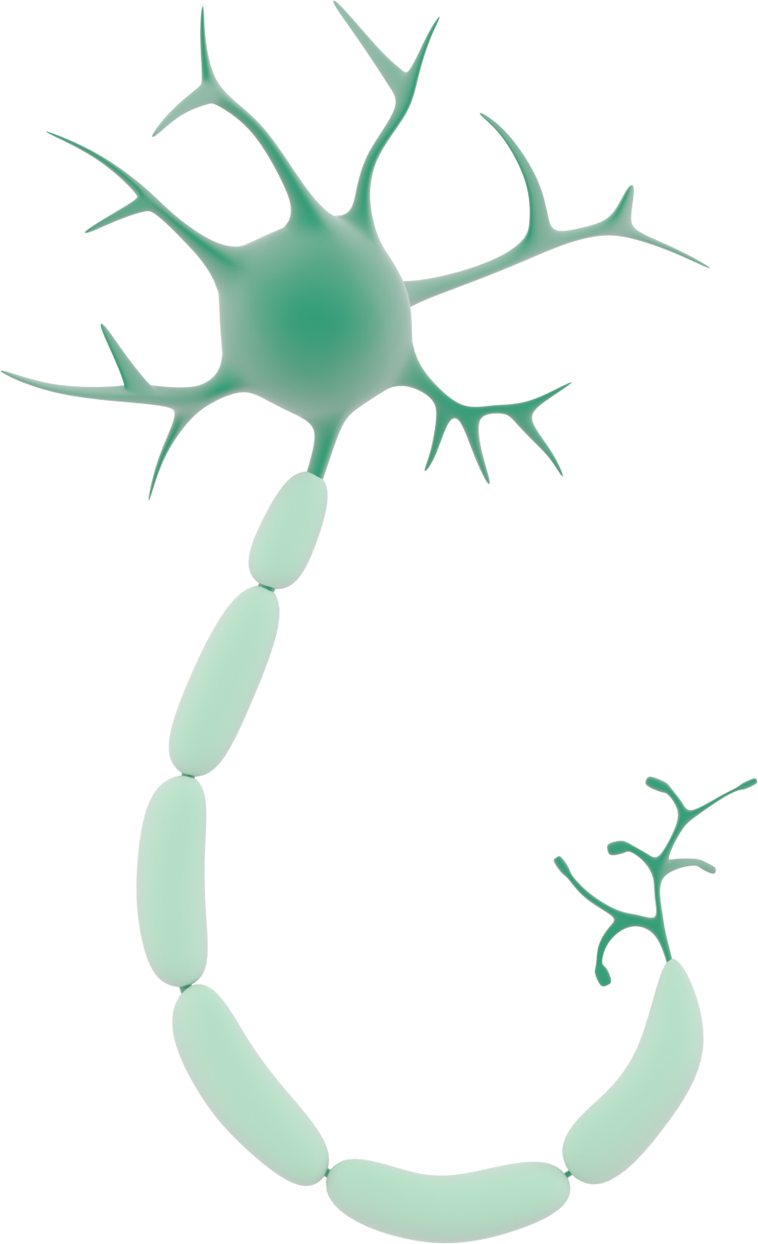

What is a memory?
Connections
Synapse =
Connections between neurons
Notes:
Briefly Introduce myself

Slide 11

How do we create a memory?
Connections
& Networks!
Stimulus
Notes:
Briefly Introduce myself

Slide 12
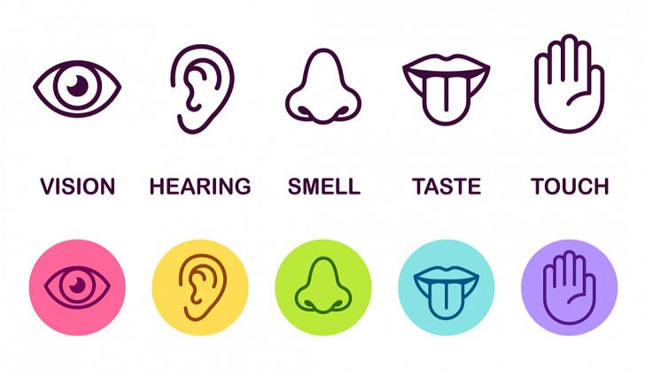

Creating a memory: the process
1st Sensory memory
If something seems unusual or new
2nd Short term or working memory

Slide 13











Memory game
Notes:
Briefly Introduce myself

Slide 14
Memory game
Notes:
Briefly Introduce myself

Slide 15
Notes:
Briefly Introduce myself

Slide 16
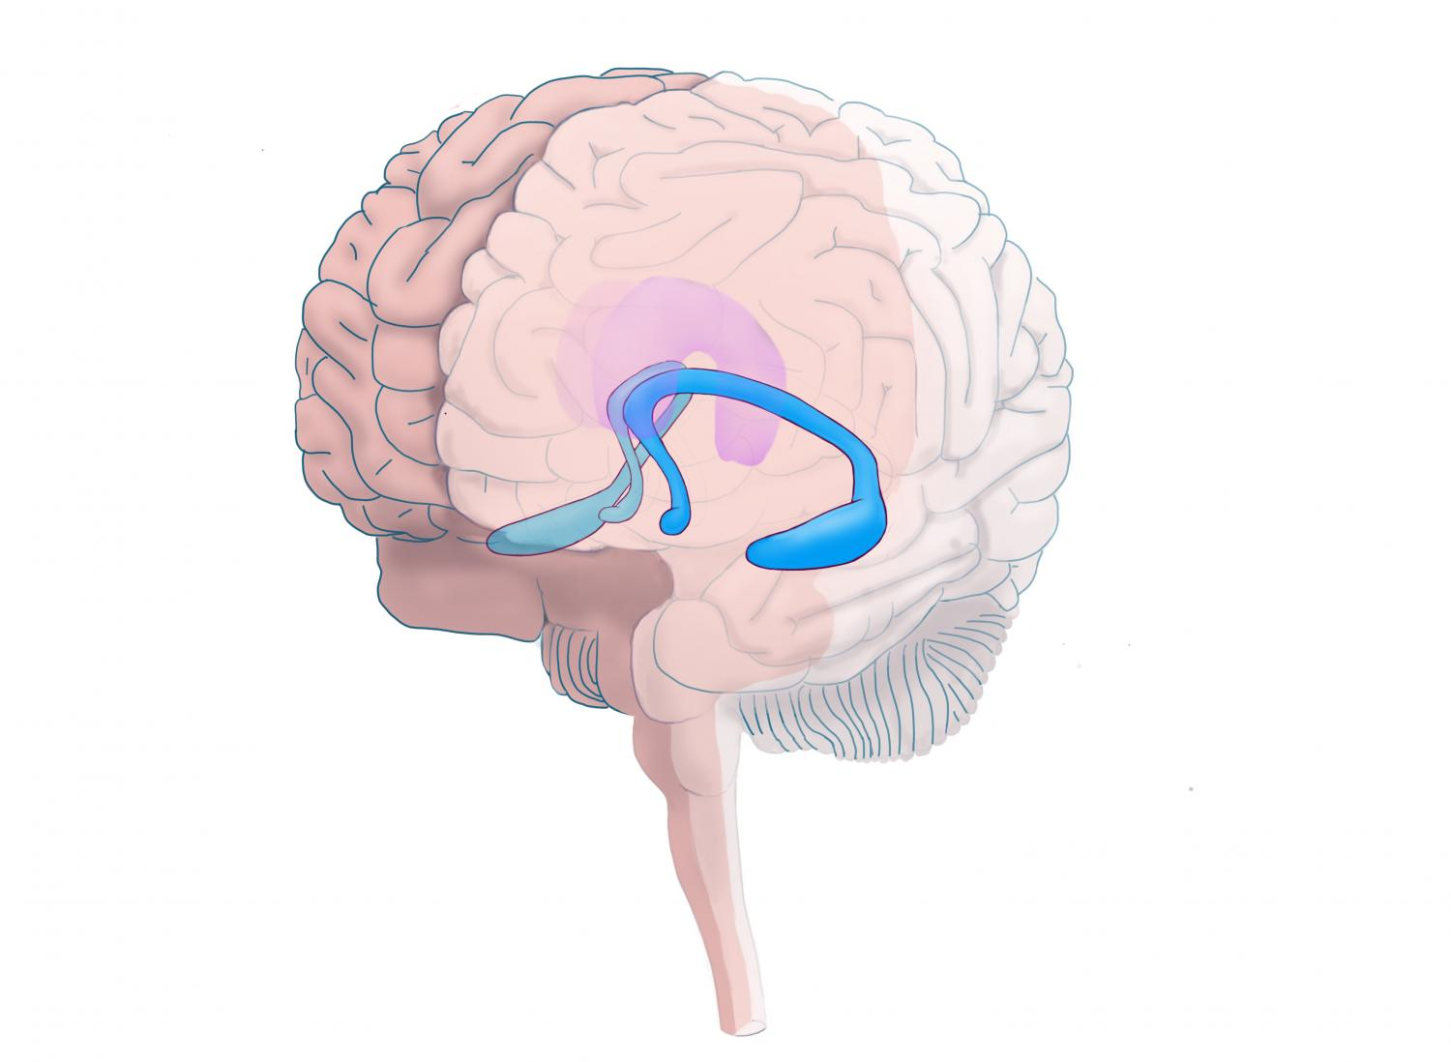
Creating a memory: the process
1st Sensory memory
2nd Short-term or working memory
If we keep our working memory by repetition
3rd Long-term memory
Hippocampus

Slide 17
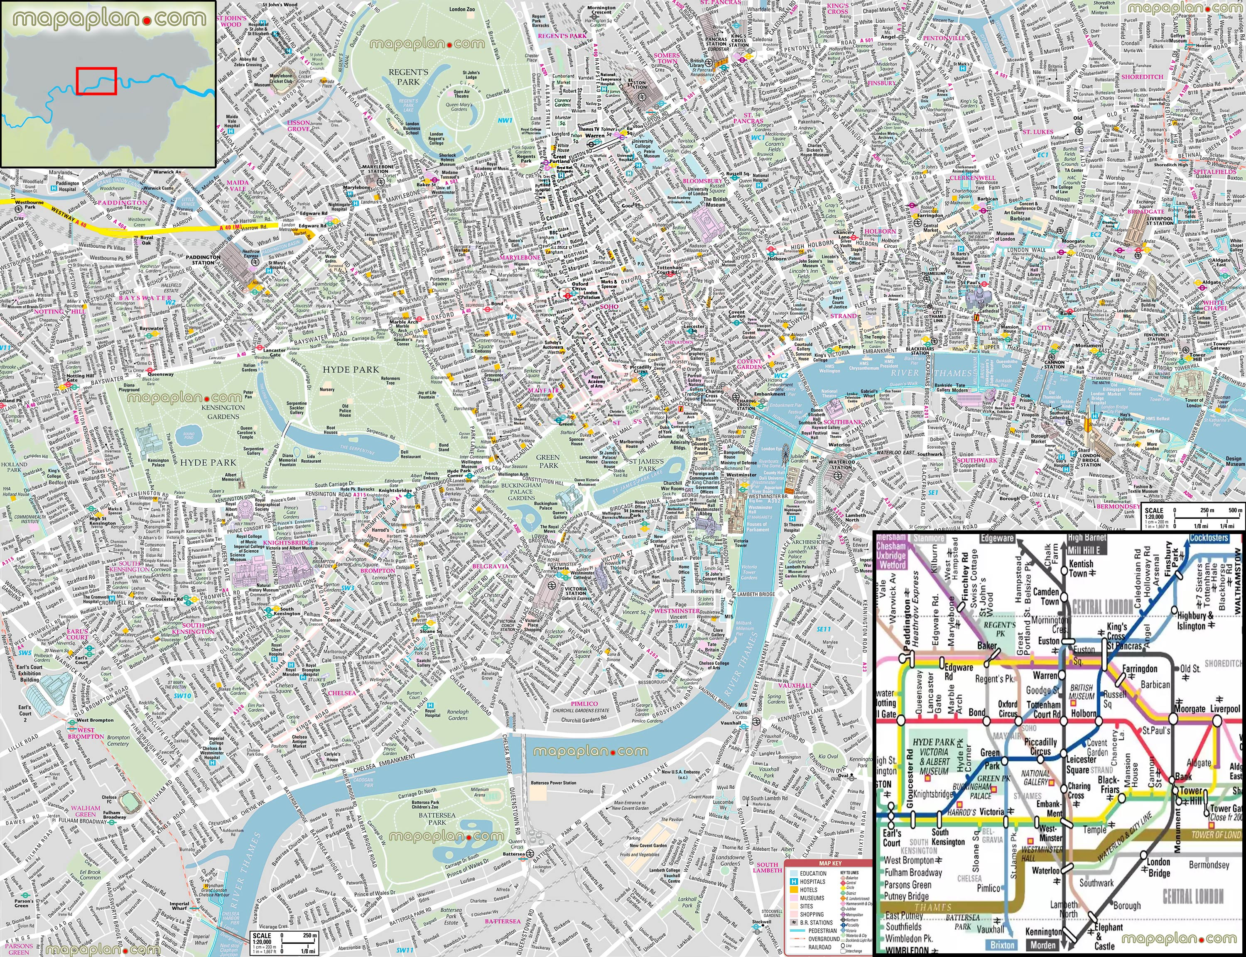

The ‘brainy cab drivers’ study

Slide 18
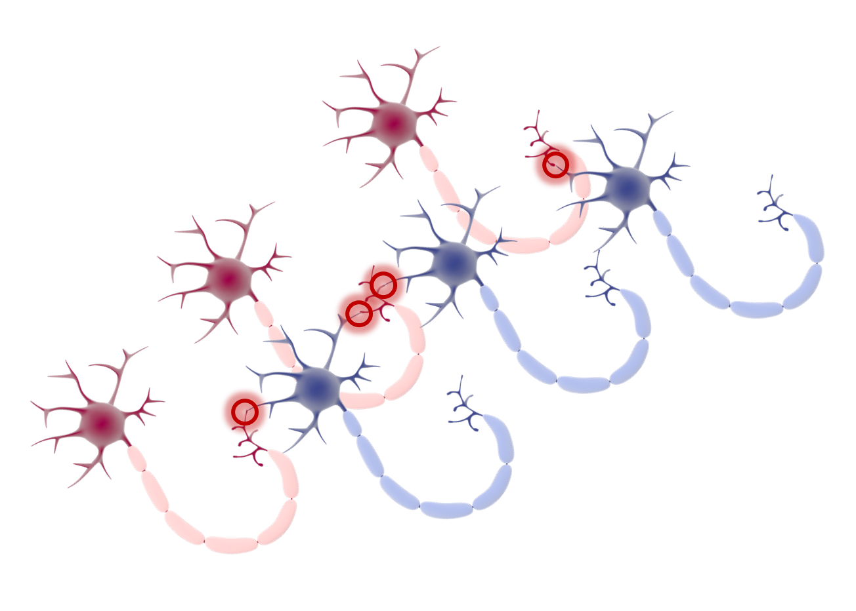
Summary
Long-term memory is stored in neuronal networks
1st Sensory memory
2nd Short-term or working memory
3rd Long-term memory
Networks are dynamic!!

Slide 19
Finally, the long-term memories are stored in neural networks but the networks are not static. They will change with time, some will be lost if we do not use the information and others will change a little bit every time we recall this memory. So its worthy taking into account that a memory you have now may be very different from the original!I
Memory is not static: Networks change
Long-term memory is stored in neuronal networks
Memory not used
Memories will be lost
Memory is used
Memories kept but they change a little bit every time we recall them
Notes:
Briefly Introduce myself

