Slide 1


Communicating Science and Shaping Research: The role of Patient and Public Involvement and Engagement
30 September 2026

Slide 2
Aims
Build understanding of the principles and value of Patient and Public Involvement and Engagement (PPIE)
Build knowledge of practical approaches to embedding PPIE throughout the research process
Build confidence in planning meaningful PPIE activities in your work

Slide 3

Housekeeping
Please use the Chat for technical issues or quick queries
Please pose questions for speakers and Panel discussion through the Q&A box
Comfort breaks at 2.55pm and 4.15pm
Recording for attendees to view again later
Slides and resources will be shared afterwards by email

Slide 4
Terms
 | Definition | Examples
Participation | Taking part as a subject; contributes data but does not shape research | Giving blood samples, completing questionnaires, joining a trial
Engagement | Sharing research knowledge; two-way conversation, but primary goal is information and learning | Public talks, lab tours, social media updates, science festivals
Involvement | Bringing patient and public insights into research design and delivery | Identifying research priorities, reviewing public-facing materials, helping translate findings into patient benefit
Involvement
Engagement

Slide 5
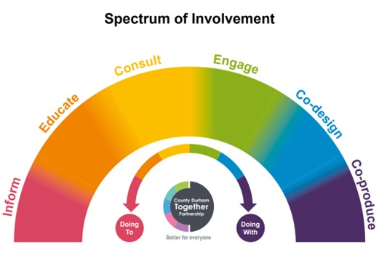
Approaches
PPIE
Inspire & inform
Consultation
Collaboration
Co-production
Notes:
County Durham Together Partnership Co-Production Resource (Spectrum of Involvement) Co-production

Slide 6



Principles
Meaningful
Respectful and inclusive
Honest and open communication
Supportive
Recognition
Sustainable partnerships
Notes:
Resources to share afterwards:
UK Standards for Public Involvement UK Standards for Public Involvement
PEDRI Good Practice Standards Our Standards - PEDRI
NCCPE Ten principles of high quality engagement Quality Practice | NCCPE

Slide 7
What has helped, or would help, meaningful PPIE happen in your research?
What has been, or do you think would be, your biggest challenge?
Notes:
Articles on barriers to PPIE in research:
Questions for more insightful and useful analyses of barriers and facilitators to public involvement and engagement in health research: a critical narrative review | Research Involvement and Engagement | Springer Nature Link

Slide 8
COMFORT BREAK
Please return in 5 minutes!

Slide 9
COMFORT BREAK
Please return by 4.25pm!

Slide 10


Thank you for attending!
Explore more PPIE resources from Alzheimer’s Research UK
Sign up to Alzheimer’s Research UK’s Researcher Newsletter

