Slide 1
This activity has been supported by a grant from Roche Products Ltd
Neuronal
communication
'Presenter 1'
'Presenter 2'
Notes:
Briefly Introduce myself

Slide 2
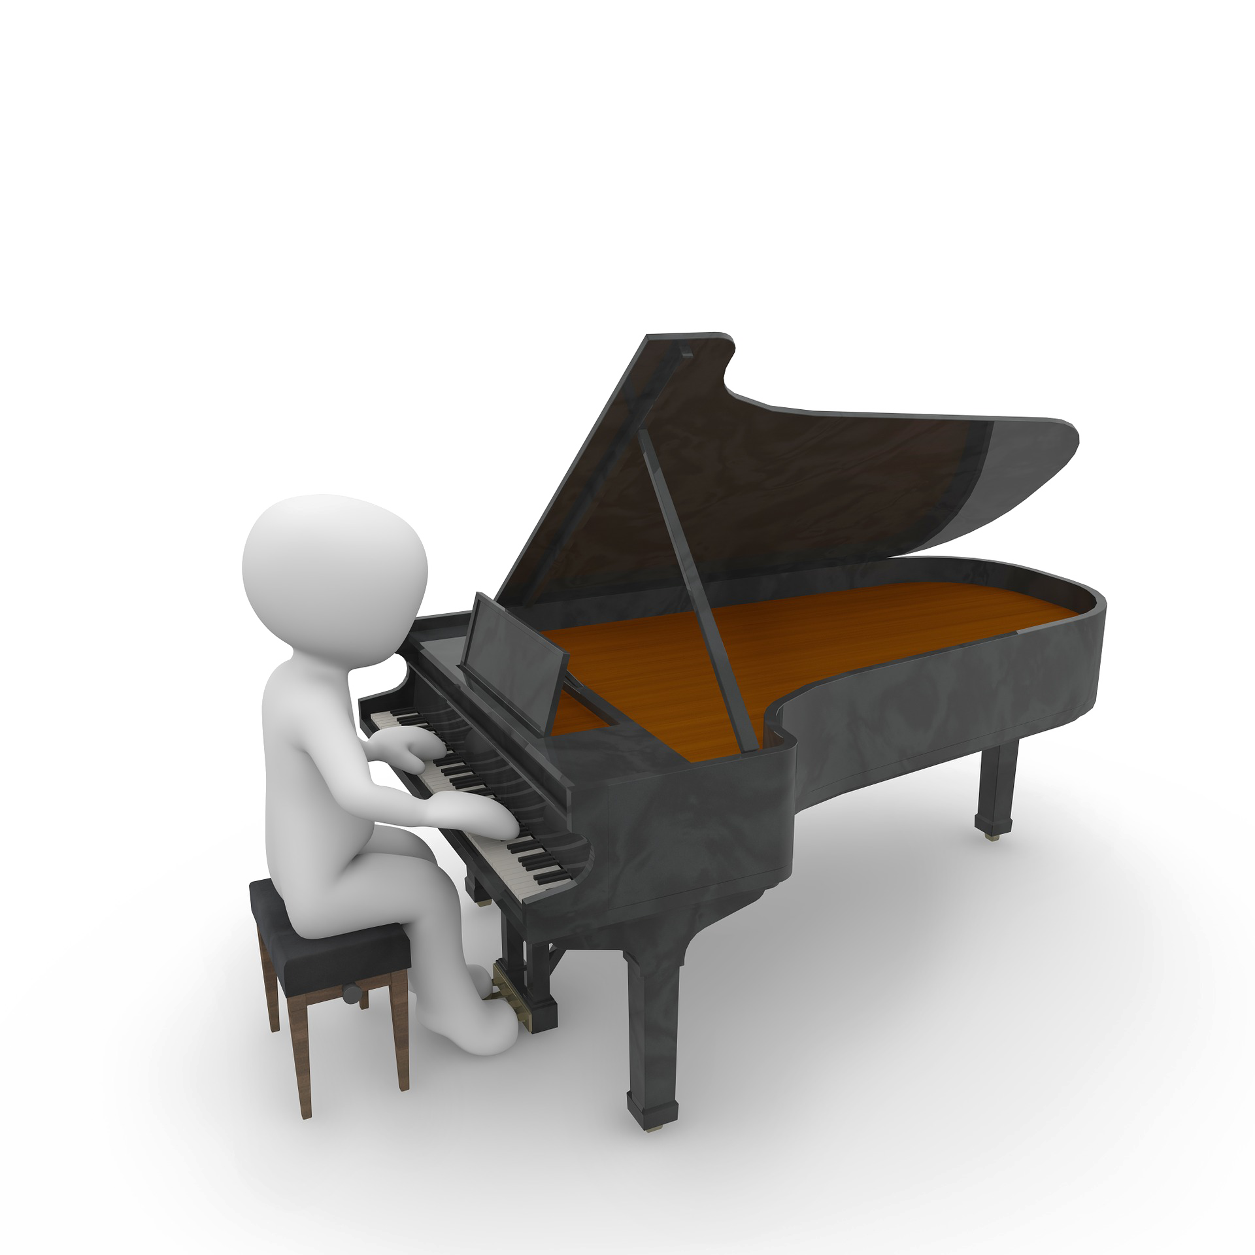

Slide 3
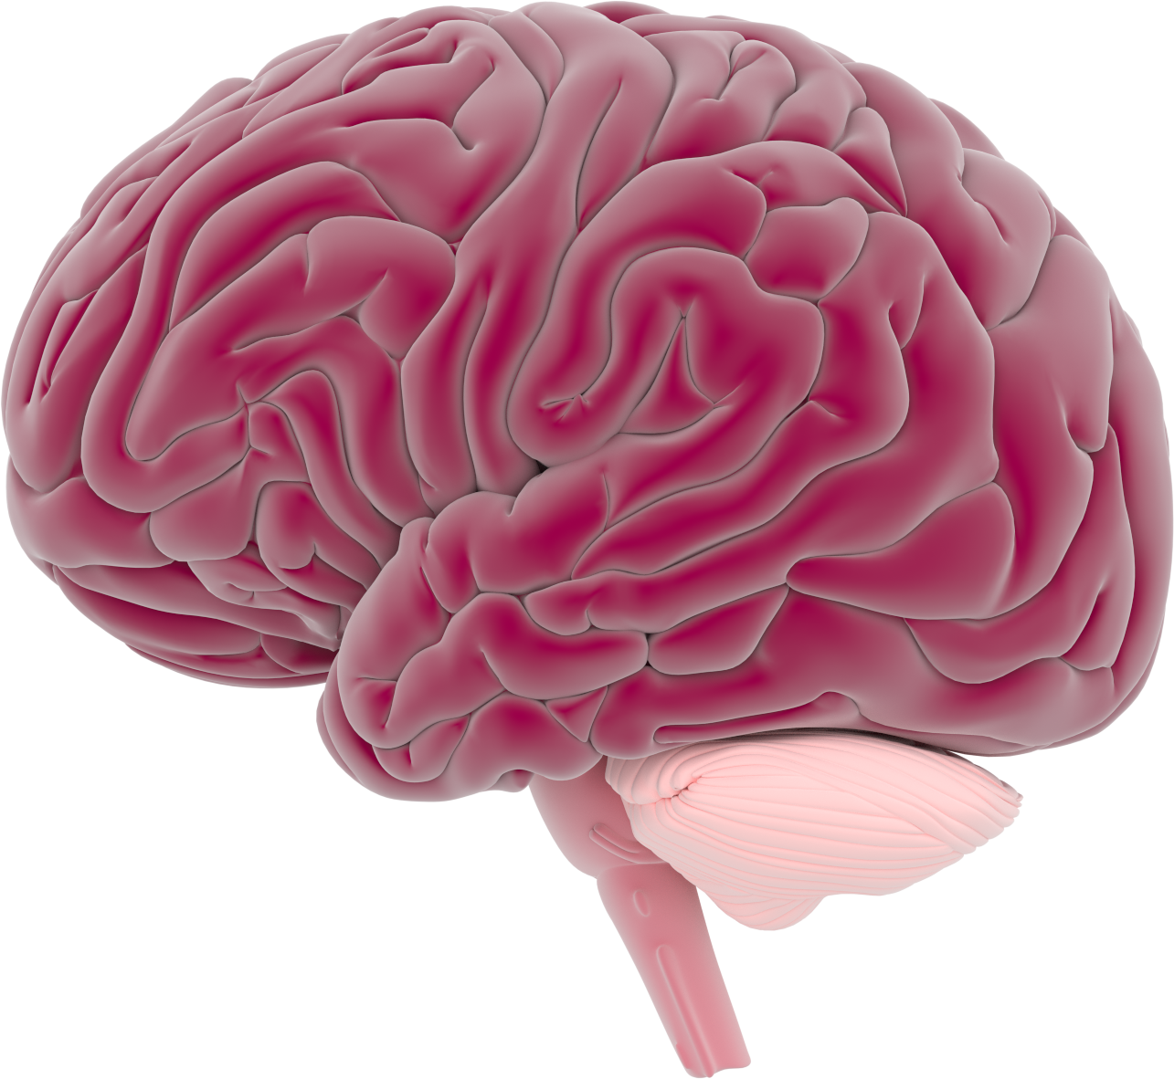
What do you know about the brain?

Slide 4
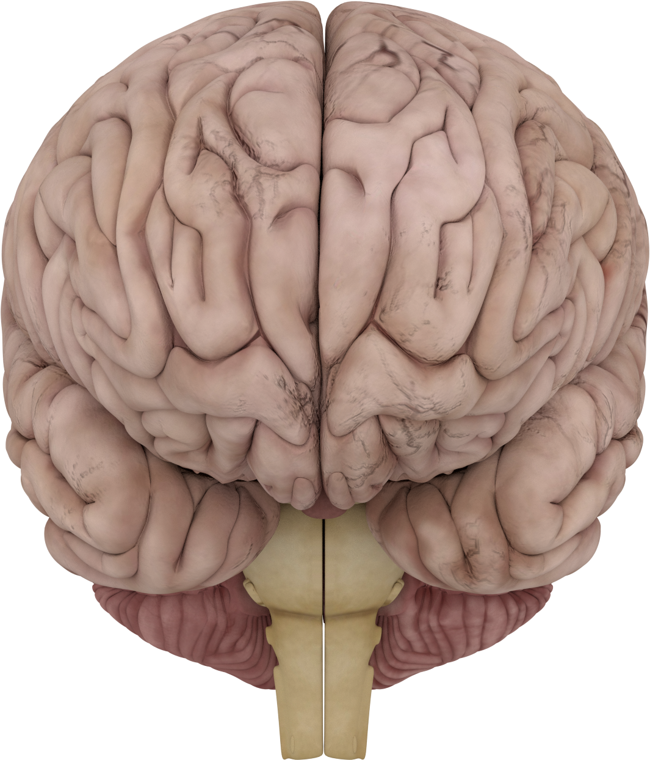
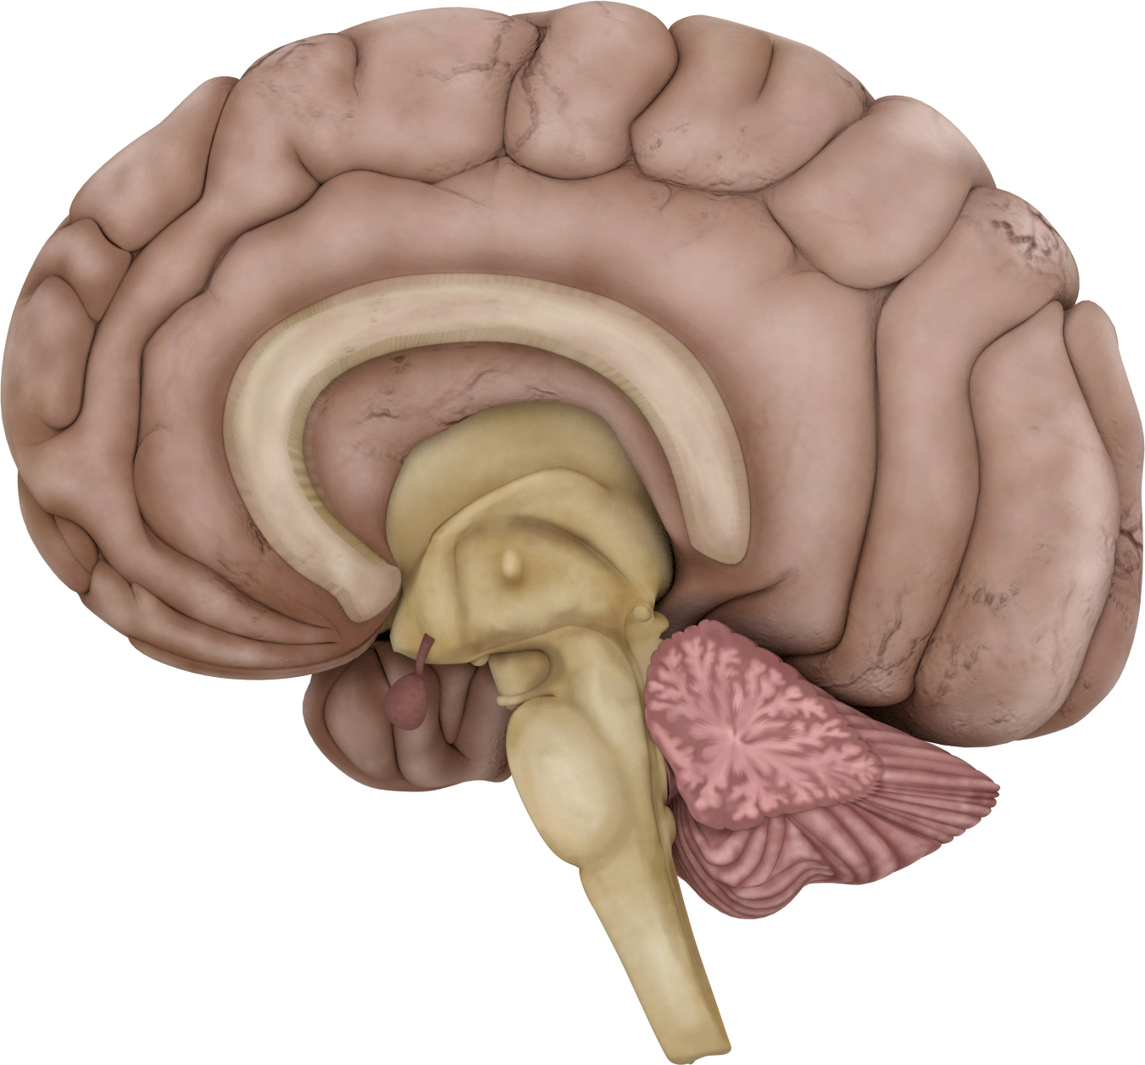
The brain has 2 sides: hemispheres

Slide 5
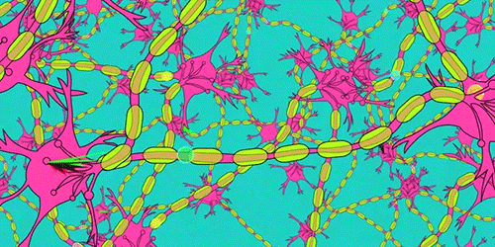
The brain is made up of different areas
Cortex
There are billions of neurons in the brain!!!
Corpus callosum
Cerebellum
Neurons make networks

Slide 6
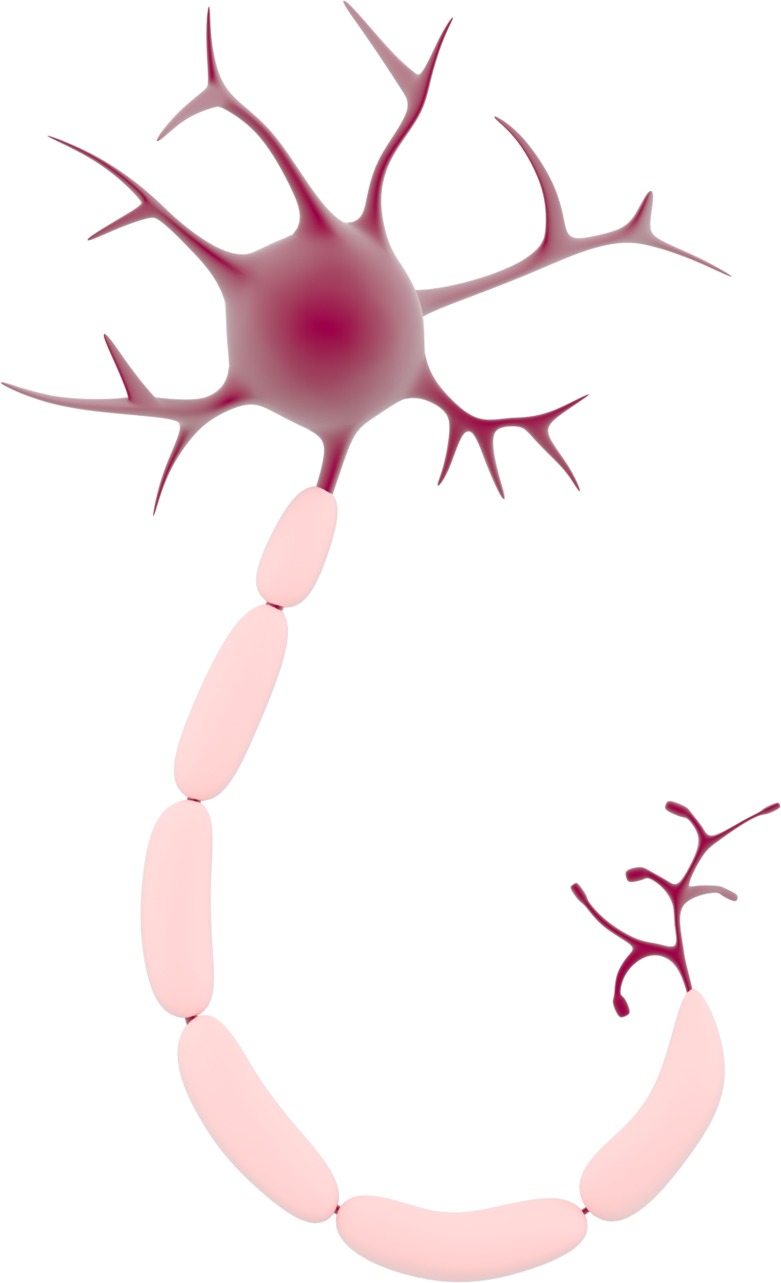
Neuron
Axon terminal
Soma
Dendrites
Axon
Myelin
'Neurons in the brain' by Dr Jonathan Clarke

Slide 7
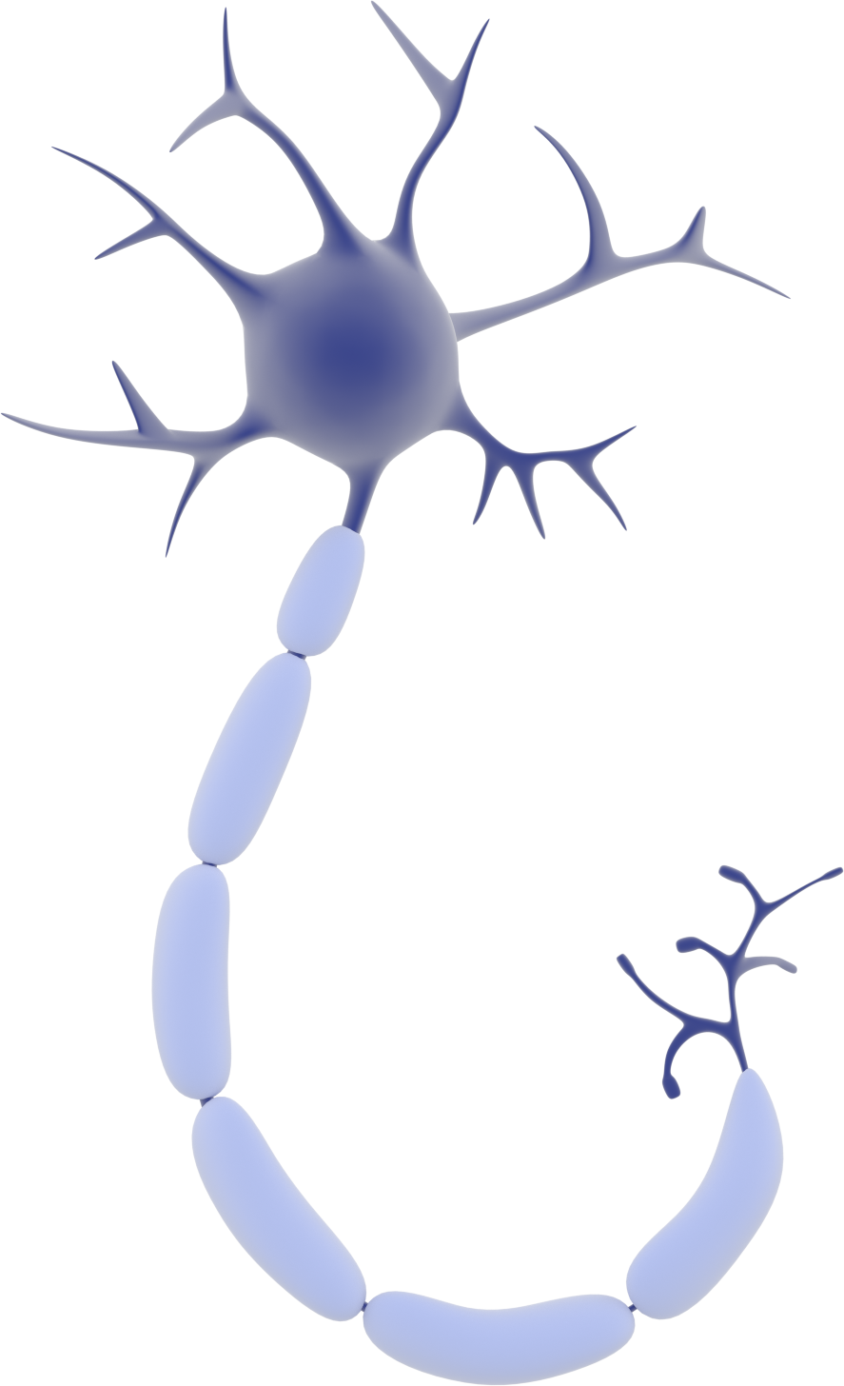
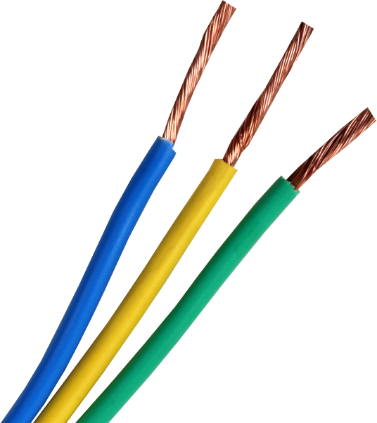
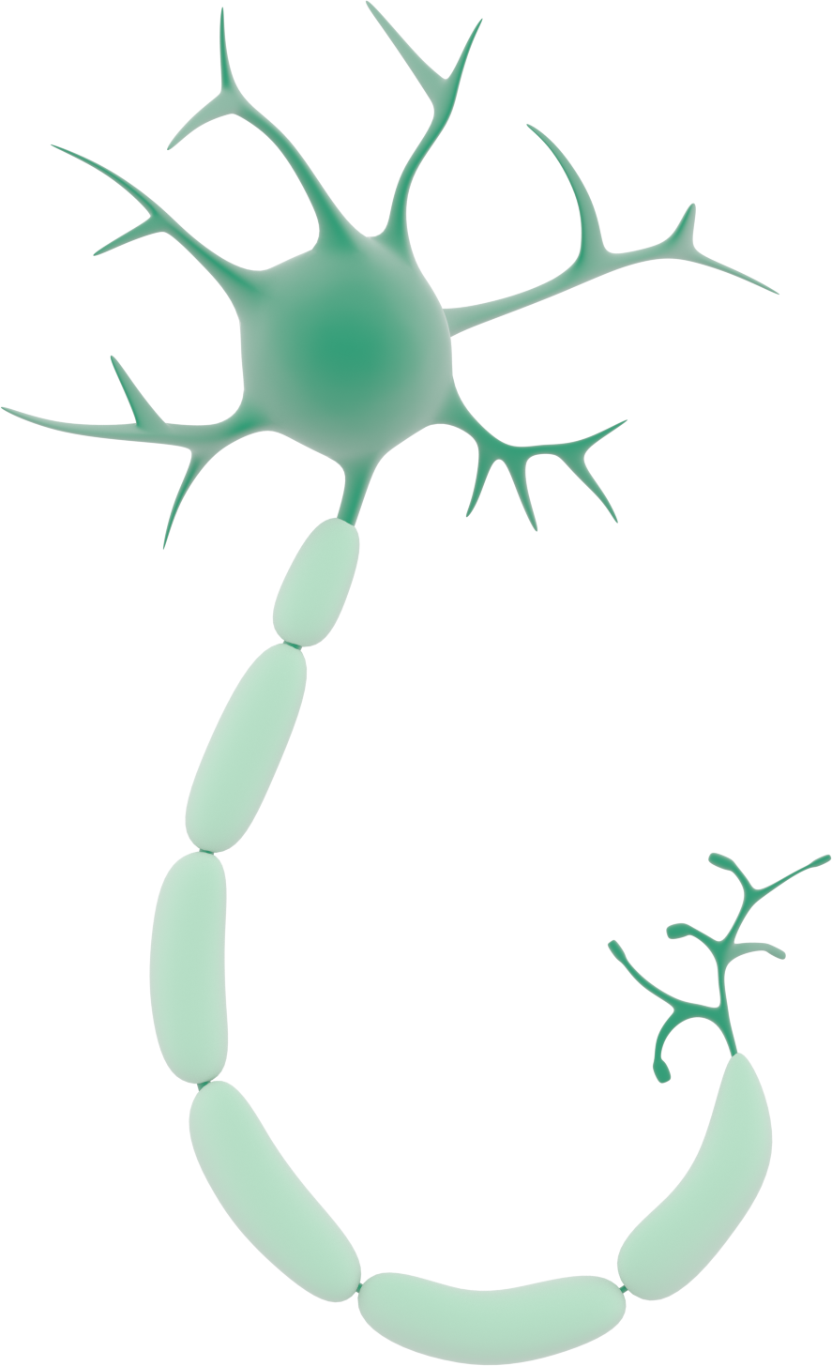
Axons work as electric cables connecting different neurons
Myelin =
Makes transmission messages faster

Slide 8
Action Potential
-
Ion negative charged
+
Ion positive charged
-
-
+
-
+
+
+
-
-
+
-
-
+
+
-
-
+
+
+
+
+
+
+
+
+
+
-
-
+
-
-
-
-
+
-
+
-
+
+
-
+
-
-
+
-
+
-
-
+
-
+
-
-
-
+
+
+
+
-
+
-
-
+
Movements of ions in and out of the neuron

Slide 9
Classroom activity

Slide 10
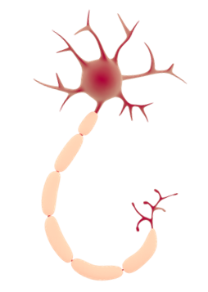
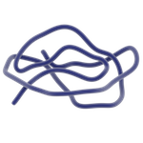
Neuron membrane
-
Ion negative charged
+
Ion positive charged
Voltage-gated channel
Outside cell (+)
Inside cell (-)

Slide 11
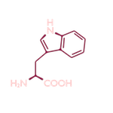
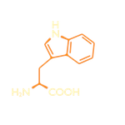
Signal arrives to the neuron
-
Ion negative charged
+ ions rush into the cell
+
Ion positive charged
Outside cell (-)
Stimulus
Inside cell (+)

Slide 12
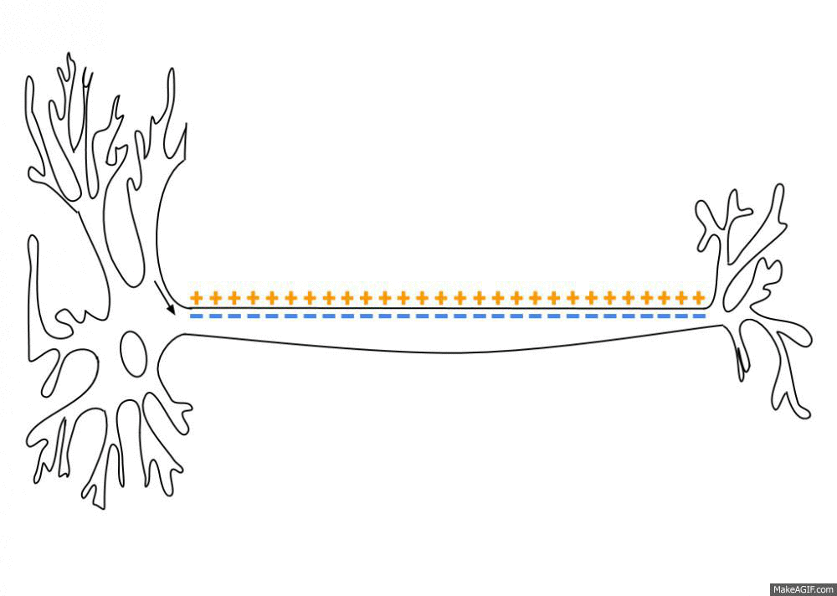
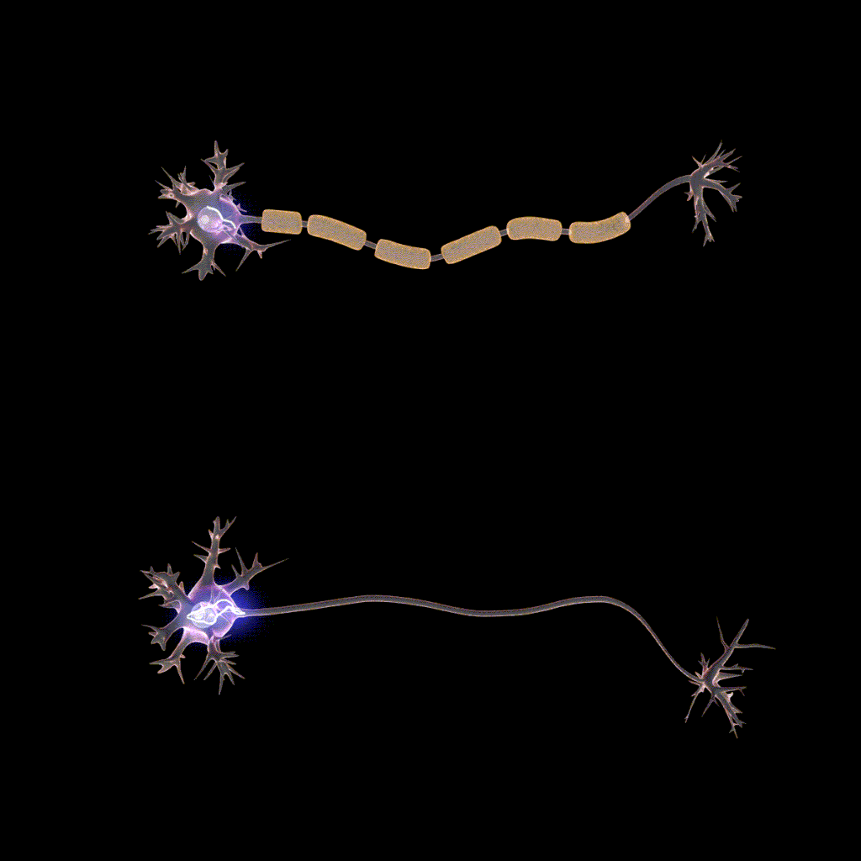
Electric transmission like a ‘sea wave’
Myelinated axon
Non-myelinated axon

Slide 13
Refractory period
-
Ion negative charged
+
Ion positive charged
+ ions leaves the cell
Outside cell (+)
Inside cell (-)

Slide 14
A gap called synapse
Synaptic vesicle
Neurotransmitters
Receptor for neurotransmitter
Ion channels

Slide 15
Activity - Neuron Race

