Slide 1



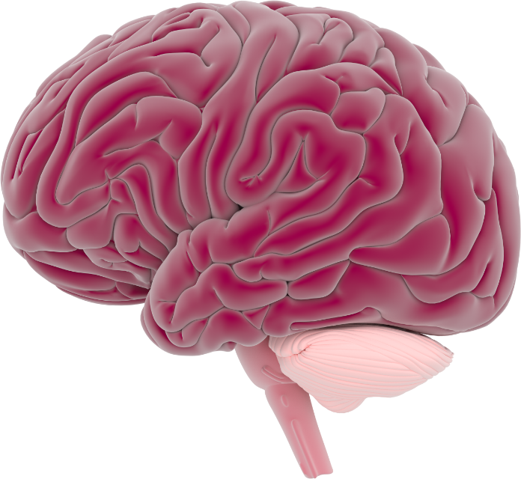
This activity has been supported
by a grant from Roche Products Ltd
Mental Health
& Wellbeing
'Presenter 1'
'Presenter 2'
Notes:
Briefly Introduce myself

Slide 2
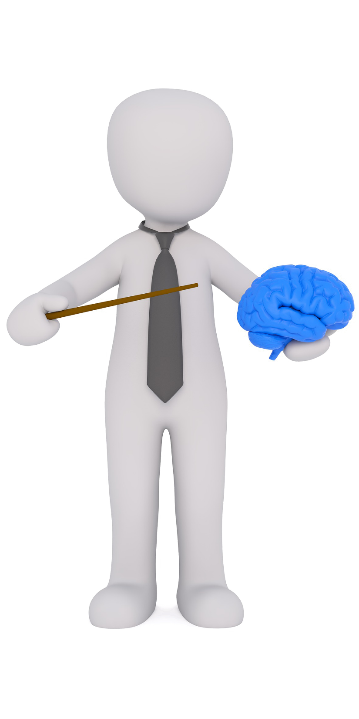
Our is responsible for our feelings & emotions
brain
Notes:
Briefly Introduce myself

Slide 3

Draw your
experiences
& emotions
Notes:
Briefly Introduce myself

Slide 4
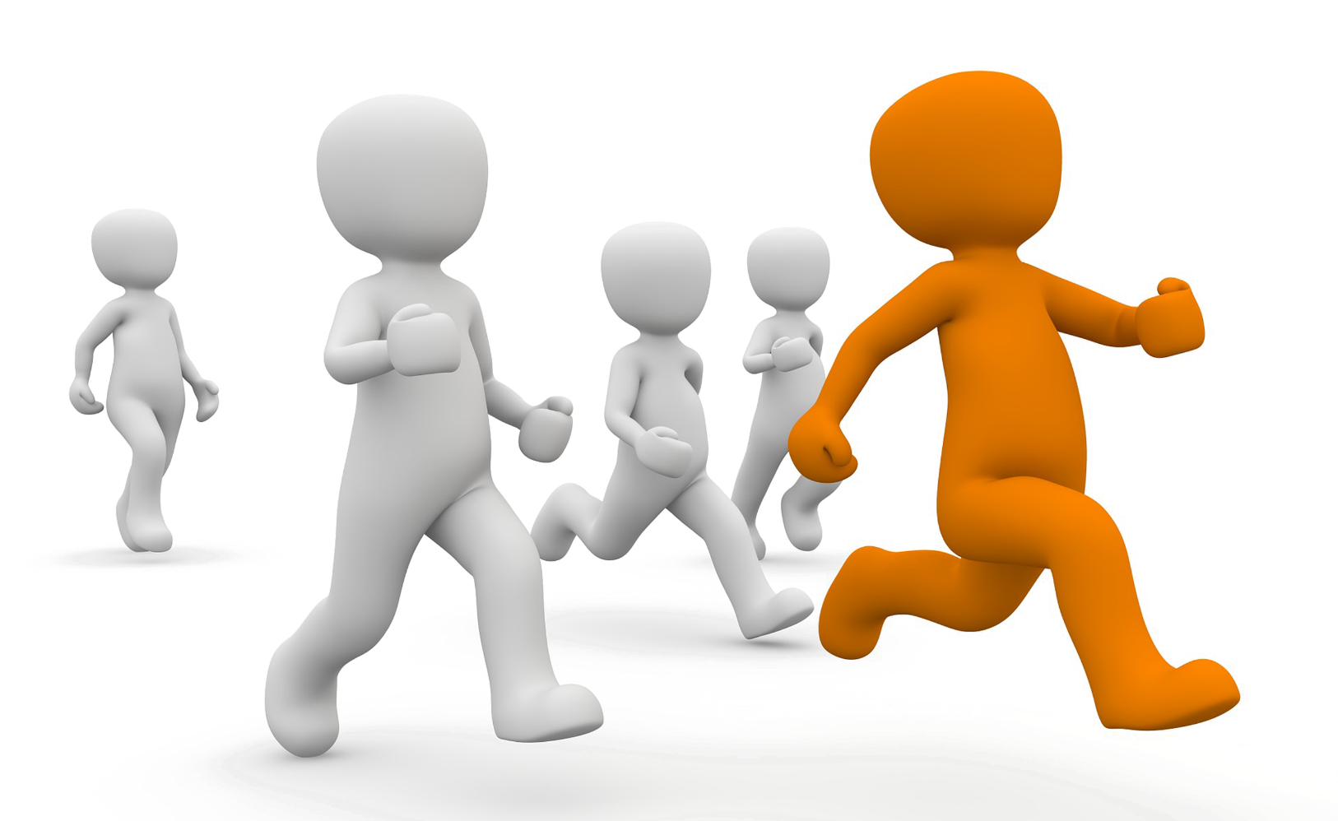
Usually our feelings only last a short time…
Notes:
Briefly Introduce myself

Slide 5

…but sometimes they
can stay with us longer
Notes:
Briefly Introduce myself

Slide 6
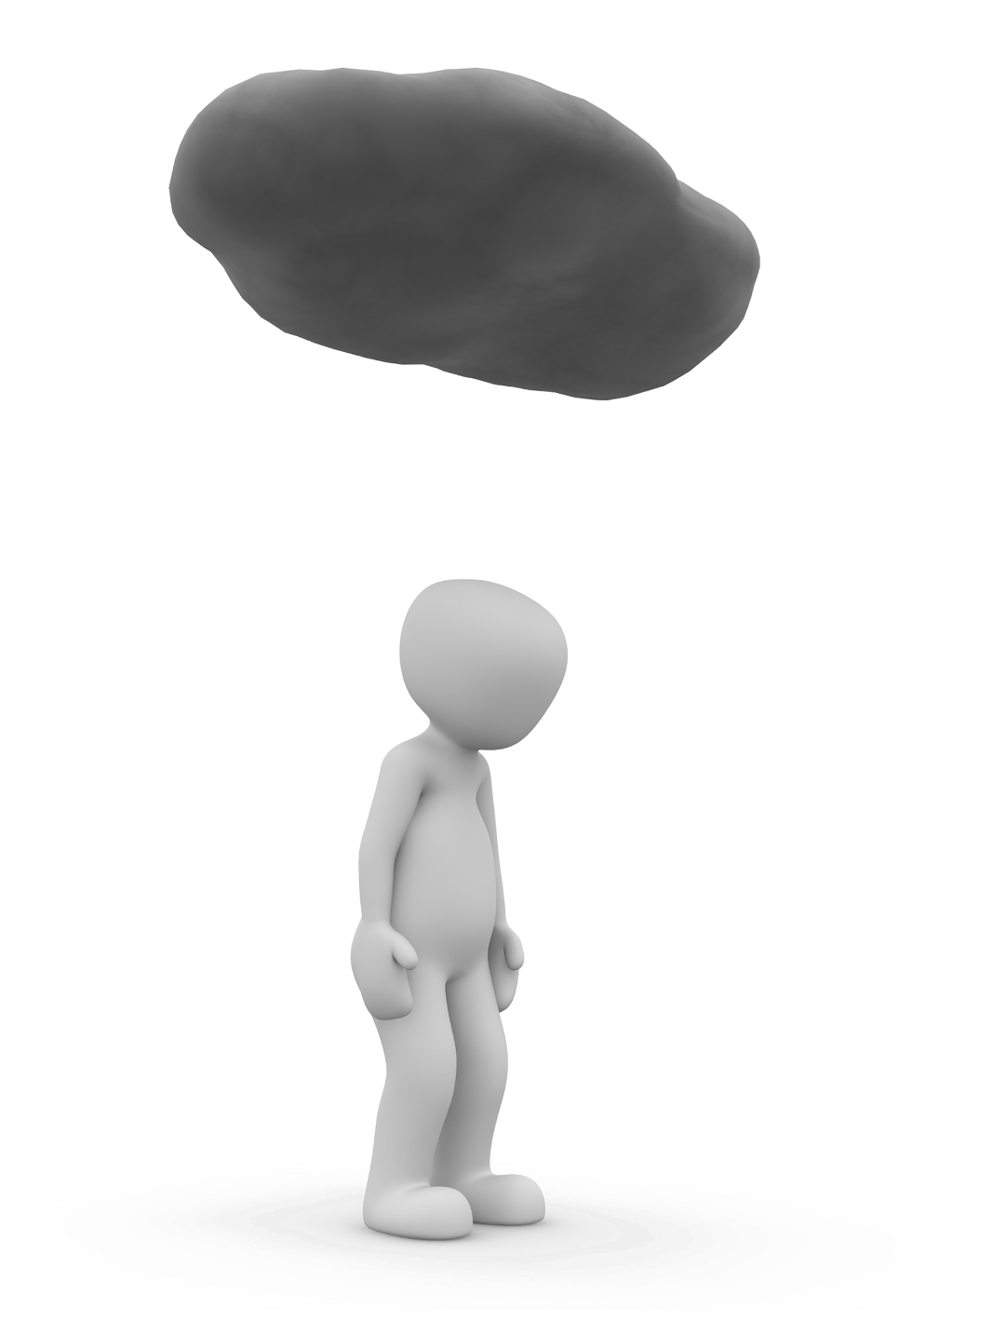
We may feel worried or sad because:
we have a lot of work to do
we have changes at home like moving house
people are being unkind to us
no reason at all
You are not alone - everyone has these feelings
Notes:
Briefly Introduce myself

Slide 7
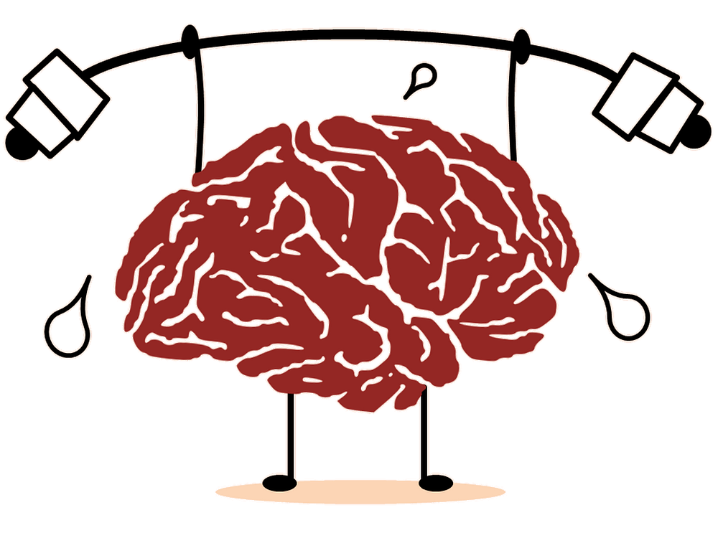
How can you keep your brain healthy?
Notes:
Briefly Introduce myself

Slide 8


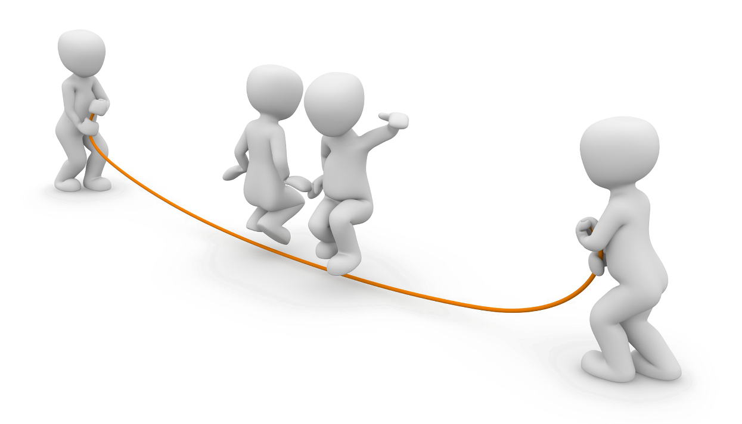
Exercising
Notes:
Briefly Introduce myself

Slide 9
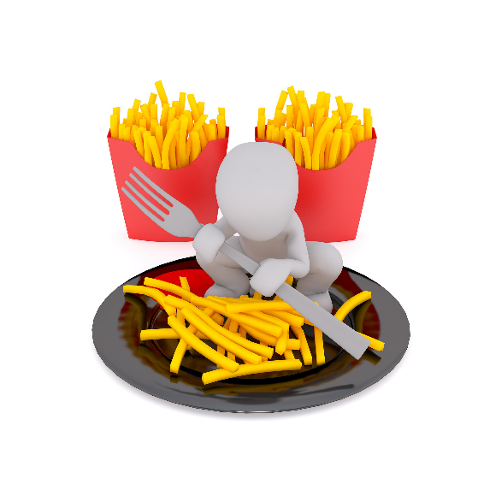
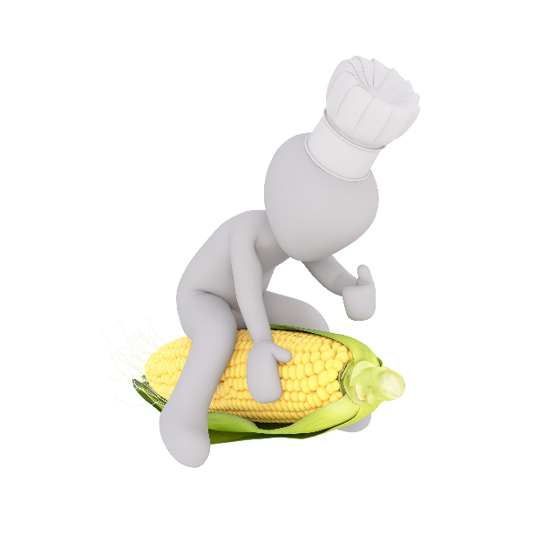
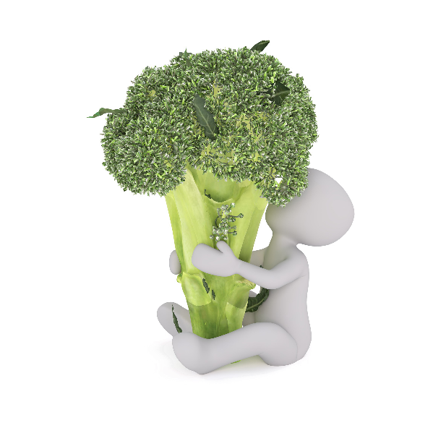
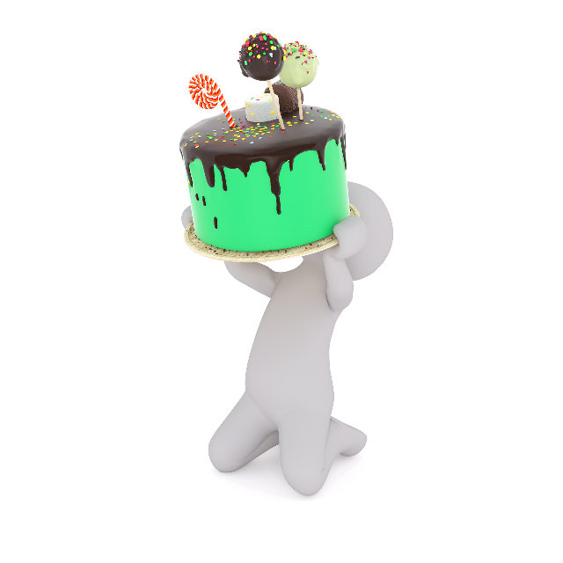


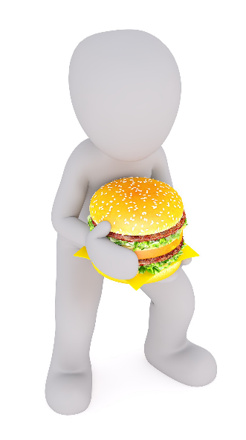
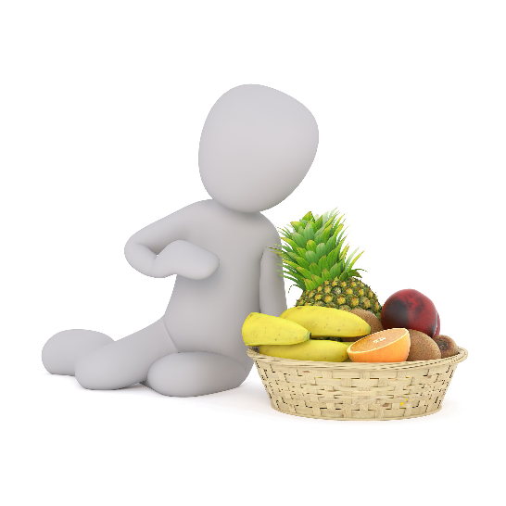
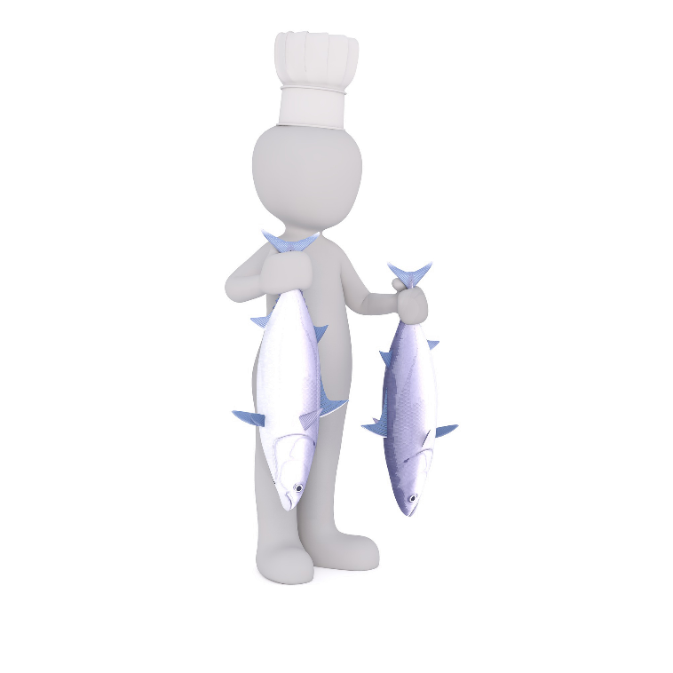

Eating healthy food
Notes:
Briefly Introduce myself

Slide 10
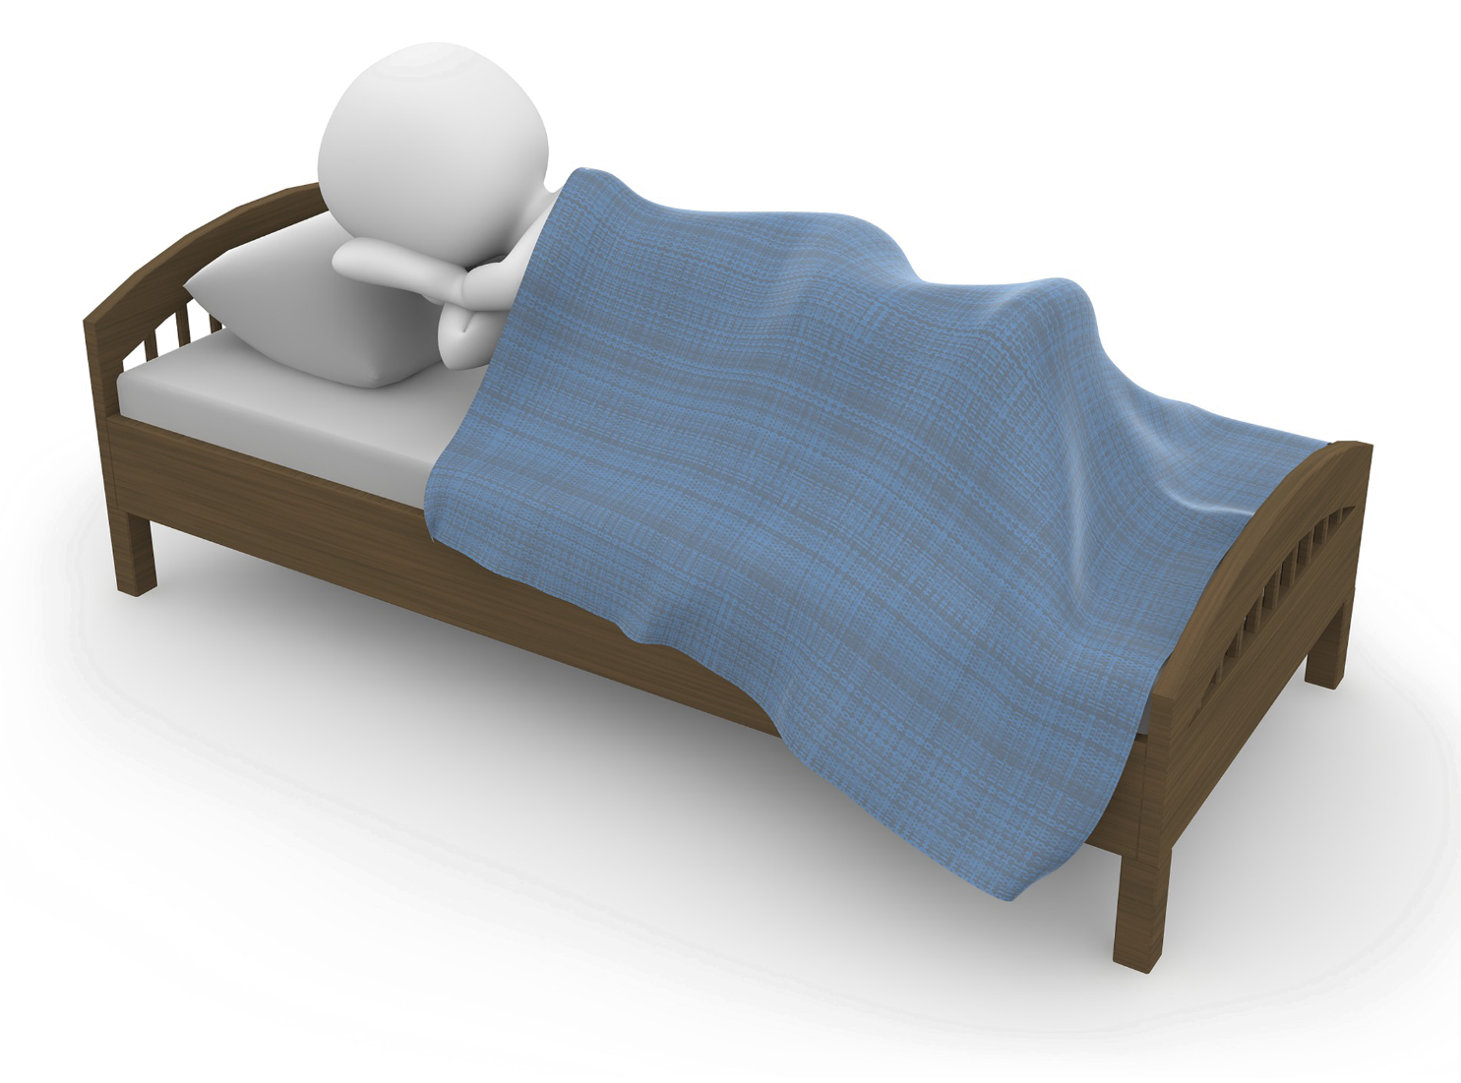


Getting plenty of sleep
Notes:
Briefly Introduce myself

Slide 11



Spending time with family and friends
Notes:
Briefly Introduce myself

Slide 12
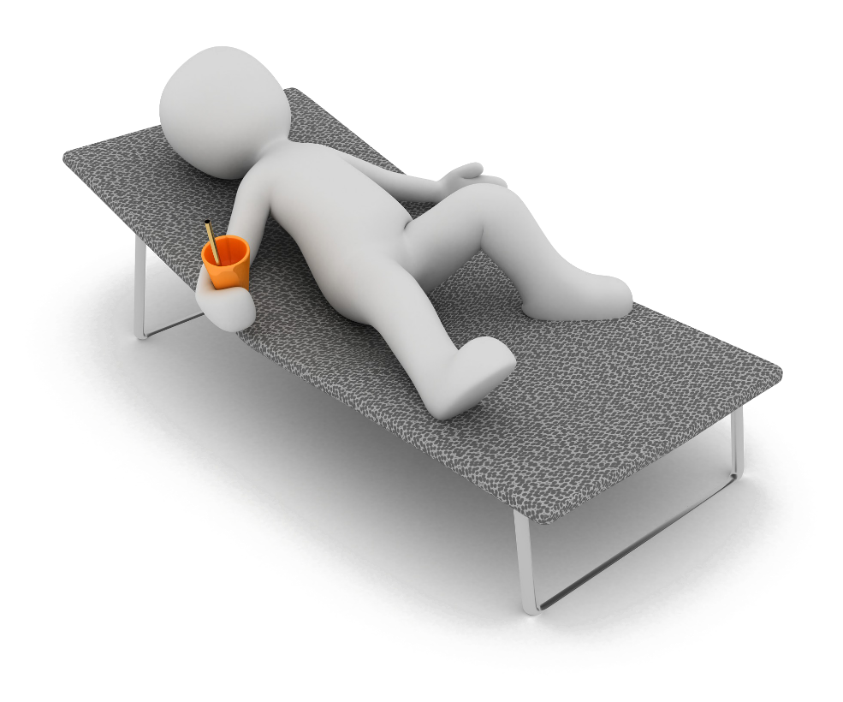
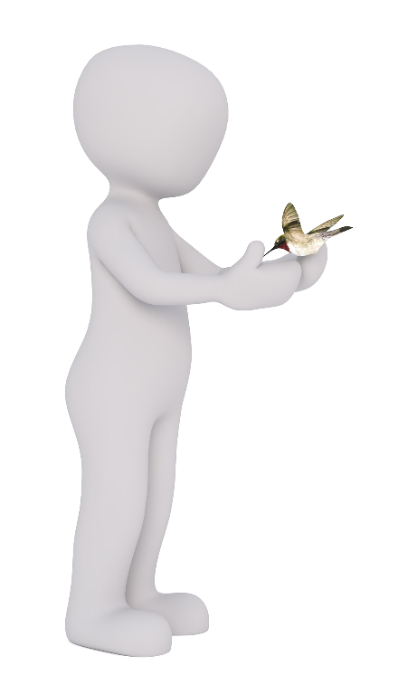
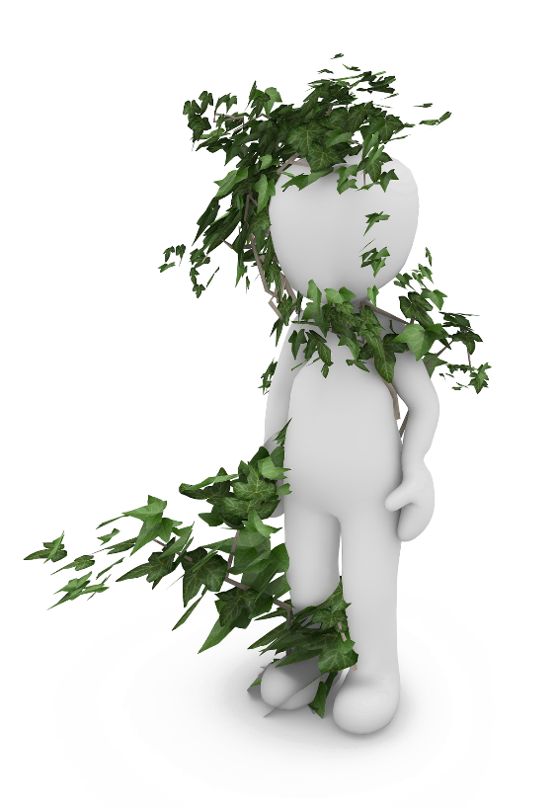

Relaxing, taking time for yourself and going out into nature
Notes:
Briefly Introduce myself

Slide 13

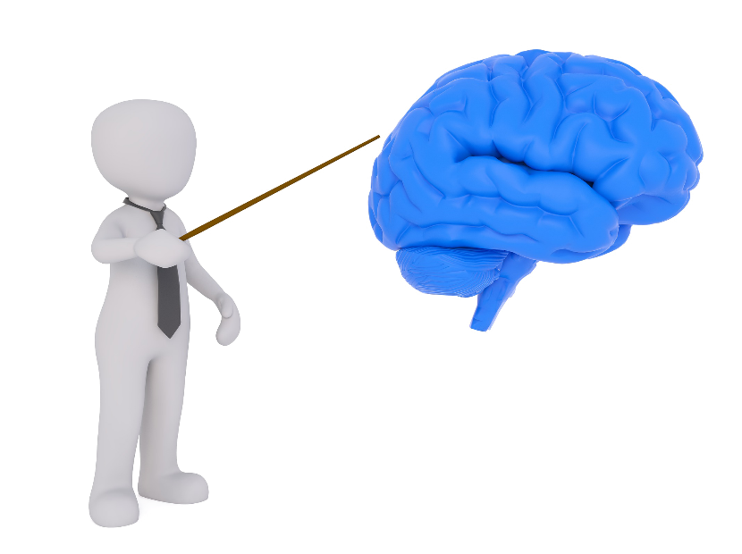
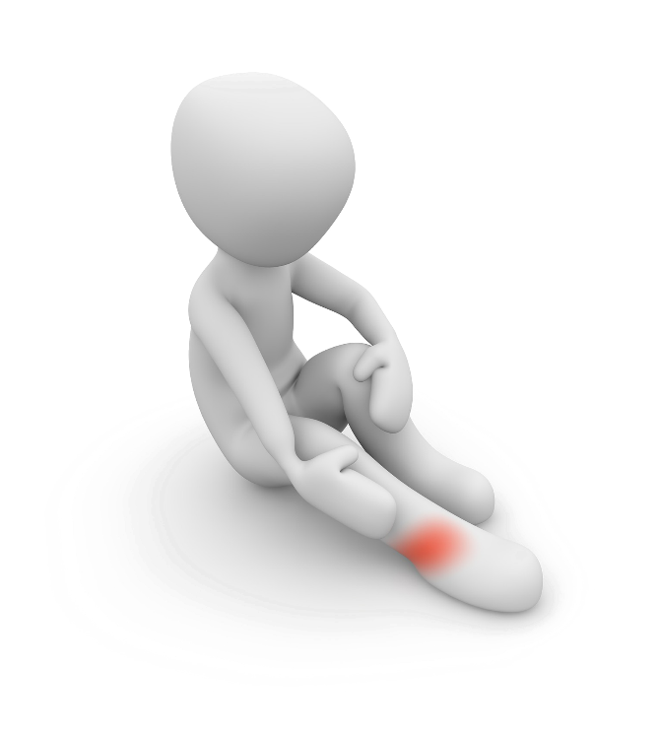

We can ask for help from our friends, family, teachers and the doctor
Notes:
Briefly Introduce myself

Slide 14

Our brain is responsible for our feelings & emotions which can last a short or long amount of time
We can help keep our brain healthy by:
  Exercising
  Eating healthy food
  Spending time and talking with others
  Relaxing, taking time for yourself and spending time in nature
We can ask for help from our friends, family, teachers and the doctor
Notes:
Briefly Introduce myself

