Slide 1



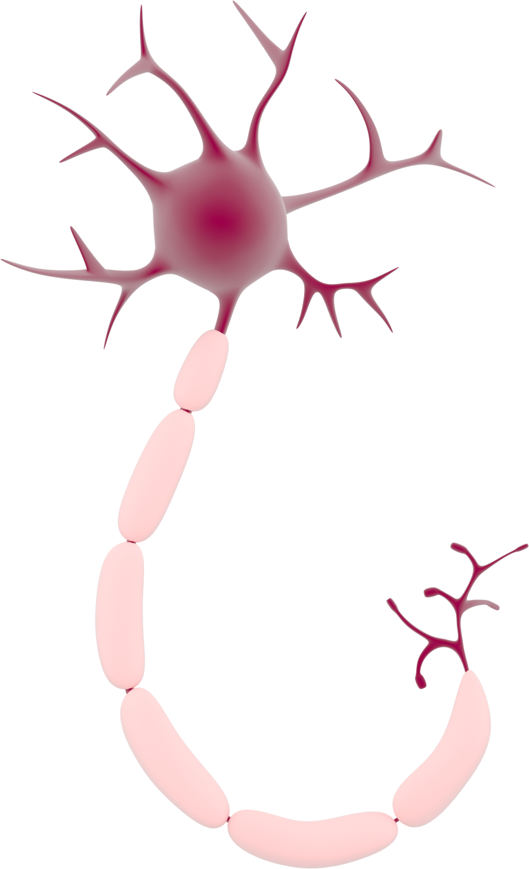
This activity has been supported
by a grant from Roche Products Ltd
Neuroethics
'Presenter 1'
'Presenter 2'
Notes:
Briefly Introduce myself

Slide 2




What is Artificial Intelligence (AI)?
Think & Learn
Computer
Robot
Notes:
Briefly Introduce myself

Slide 3




How does it work?
Notes:
Briefly Introduce myself

Slide 4

How does it work?
=
Notes:
Briefly Introduce myself

Slide 5




How much progress have we made?
Play games against us
Guess human drawings
Understand our speech
Drive cars
Notes:
Briefly Introduce myself

Slide 6
Should we allow robots to become as smart as humans?
What are the advantages?
What are the disadvantages?
Do they need a set of rules?
Should we treat them the same as humans?
Notes:
Briefly Introduce myself

Slide 7

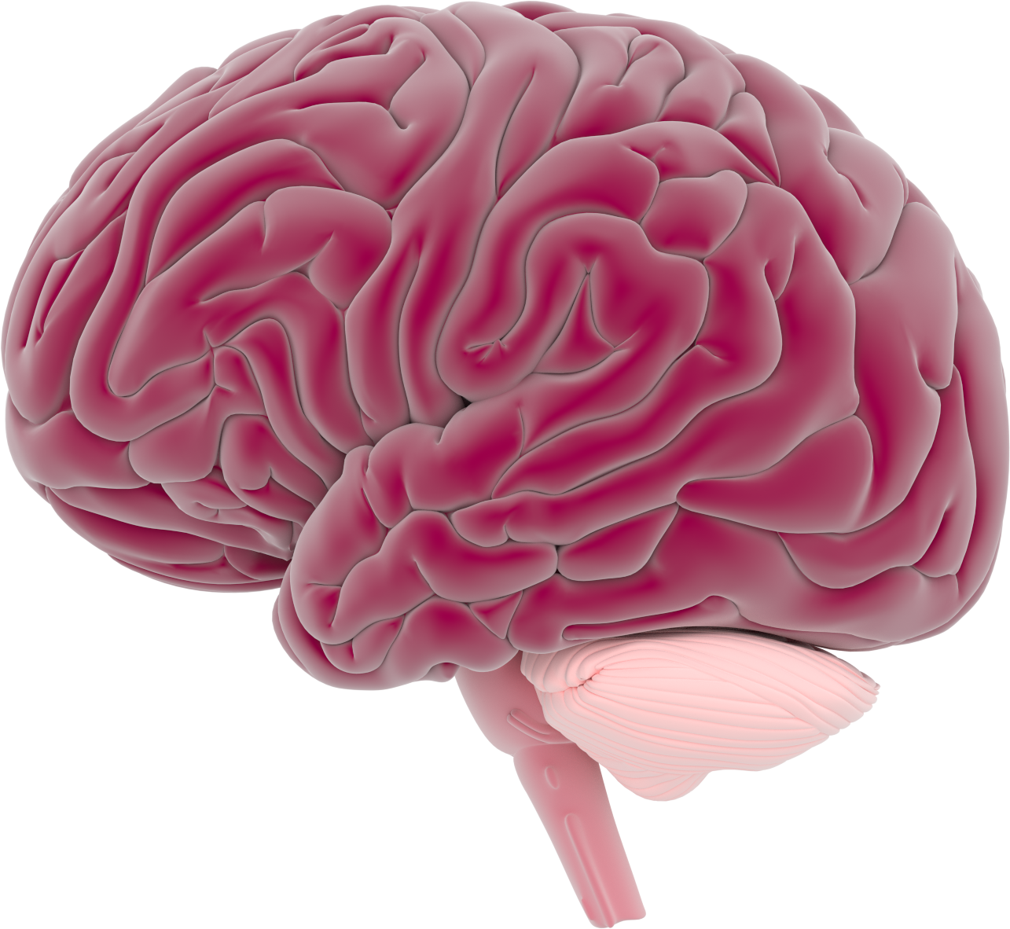
Reading Minds
Should we be allowed to read minds?
When should we be able to read minds?
Who should be allowed to read our minds?
Should we be able to put people in jail if they think about doing a crime in the future?
Notes:
Briefly Introduce myself

Slide 8
Changing Memories
Should we be allowed to change memories?
When should we be able to change memories?
Who should be allowed to change our memories?
Notes:
Briefly Introduce myself

