Slide 1
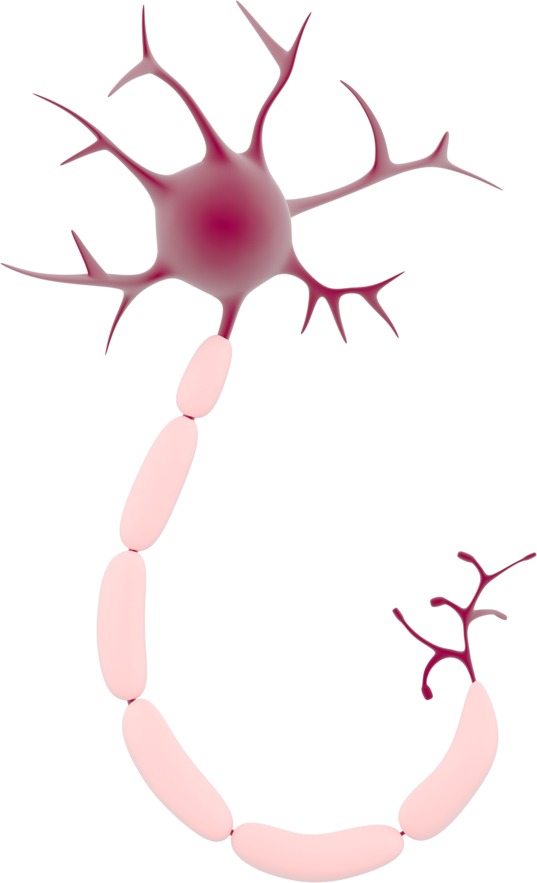
This activity has been supported by a grant from Roche Products Ltd
Neuroethics
'Presenter 1'
'Presenter 2'
Notes:
Briefly Introduce myself

Slide 2
What is Artificial Intelligence (AI)?
Think & Learn
Computer
Robot
Notes:
Briefly Introduce myself

Slide 3
How does it work?
Notes:
Briefly Introduce myself

Slide 4
How does it work?
=
Notes:
Briefly Introduce myself

Slide 5
How much progress have we made?
Play games against us
Guess human drawings
Understand our speech
Drive cars
Notes:
Briefly Introduce myself

Slide 6
Should we allow robots to become as smart as humans?
Q1. If AI develops consciousness, how would society change to accommodate AI rights?
How would AI fit into society?
Q2. Do AI need rules or a code to follow?
Notes:
Briefly Introduce myself

Slide 7
Should we allow robots to become as smart as humans? cont.
Q3. Should people spend their lives actually living instead of working?
Q4. If so, how would wealth be distributed?
Q5. What if AI surpasses human intelligence? What affect could this have on human rights and society?
Notes:
Briefly Introduce myself

Slide 8
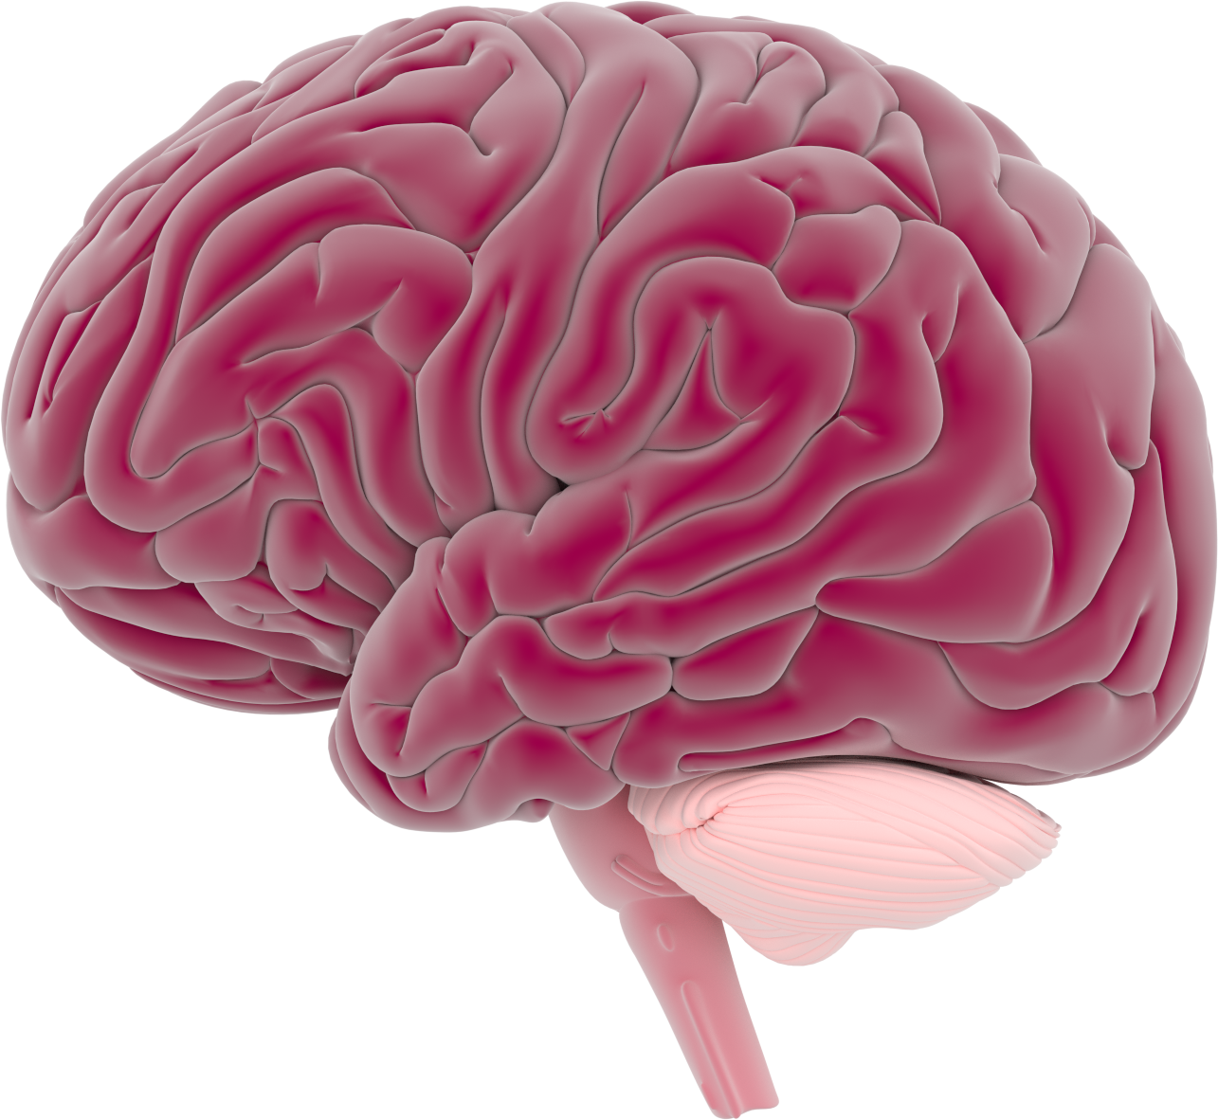
Reading Minds
Should we be allowed to read minds?
Q1. When should we be able to read minds?
Q2. Who should be allowed to read our minds?
Q3. Should we be able to put people in jail if they think about doing a crime in the future?
Notes:
Briefly Introduce myself

Slide 9
Reading Minds
Should we be allowed to read minds?
Q4. What if reading minds did not inform you about a person’s intent, should you be able to read their mind?
Q5. What if reading minds did not inform you of neurological medical conditions, should you be able to read their mind?
Q6. Should we read the minds of people in a vegetative state (coma)?
Notes:
Briefly Introduce myself

Slide 10
Changing Memories
Should we be allowed to change memories?
Q1. When should we be able to change memories?
Q2. Who should be able to change memories?
Q3. Should there be a limit on which memories that can we change?
Q4. What affect does changing memories have on people? And society?
Notes:
Briefly Introduce myself

Slide 11
Genetic Modification
Should we be allowed use genetic modification?
Q1. Should we use gene editing to get rid of disorders?
Q2. Should we improve people’s brains such as intelligence, personality or reflexes?
Q3. What limitations should there be and who decides that?
Q4. Should employers only hire people that have been modified to the suitable level for the job?
Notes:
Briefly Introduce myself

