Slide 1
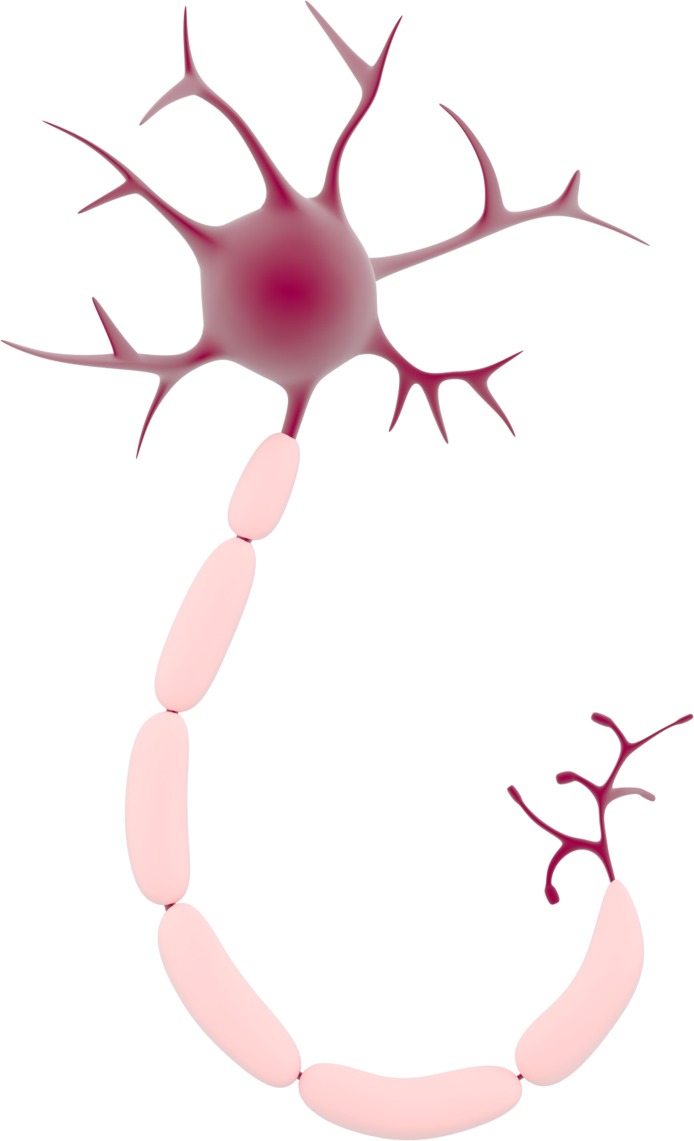
Make a neuron
Notes:
Briefly Introduce myself

Slide 2
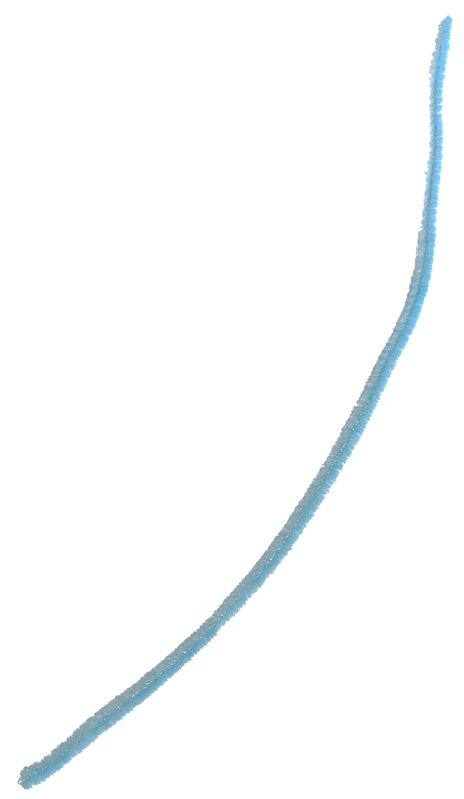
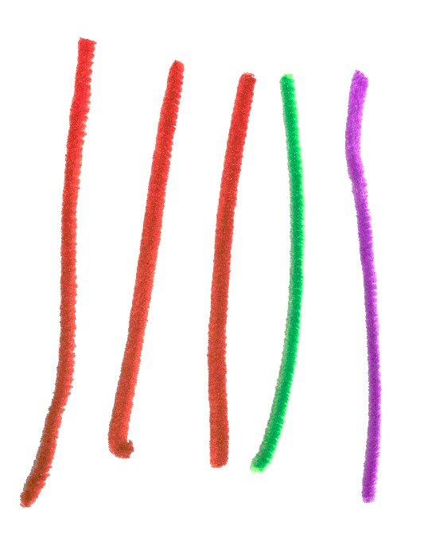
You will need:
1 x long pipe cleaner
5 x short pipe cleaners
Notes:
Briefly Introduce myself

Slide 3
Step 1: Take one long pipe cleaner & roll half of it into a ball.
Cell body
Axon
Notes:
Briefly Introduce myself

Slide 4
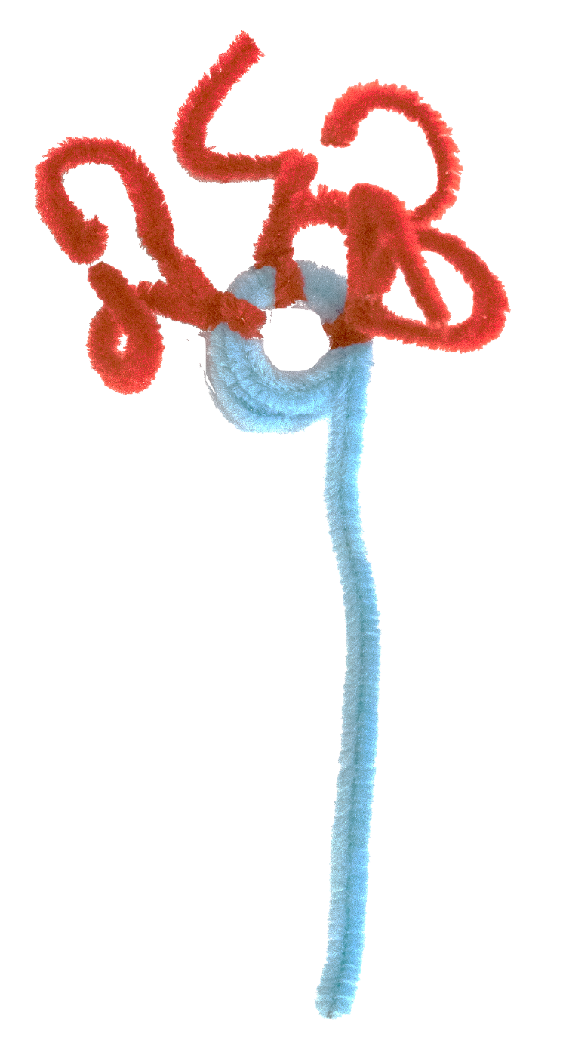
Step 2: Take short pieces of pipe cleaner and push them into the cell body. Repeat two times.
Dendrites
Notes:
Briefly Introduce myself

Slide 5
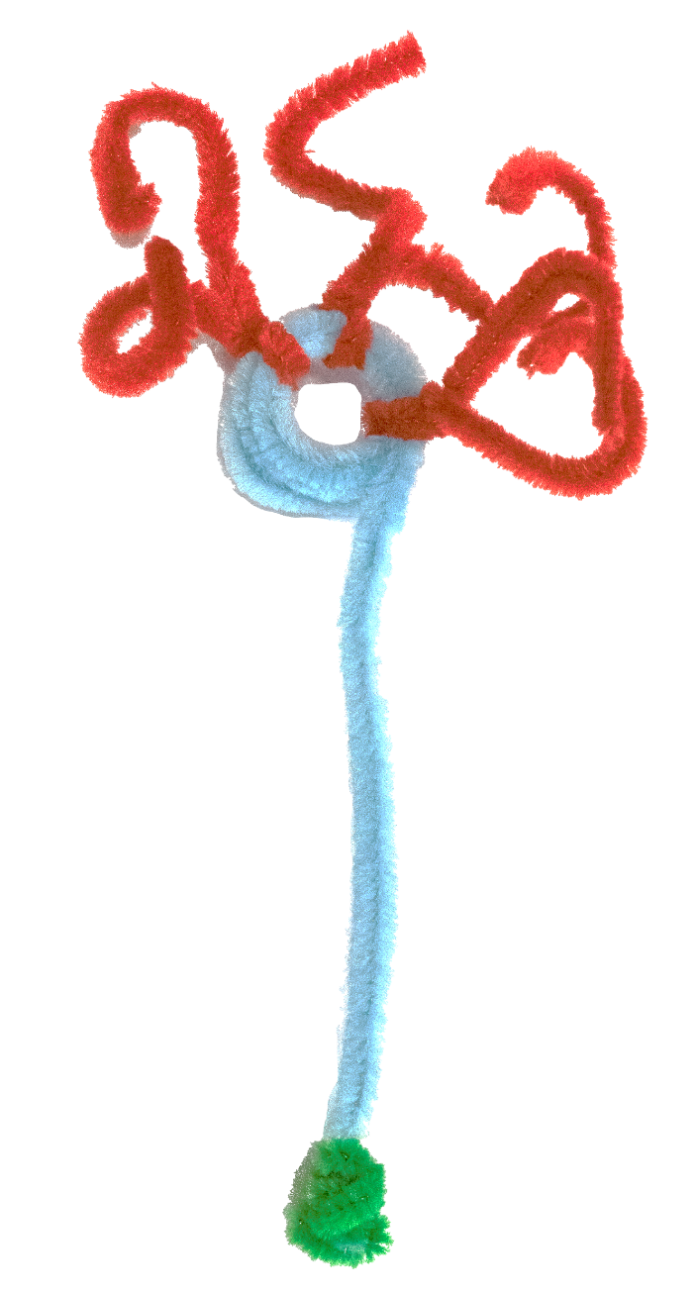
Step 3: Take another short piece of pipe cleaner and wrap it around the end of the long pipe cleaner (axon).
2
Axon terminal
Notes:
Briefly Introduce myself

Slide 6
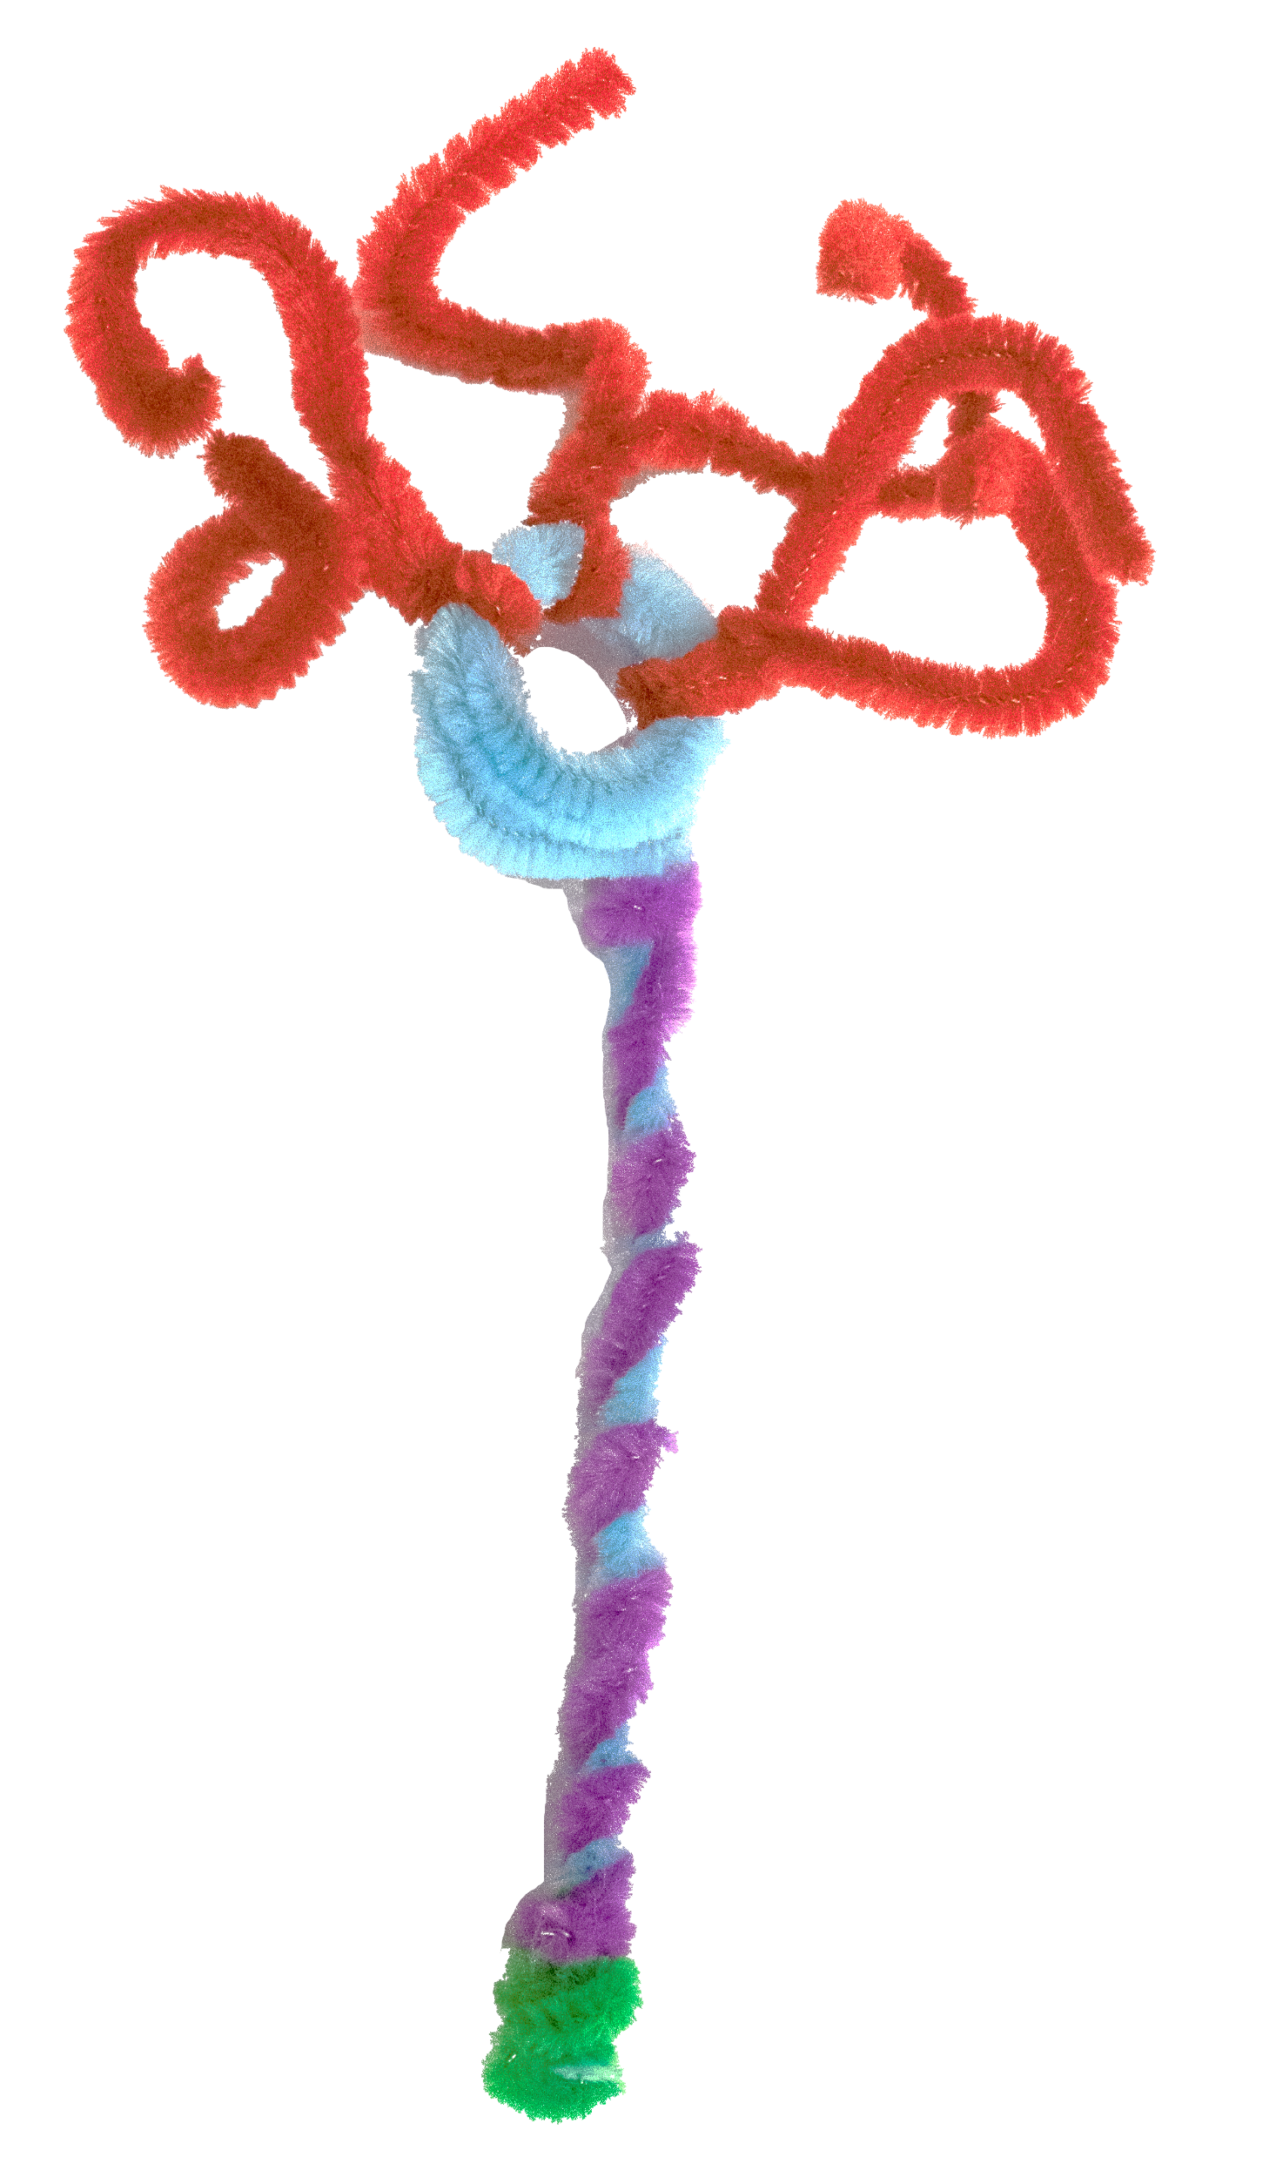
Step 4: Take the last short piece of pipe cleaner and wrap it along the axon.
2
Myelin sheath
Notes:
Briefly Introduce myself

