Slide 1


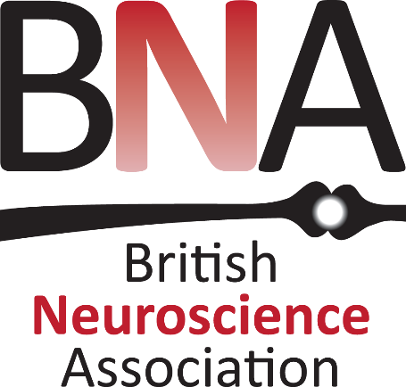
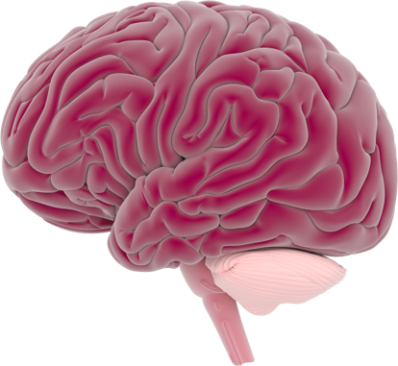
This activity has been supported
by a grant from Roche Products Ltd
Drugs
& Addiction
'Presenter 1'
'Presenter 2'

Slide 2
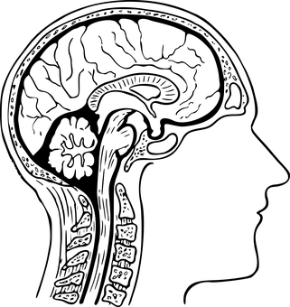
Contents:
What do you know about drugs?
The neuroscience of drug abuse
The neuroscience of drug addiction

Slide 3
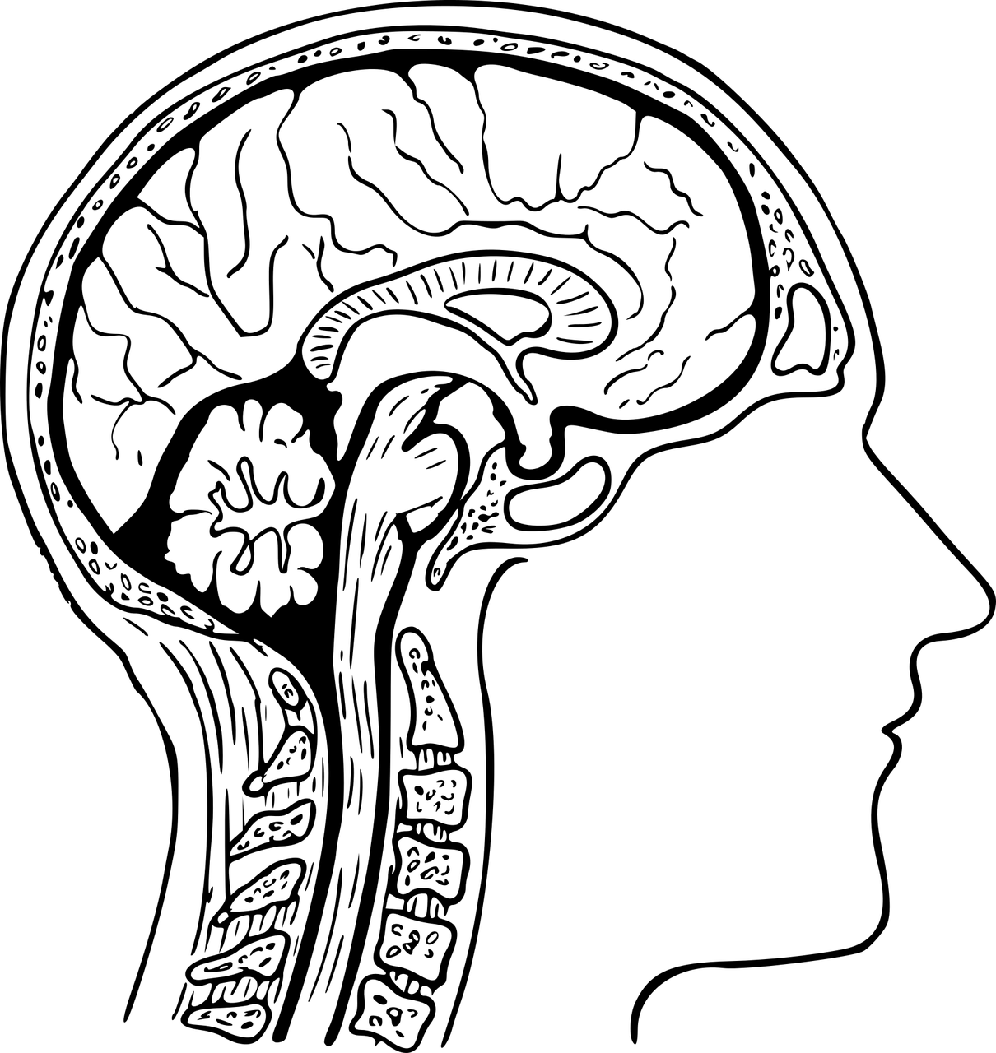
What do you know about drugs?

Slide 4

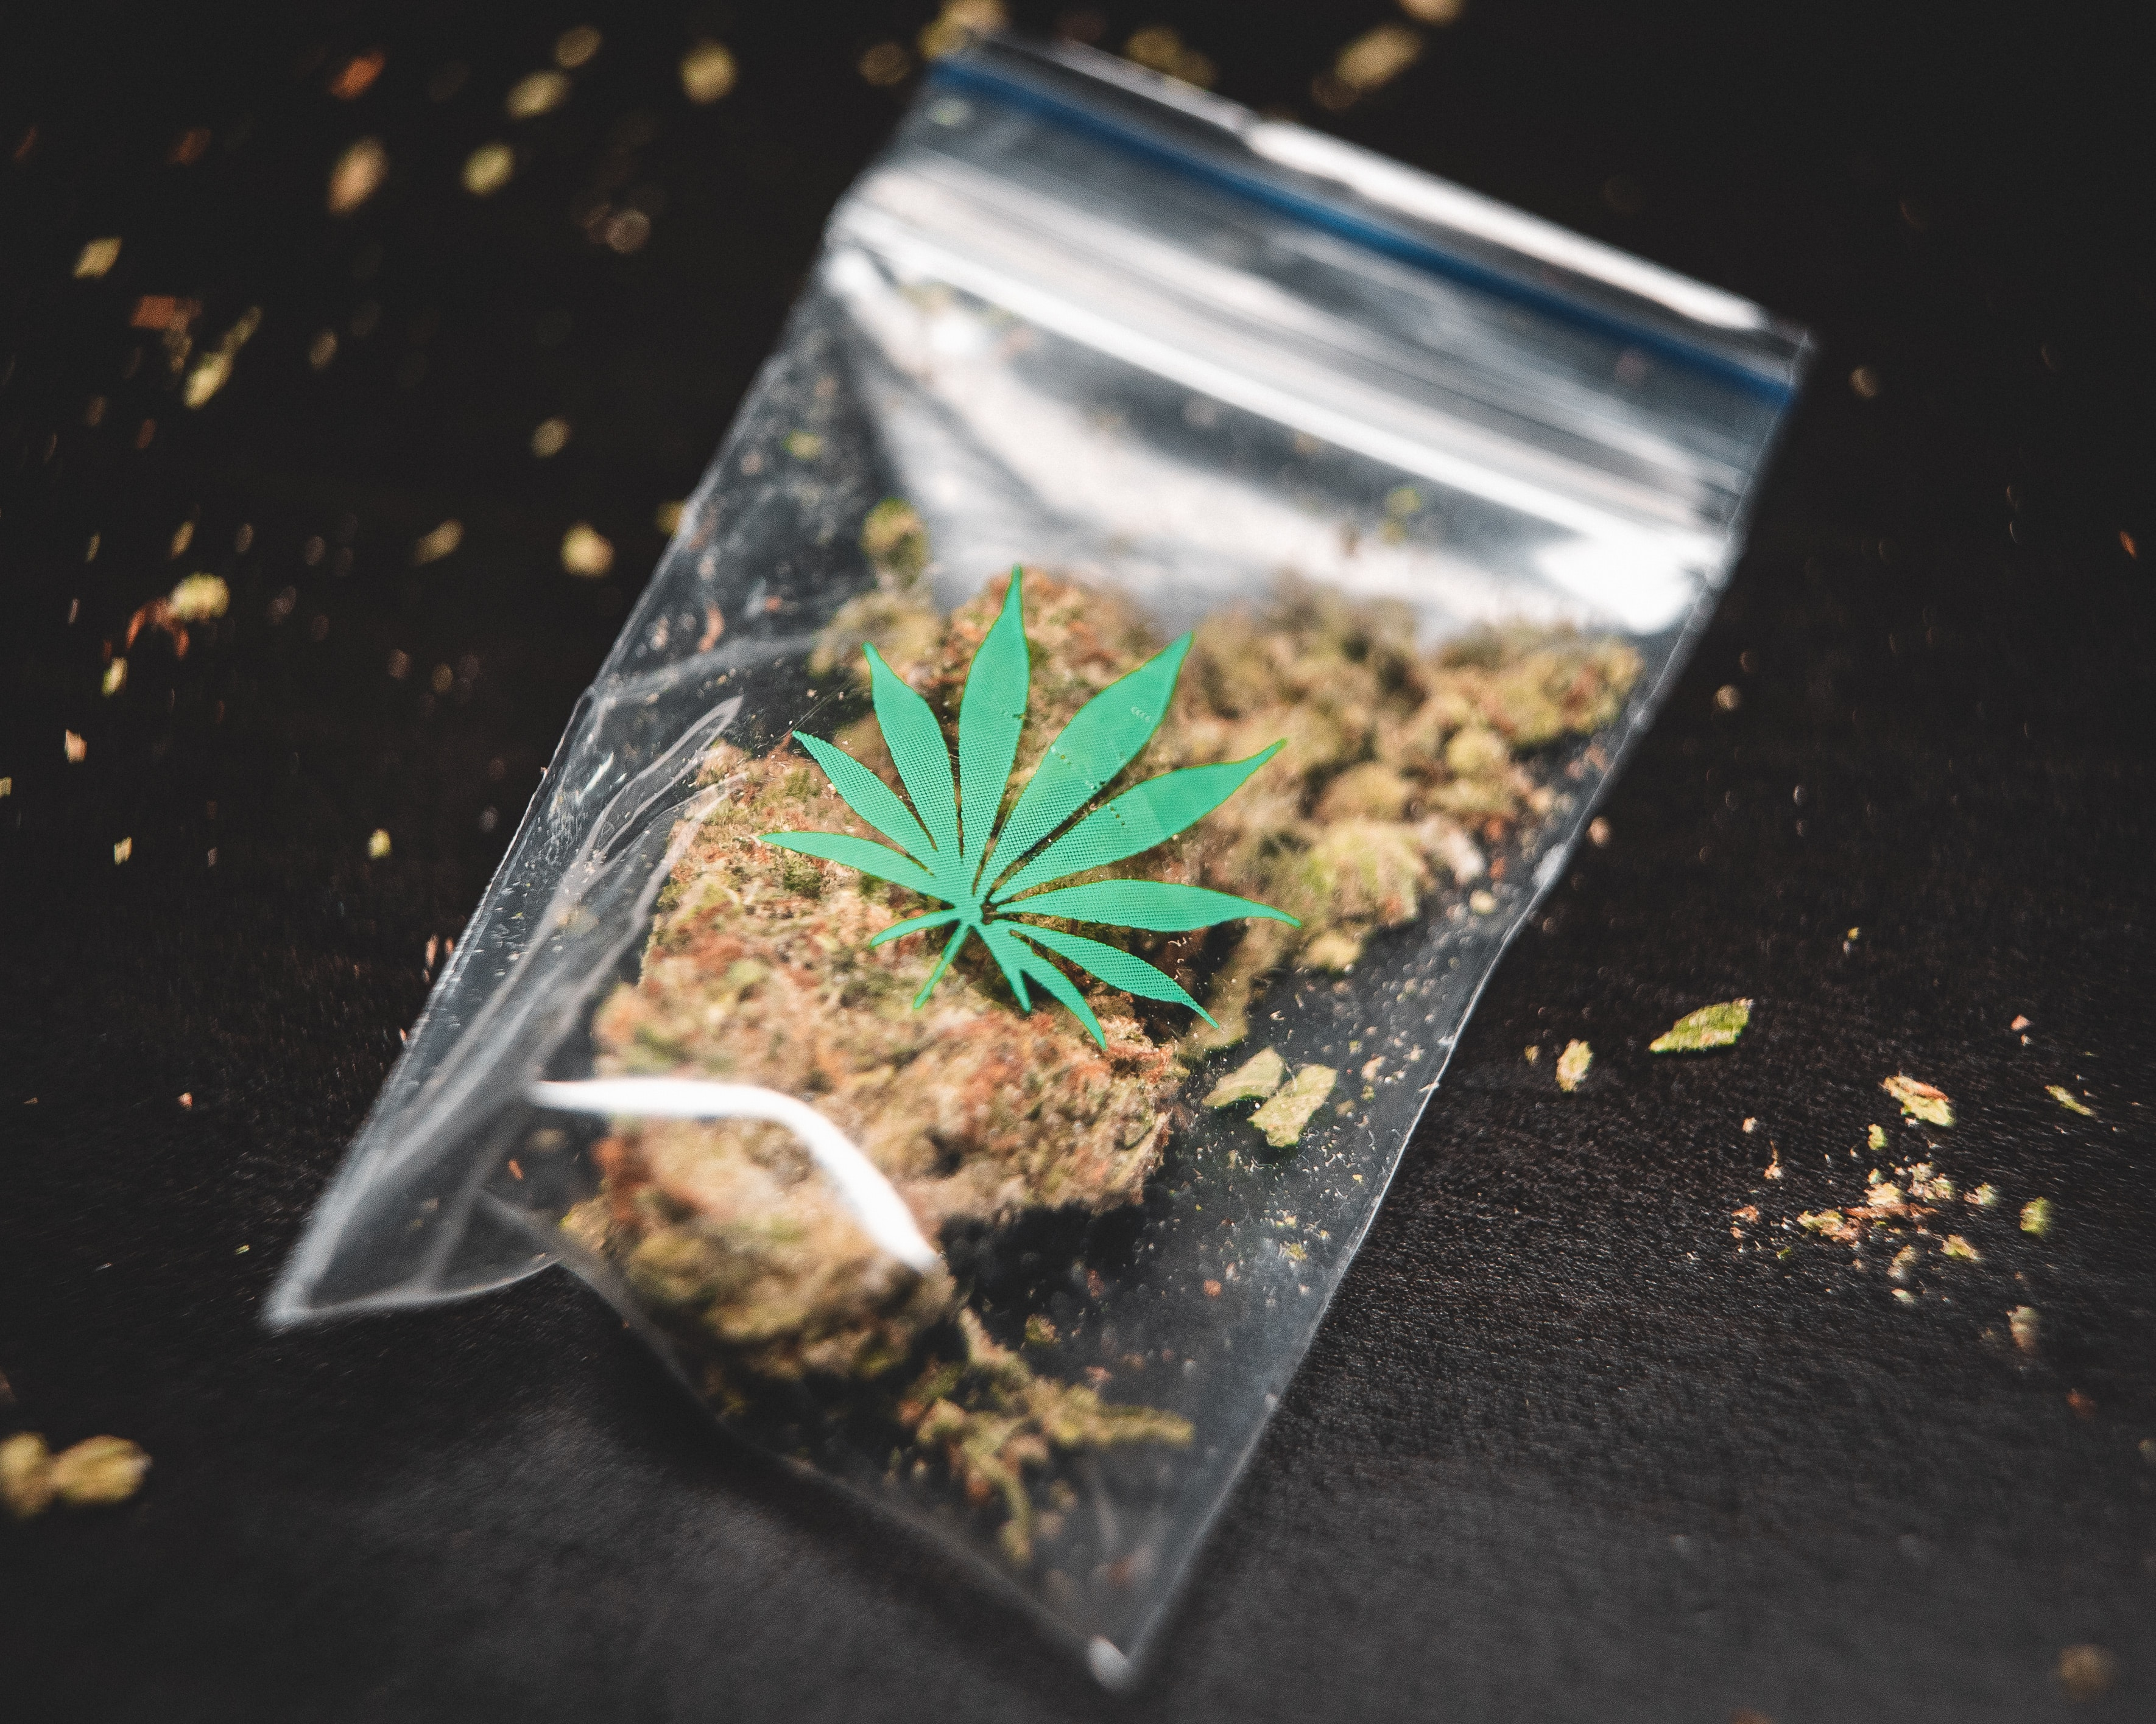
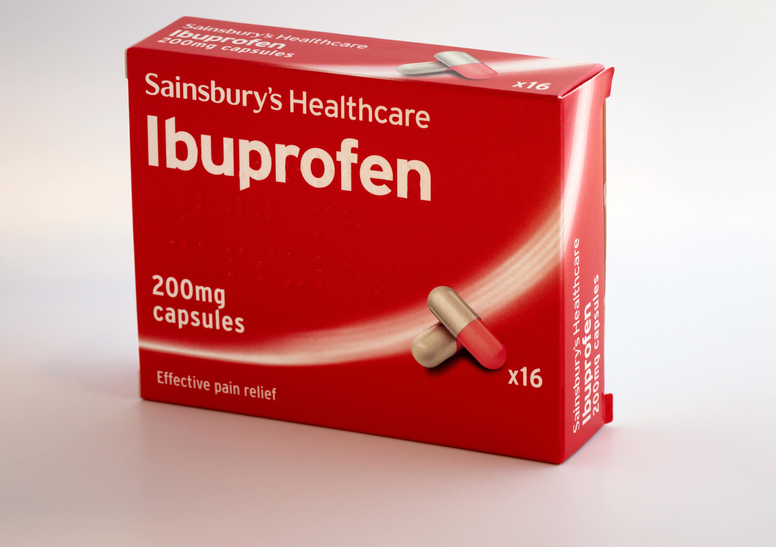
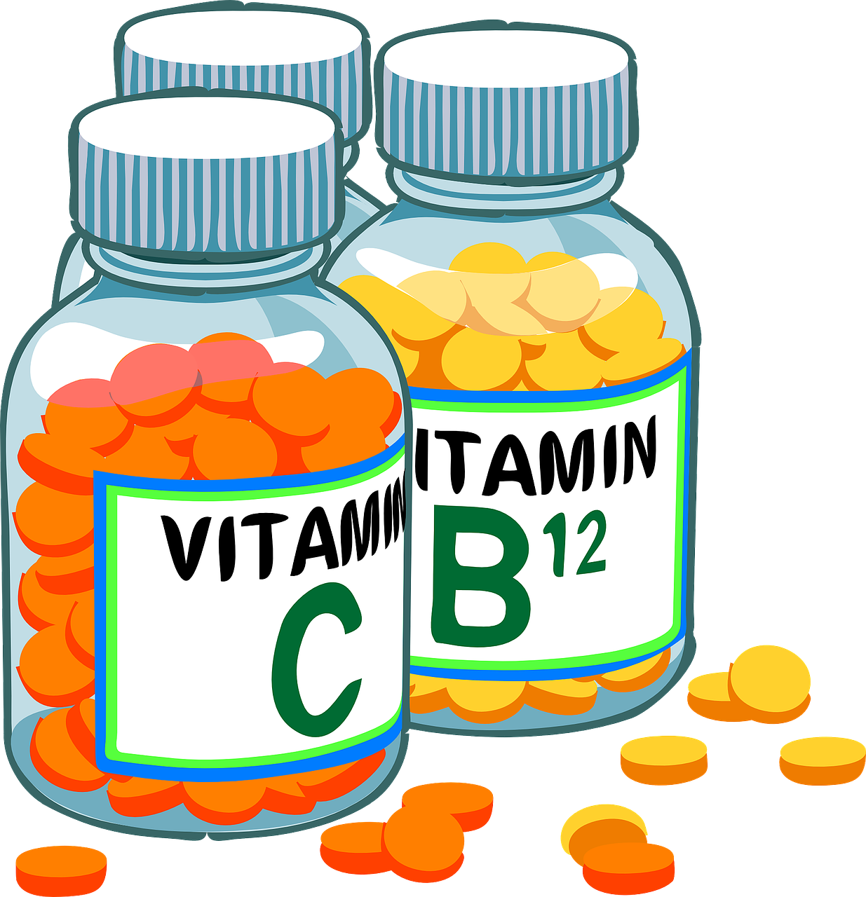
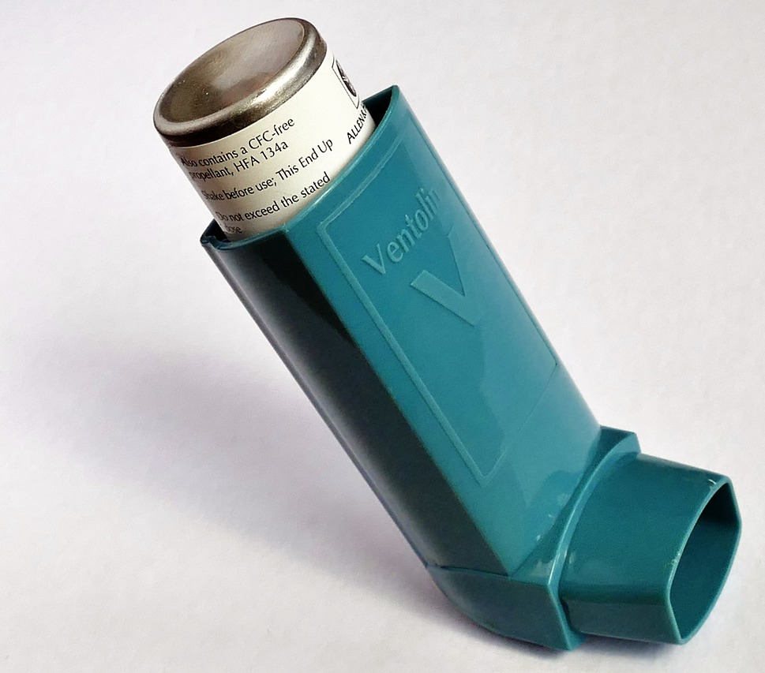

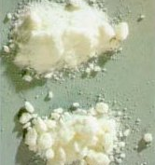
Medicines
Drugs of abuse

Slide 5
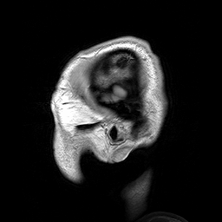
Neuroscience:
understanding drug abuse

Slide 6
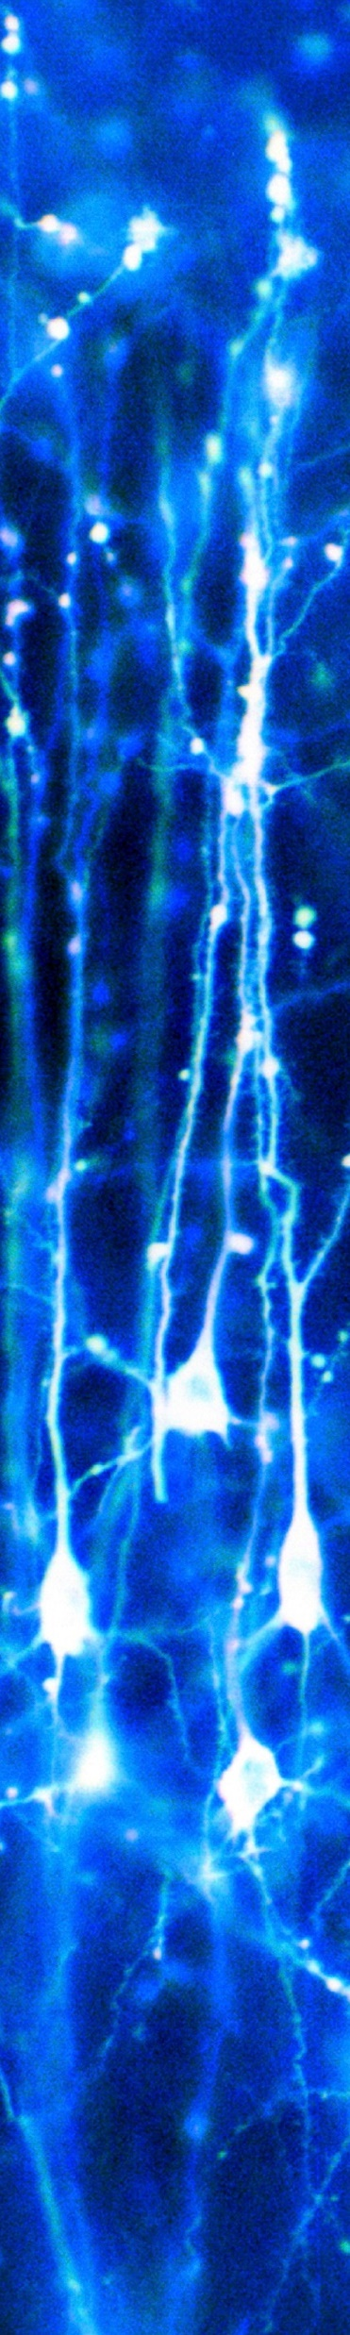
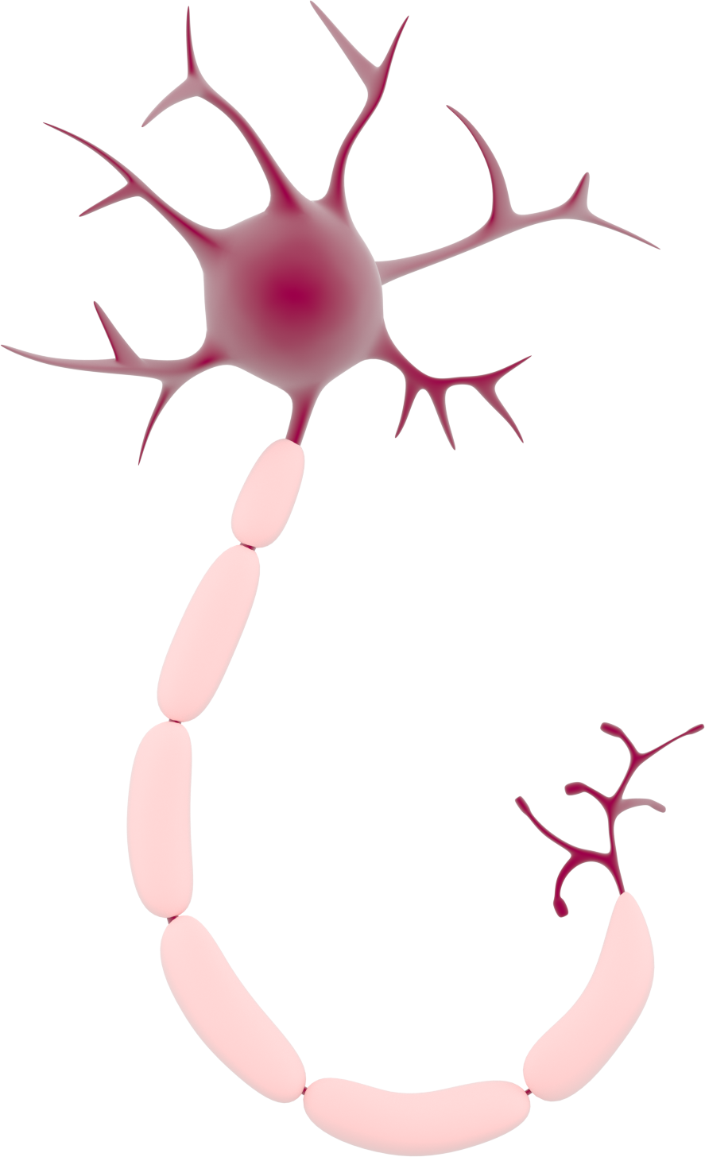
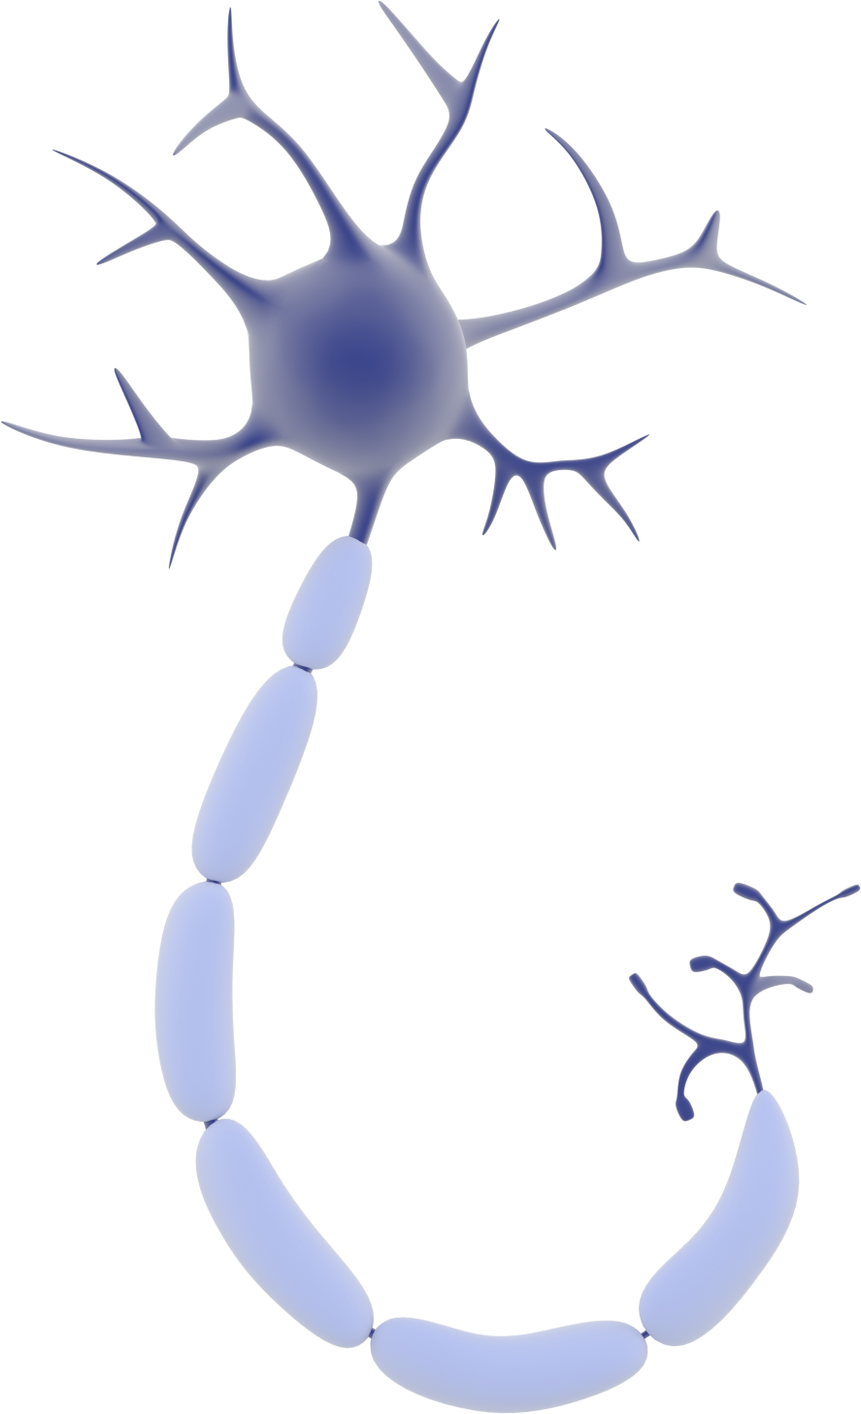
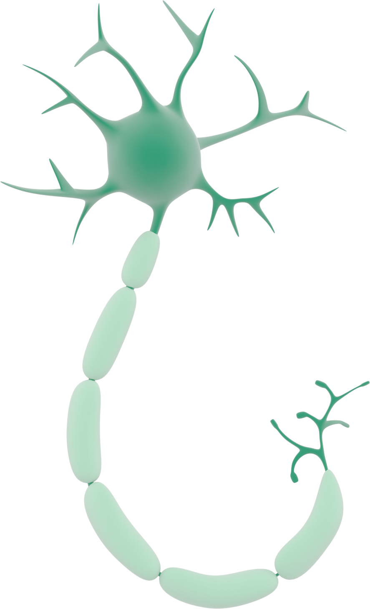
Neuron
Signal sent
Signal received
'Neurons in the brain' by Dr Jonathan Clarke

Slide 7
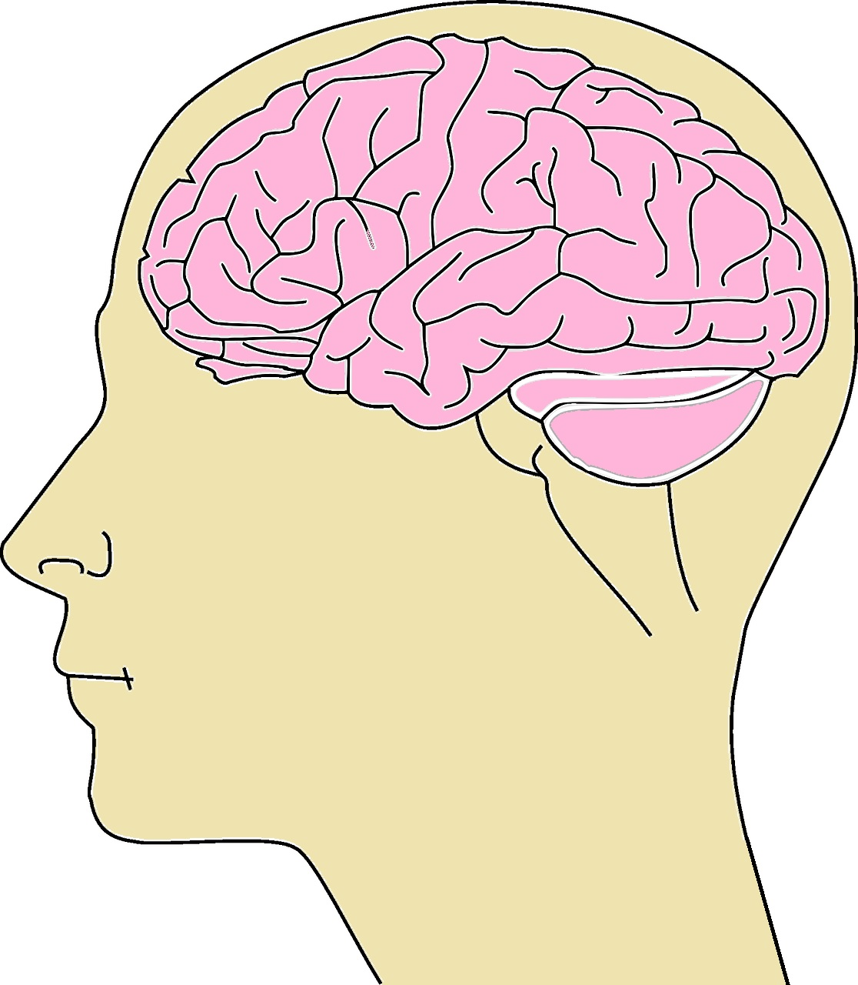

Neurons communicate by releasing chemicals called neurotransmitters into the synapse
Synapse
Chemicals in between neurons

Slide 8
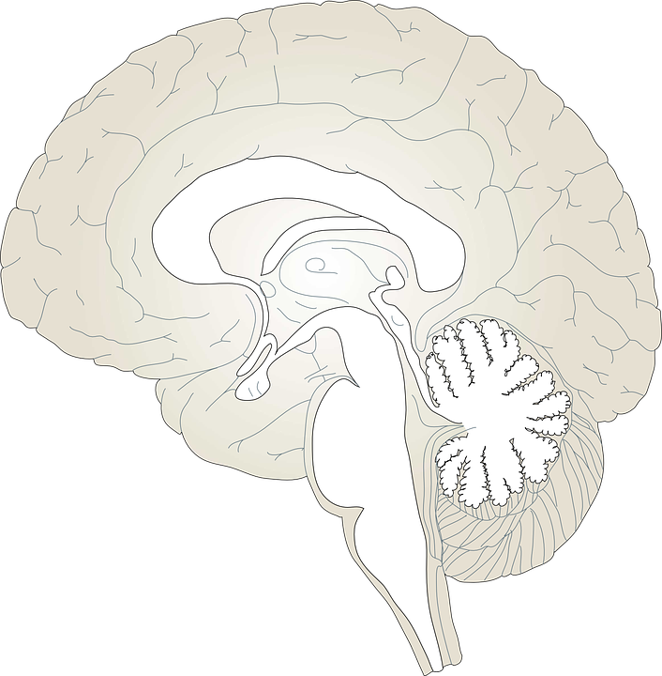
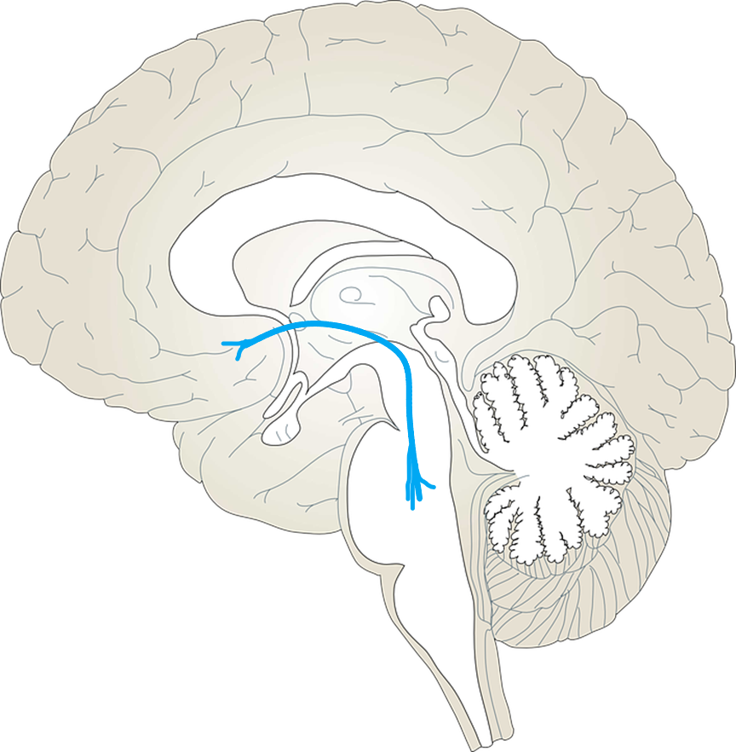
The Reward System/Mesolimbic pathway

Slide 9






What is your favourite food?

Slide 10

Drugs increase dopamine in the brain
Drugs
Dopamine
More dopamine!

Slide 11


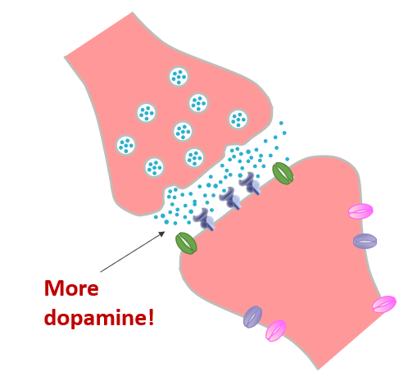
The Reward System/Mesolimbic pathway

Slide 12


Mouse Party Game
See what happens in the brains of different mice on drugs!
Notes:
https://learn.genetics.utah.edu/content/addiction/mouse/

Slide 13



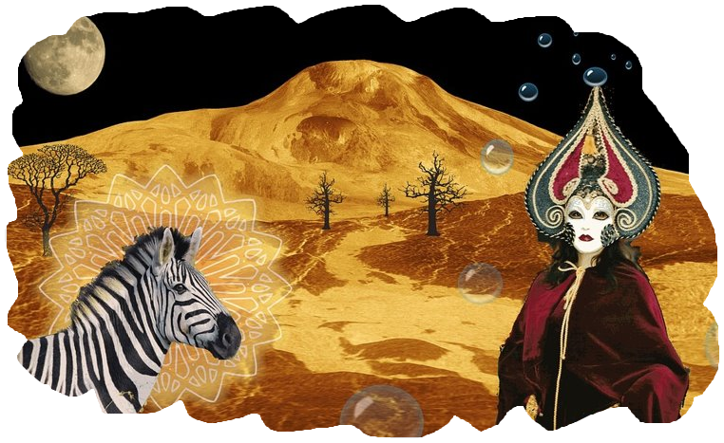



Different Types of drugs have different effects
Stimulants
e.g. cocaine
Opiates
e.g. morphine
Depressants
e.g. alcohol
Hallucinogens
e.g. LSD
Notes:
Some drugs can be in more than one category e.g. cannabis is a depressant, stimulant and hallucinogen, and heroin is both an opiate and a depressant
Mixing is really dangerous, for example if you drink alcohol and take some toher sedative drug at the same time- high risk of respiratory failure and this can be lethal
There are four main groups of drugs, divided according to their major effects, plus a few substances that do not easily fit into any category. The main categories are:
stimulants (e.g. cocaine)
depressants (e.g. alcohol)
opium-related painkillers (e.g. heroin)
hallucinogens (e.g. LSD)
From: https://www.mind.org.uk/information-support/types-of-mental-health-problems/drugs-recreational-drugs-alcohol/types-of-recreational-drug/

Slide 14
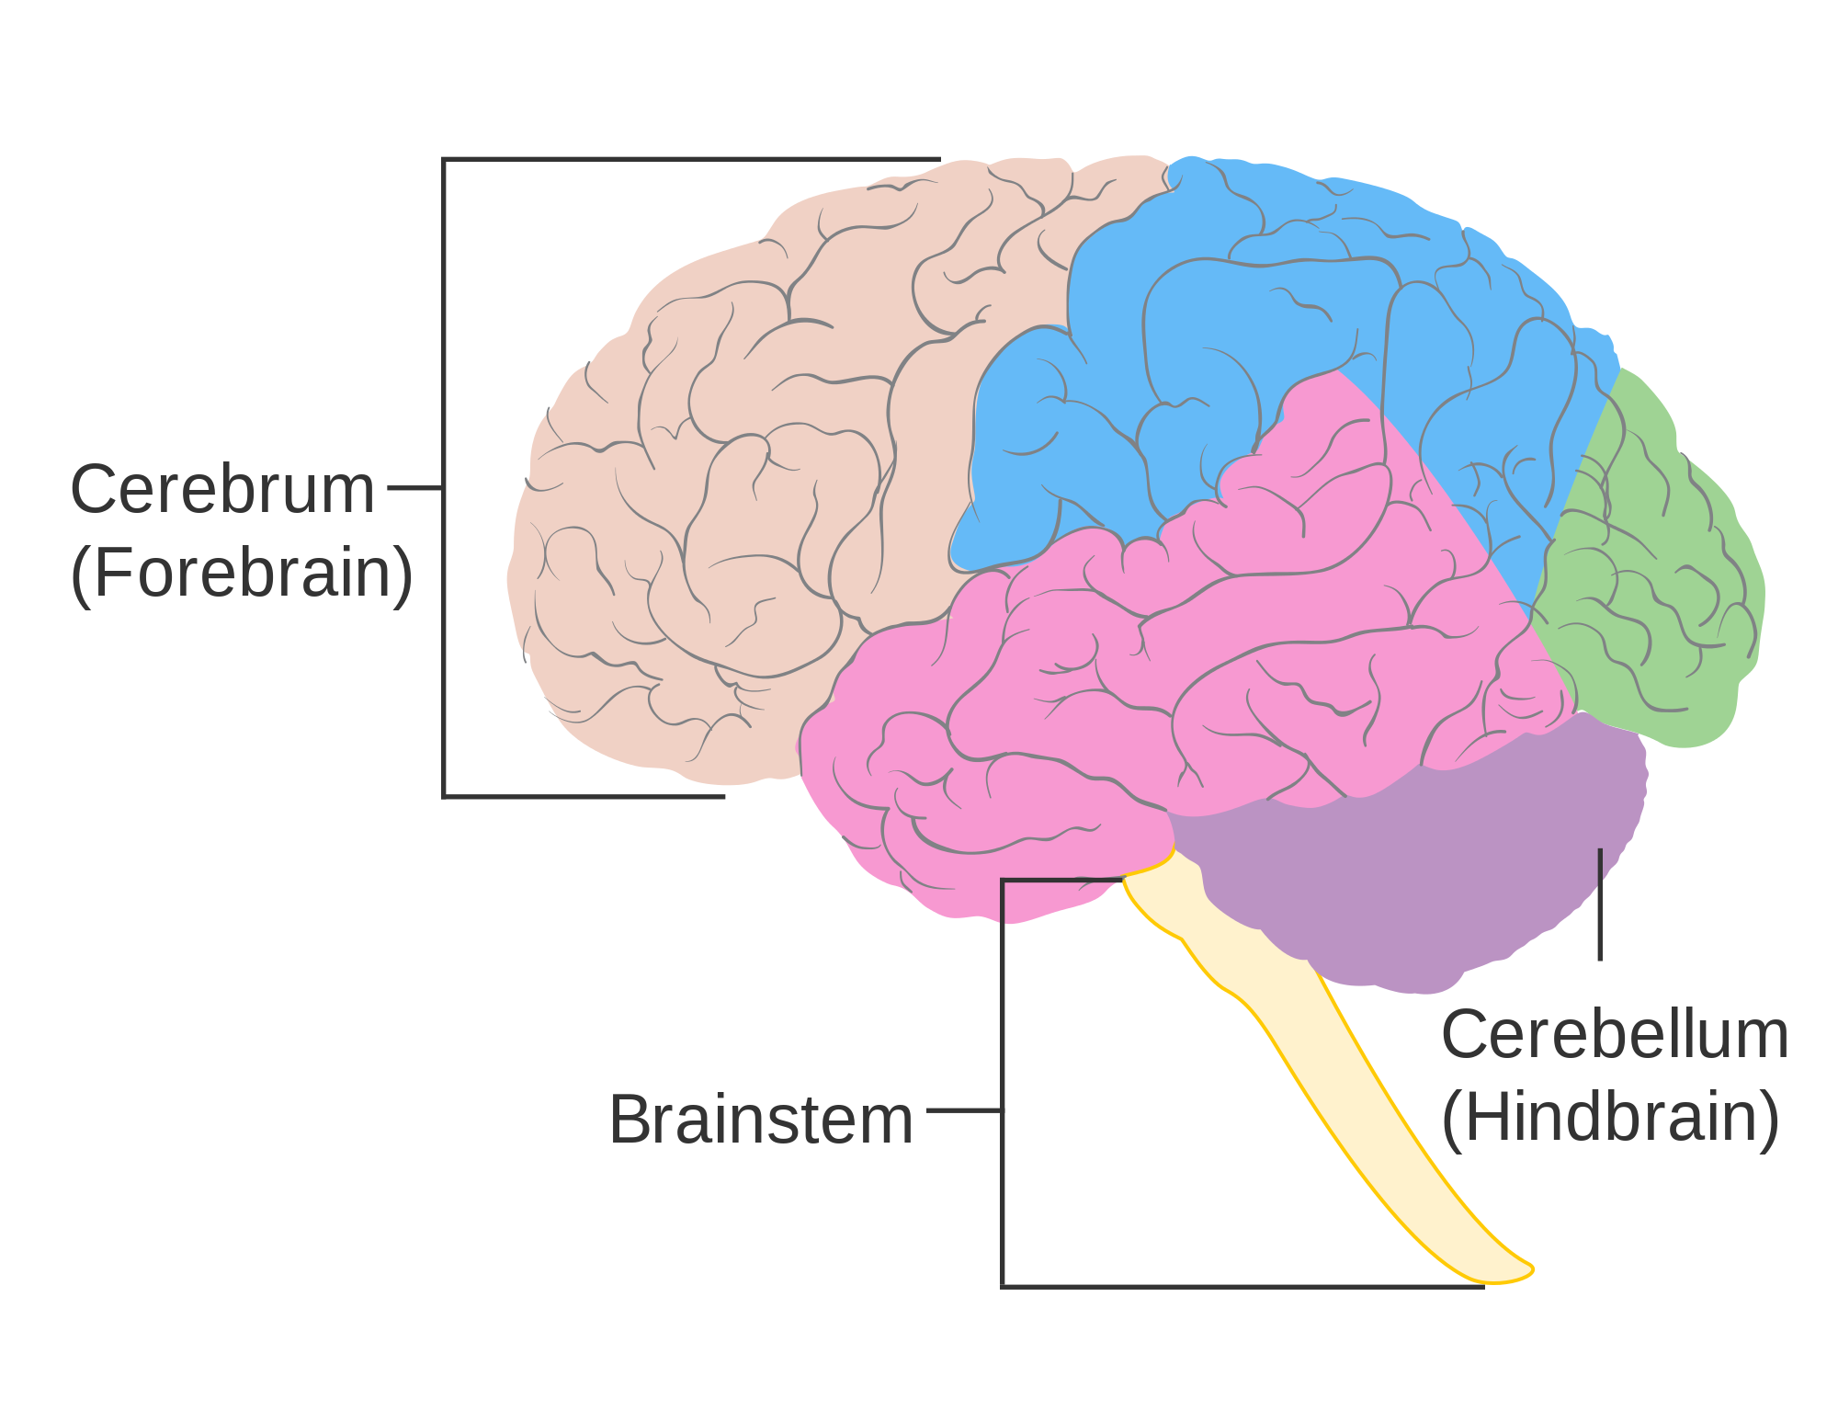
Alcohol
Movement
Sensations
Decision making
Vision
Memory and learning
Vital functions e.g. heart rate and breathing
Coordination
Notes:
Talk about alcohol short term effects and long term effects here

Slide 15

Cannabis
Movement
Sensations
Hallucinations
Decision making
Memory and learning
Appetite
Coordination
Notes:
Type of drug: stimulant, depressant and hallucinogen

Slide 16
Neuroscience:
understanding drug addiction

Slide 17
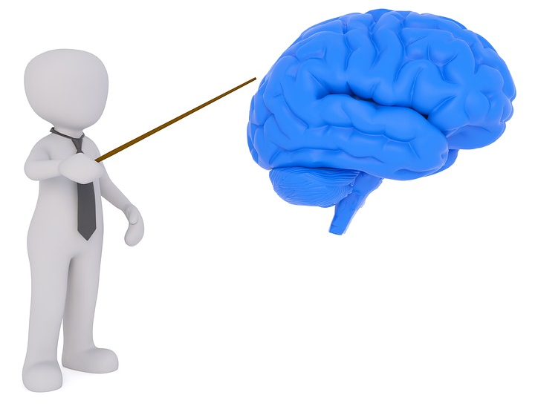
What is addiction?
‘Addiction is defined as not having control over doing, taking or using something to the point where it could be harmful to you’- NHS

Slide 18

How can drug addiction harm you?

Slide 19
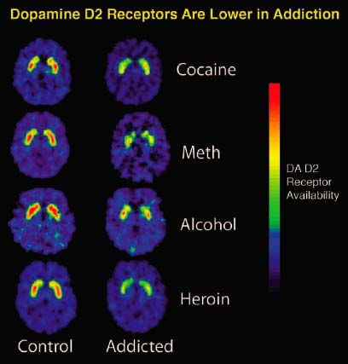
Addiction: brain changes! Neuroadaptation
Source: National Institute on Drug Abuse; National Institutes of Health; U.S. Department of Health and Human Services.
Notes:
The PET images show that repeated exposure to drugs depletes the brain's dopamine receptors, which are critical for one's ability to experience pleasure and reward.

Slide 20



Drugs can decrease the number of dopamine receptors in the brain
Drug abuse
Drug addiction
More dopamine!
Fewer receptors!

Slide 21
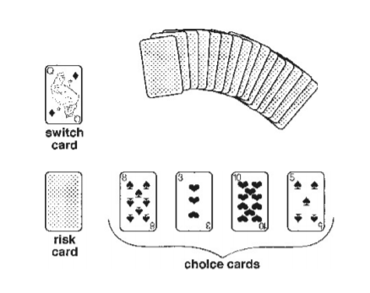
Card game
Instructions:
Pick a card from the small pile (switch card)
Pick a card from the larger pile and put it face down (risk card)
Pick up as many cards as you want from the larger pile (choice cards)

Slide 22
Card game
Jack: 15 points
Queen: 25 points
King: 35 points
Ace: 1 point
All other cards: number on card is the number of points
Add up the choice cards and the risk card, is the value higher than the switch card?

Slide 23
Card game
What do all the types of cards mean?
Choice cards: each represents an episode of drug abuse
Risk card: your individual risk of becoming addicted according to your genes and environment
Switch card: the point at which, if exceeded, drug abuse will result in drug addiction

Slide 24
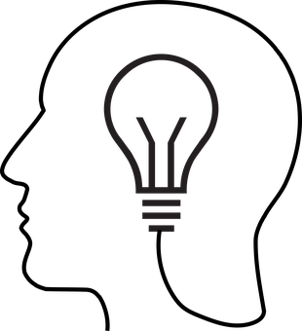
Treatments for drug addiction?

Slide 25
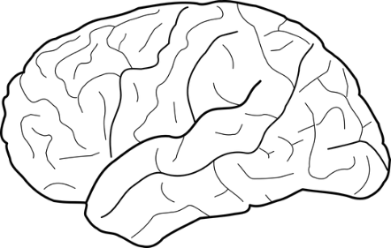
Take home messages:
There is an overlap between medicines and drugs of abuse
Drugs of abuse give you a feeling of pleasure through increasing the neurotransmitter dopamine in the reward pathway
Drug abuse can lead to drug addiction when more permanent changes in the brain have occurred and this is called neuroadaptation
We all have different genetic and environmental risk factors that we may not know about, which could make us more vulnerable to drug abuse and addiction
Neuroscience has provided us with all the knowledge we have today of brain function and drug abuse/addiction, and it is important to understand the brain in order to develop treatments!
Notes:
Briefly Introduce myself

