Slide 1
Annual General Meeting 2019

Slide 2
Agenda
Chair: Professor Stafford Lightman
Report from the President, Professor Stafford Lightman
Governance: Confirmation of elected Council and Committee members, and announcement of President-Elect 2019-2021
Strategy: Update on the BNA’s strategic plans
Journal: Brain and Neuroscience Advances
Report from the Treasurer, Professor Catherine Harmer
Annual accounts for the British Neuroscience Association Ltd and for BNA Events Ltd
Report from the Secretary, Dr Anne Cooke for Professor Zoe Kourtzi
Membership report
Meetings: 2017 Christmas Symposium
2017 Prize winners
Any other business

Slide 4
Year end accounts of BNA Charity
YE2017
YE2018

Slide 5
Year end accounts of BNA Events Ltd

Slide 6
Agenda
Chair: Professor Stafford Lightman
Report from the President, Professor Stafford Lightman
Governance: Confirmation of elected Council and Committee members, and announcement of President-Elect 2019-2021
Strategy: Update on the BNA’s strategic plans
Journal: Brain and Neuroscience Advances
Report from the Treasurer, Professor Catherine Harmer
Annual accounts for the British Neuroscience Association Ltd and for BNA Events Ltd
Report from the Secretary, Dr Anne Cooke for Professor Zoe Kourtzi
Membership report
Meetings: 2017 Christmas Symposium
2017 Prize winners
Any other business

Slide 7
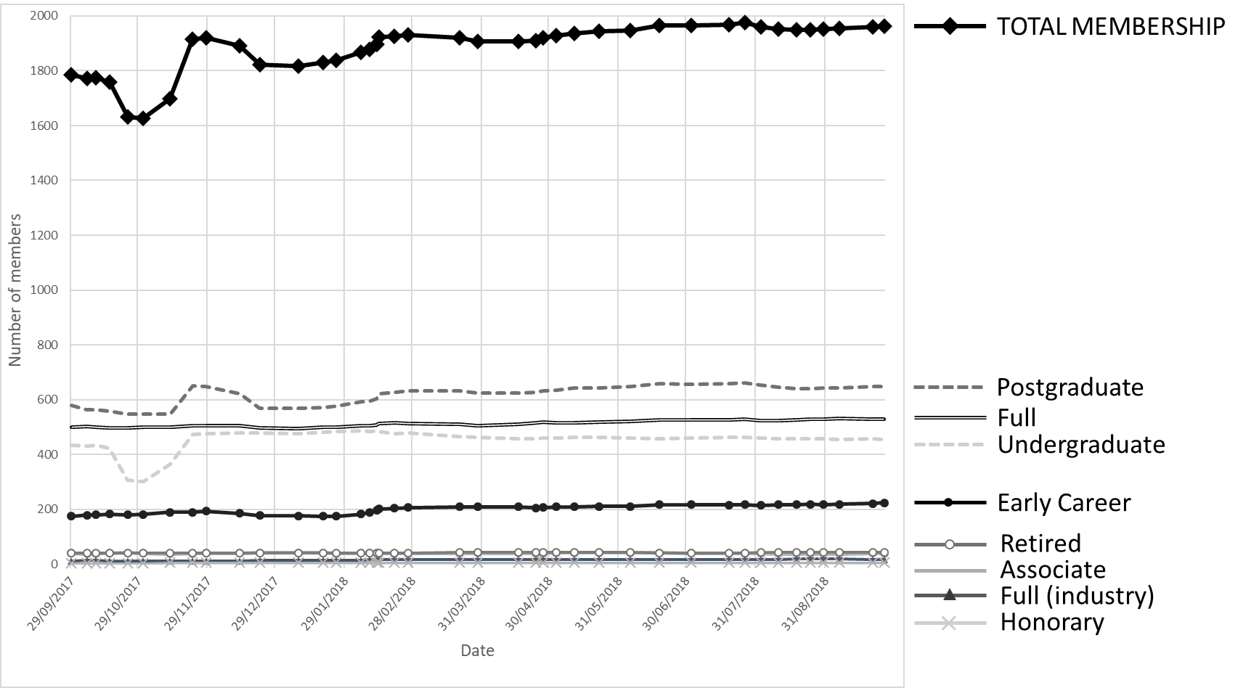
Membership report

Slide 8
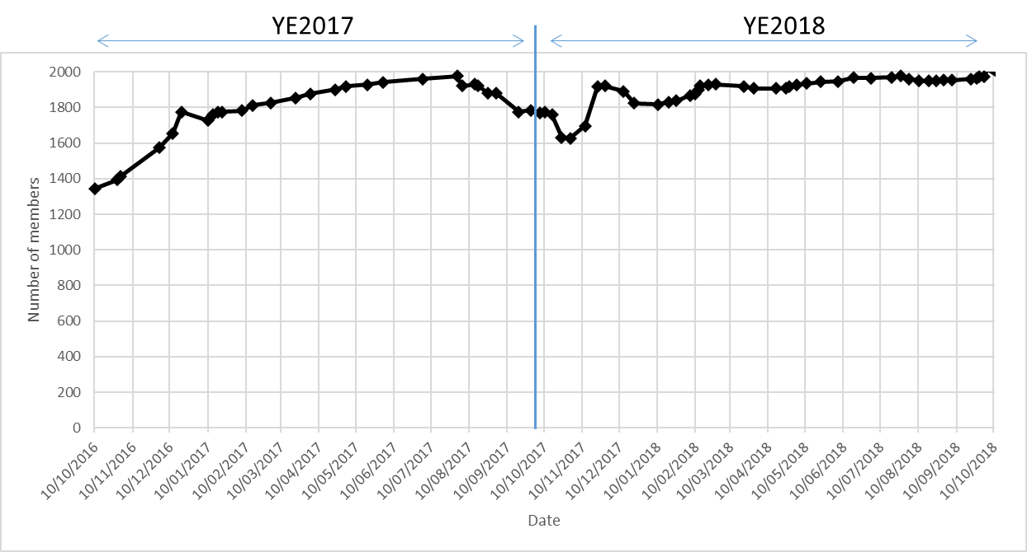
Membership report

Slide 9
Meetings and prizes
2017 Christmas symposium:
18 December 2017 in London’s Canary Wharf
‘Brain technologies: A brave new world?’.
2018 The Anne Silk Lecture
18 April 2018 at the Royal Society of Medicine, London
‘The Ageing Brain – A Population Perspective’ by Professor Carol Brayne CBE
BNA 2017 Prizes:
Honorary Memberships awarded to Steven Rose, Robert Balazs and John Lagnado
Michael Owen (Outstanding contribution to neuroscience)
Dervila Glynn (Public Engagement of neuroscience)
Gido van de Ven (Postgraduate Prize)
Irene Altura (Undergraduate Prize)
The Sieratzki UK-Israel Prize for Advances in Neuroscience
UK Young Researcher’s Prize - Dr Linda Katona
Israeli Young Researcher’s Prize - Dr Ella Striem-Amit
UK Early Career Researcher’s Prize - Dr Charlotte Stagg
Israeli Early Career Researcher’s Prize - Dr Nitzan Censor

