Slide 1
Wellcome Trust Neuroscience Funding
Neuroscience and Mental Health
John Isaac
j.isaac@wellcome.ac.uk
Raliza Stoyanova
r.stoyanova@wellcome.ac.uk
Daniel Lametti
d.lametti@wellcome.ac.uk

Slide 2





Five major challenges
Maximising the health benefits of genetics and genomics
2) Understanding the brain
3) Combating infectious diseases
4) Investigating development, ageing and chronic disease
5) Connecting environment, nutrition and health

Slide 3
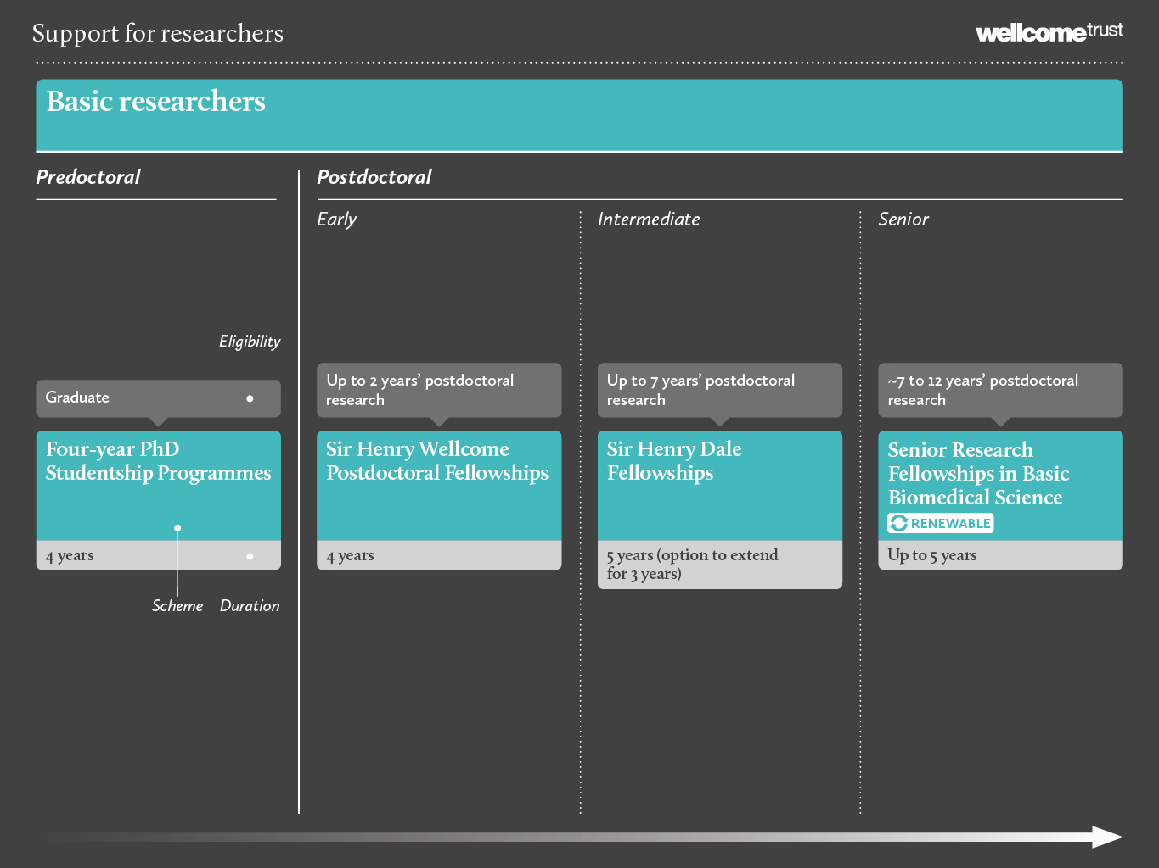

Slide 4

Assessment criteria
Person
The candidate’s track record.
The candidate’s vision of how the funding will contribute to their career development.
The candidate’s long-term aspirations.
Project
The importance of the research question.
The feasibility of the approach.
The appropriateness of the resources.
Place
The candidate’s choice of research sponsors.
The quality and suitability of the research environment.

Slide 5



Sir Henry Wellcome Postdoctoral Fellowships
For the best newly qualified post-doctoral researchers looking to start an independent research career
Encouraged to spend part of the award abroad
Flexible support of £250k over four years
Up to 35 awards per year
Applications considered twice a year: 15th May 2015 is next deadline for preliminary applications
Ben Newland, Cardiff University
Julija Krupic, University College London
Miriam Klein-Flugge, University of Oxford
Notes:
You must be in the final year of your PhD studies or have no more than one year of postdoctoral research experience from the date of your PhD viva to the full application submission deadline

Slide 6



Sir Henry Dale Fellowships
Jointly funded by the Royal Society and the Wellcome Trust.
Replaces the Research Career Development Fellowship scheme in the UK
For post-doctoral scientists to forge an independent research career
Up to 7 years postdoc
Five years support, potentially renewable for three further years
Fellow’s salary and research expenses, covering normally one post (postdoc or graduate RA or technician)
Applications considered twice a year. 17th April 2015 is next deadline for preliminary applications
Tiago Branco, MRC Laboratory of Molecular Biology
Nathalie Rochefort, University of Edinburgh
Charlotte Stagg, University of Oxford
Notes:
including research assistance (normally one post which may be a postdoc or graduate RA or technician; requests for additional research staff may be considered where fieldwork or clinical studies in a low- or middle-income country are proposed)

Slide 7
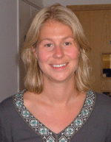

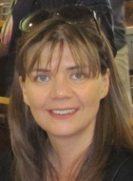

Senior Research Fellowships in Basic Biomedical Science
Normally 7-12 years postdoc
5 years support, potentially renewable in partnership with the host institution.
Full research costs supported
(salary, staff, equipment, consumables, field costs, animals etc.)
Applications considered three times a year. 8th May 2015 is next deadline for preliminary applications.

Slide 8
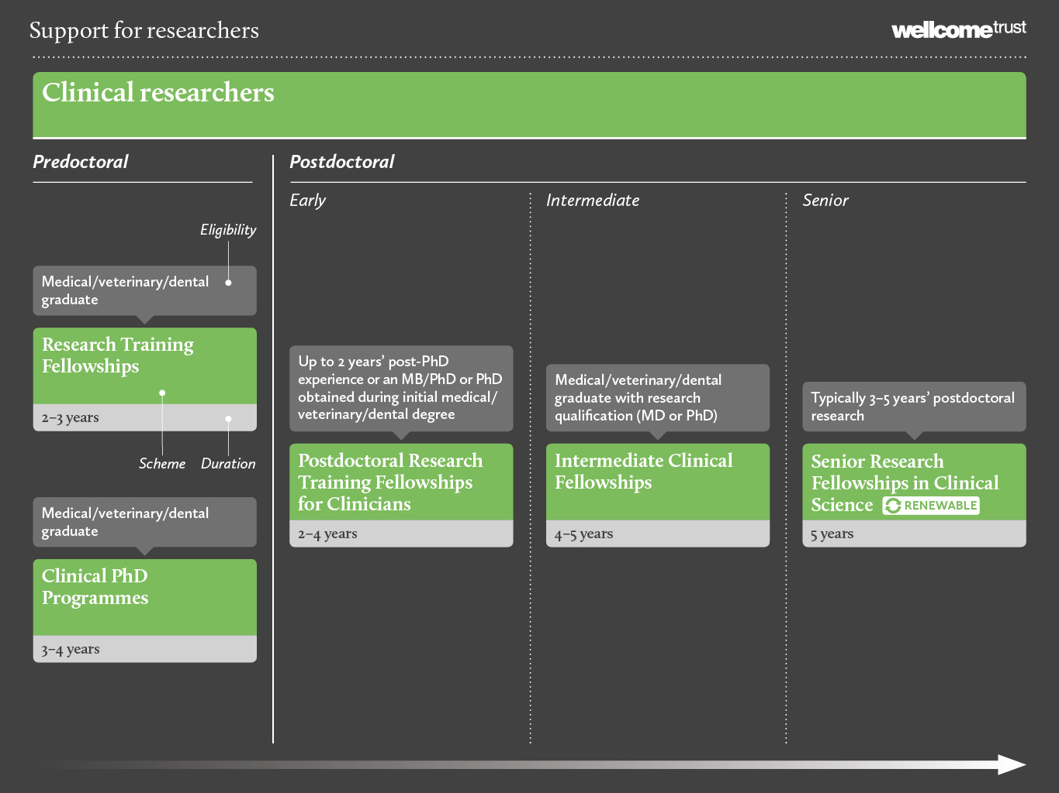

Slide 9
Wellcome Trust Clinical Fellowships
For outstanding clinical researchers to establish themselves as leading investigators in clinical academic medicine.
Considered three times a year. Next deadline: 8th May 2015 (prelim)
Senior Research Fellowships
Intermediate Clinical Fellowships
For clinicians to continue research at postdoctoral level and maintain a clinical career, with the aim to transition to independence
Considered twice a year. Next deadline: 18th May 2015 (prelim)
Postdoctoral Research Training Fellowships
For Clinicians
For candidates who either undertook a PhD early in their career, e.g. MB/PhD (to refresh their research skills), or those who have recently completed a PhD and wish to explore a new research field or environment
Considered three times a year. Next deadline: 18th May 2015 (prelim)
Research Training Fellowships
For medical, dental and veterinary graduates with little/no research experience, to pursue training in a research lab towards a PhD or MD.
Considered three times a year. Next deadline: August 2015 (full)
Notes:
All fellowships provide salary
RTF out of programme
ICF and Postdoc
Clinical work during the fellowship is restricted to eight hours or two programmed activities per week.

Slide 10
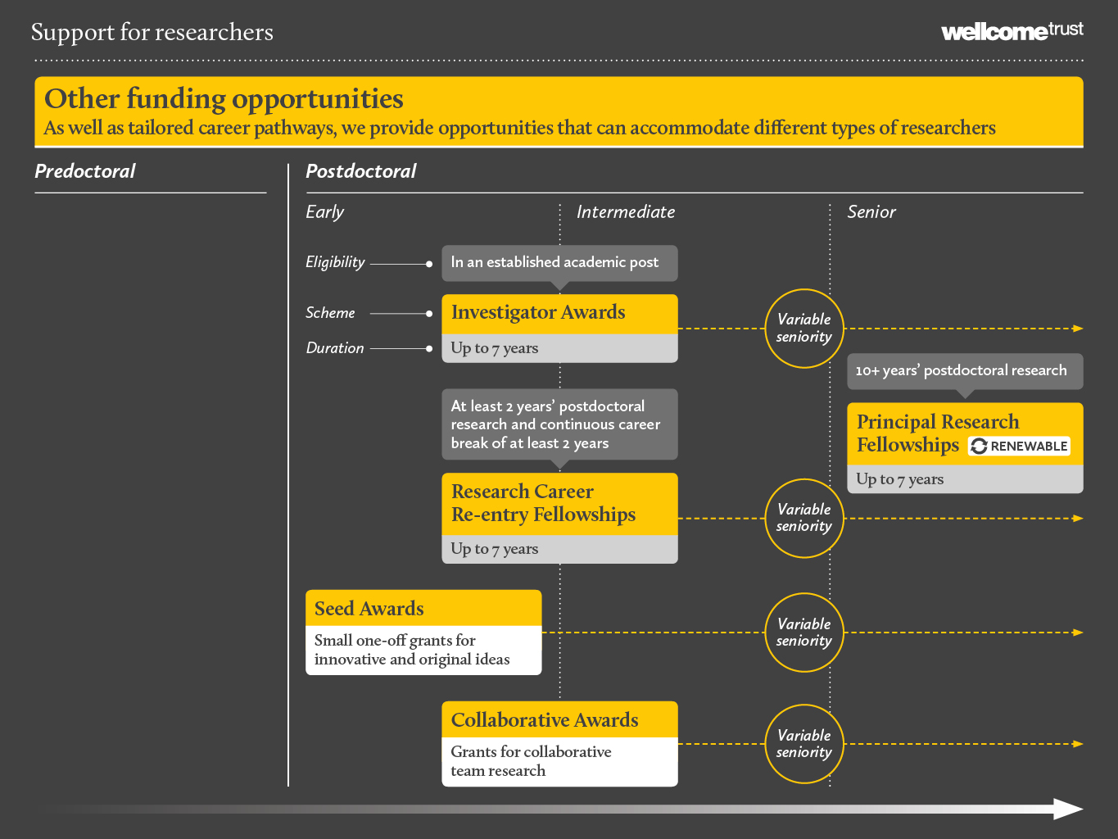

Slide 11

Investigator awards
For researchers who have established academic posts
Research question drives value and duration of award
Full research costs supported
(staff, equipment, consumables, field costs, animals etc.)
Up to 7 years funding
Applications considered three times a year. 17th July 2015 is next deadline for applications

Slide 12
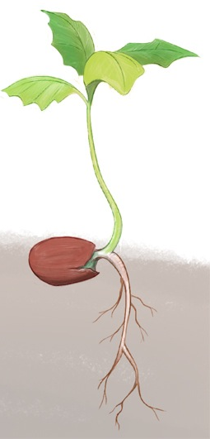
Seed Awards
Responsive, flexible funding, enabling researchers to develop a novel idea
To generate resources, tools and/or preliminary data leading to a larger research application
Up to £100,000 over 2 years
Not for researchers with a current personal award or other substantive funding
Only one award per lifetime
Considered 3 times per year. Next deadline: July 2015

Slide 13

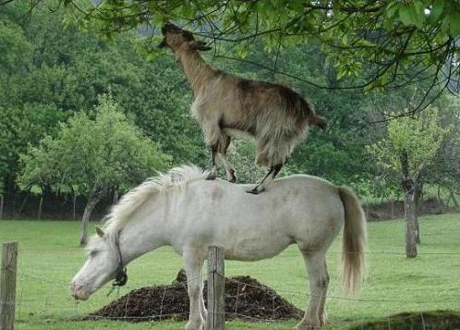
Collaborative Awards
Collaborative research projects trying to solve a problem that can only be achieved by teams working together
Up to £4 m over 5 years
Considered 3 times per year
First deadline date for preliminary applications: 20th May 2015
Awarded following interview

Slide 14
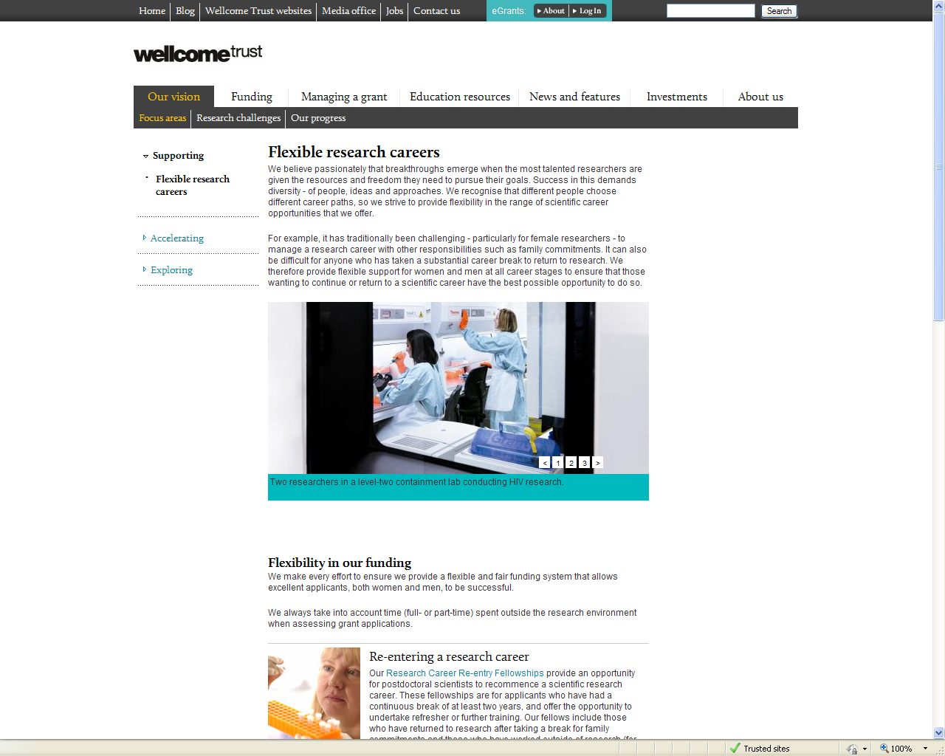
Flexible Research Careers
We always take into account time (full- or part-time) spent outside the research environment when assessing grant applications.

Slide 15

Maternity/paternity/adoption/sick leave and pay
We will cover the actual cost paid by the employing institution that is over and above any recoverable statutory pay
In the case of grant holders, the end date of their grant may also be extended for the period equivalent to the leave taken
We will also consider requests to cover additional direct research costs (such as research staff and expenses) to cover time taken off
Flexible working
Wellcome Trust funded researchers may change their working hours, following discussion and agreement with us and their employing institution.

Slide 16

Re-entering a research career
Research Career Re-entry Fellowships provide an opportunity for postdoctoral scientists to recommence a scientific research career.
These fellowships are for applicants who have had a continuous break of at least two years, and offer the opportunity to undertake refresher or further training.
Our fellows include those who have returned to research after taking a break for family commitments and those who have worked outside of research.
Up to 4 years support, with opportunity for updating research skills
Applications considered twice a year. 15th May 2015 is next preliminary application deadline

Slide 17
Review Process
Clinical Fellowships are reviewed by the Clinical interview committee
Dales, Fellowships, and Investigator awards are reviewed by appropriate Expert Review Group (ERG) and then the Interview Panel
Seeds are reviewed by ERGs
Collaborative Awards are reviewed by the Collaborative Awards Interview Committee
Note that in May a new grants management system is being launched with new on-line application forms. See website for further details

Slide 18
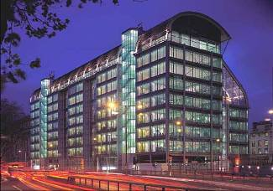
www.wellcome.ac.uk
Questions?

